Slide 1
Machine Learning – a Hands on Session
Raman Sankaran
Saneem Ahmed
Chandrahas Dewangan
Sachin Nagargoje

Slide 2
Disclaimer
Most of the images in this presentation are shamelessly downloaded from Google images

Slide 3
Why is this pic included here ?

Slide 5
Popular Applications of Machine Learning

Slide 6
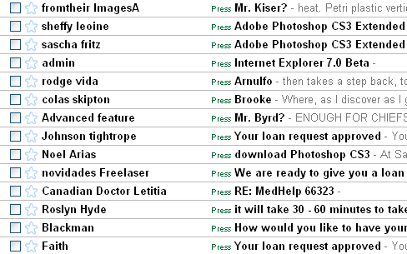
Spam Filtering

Slide 7
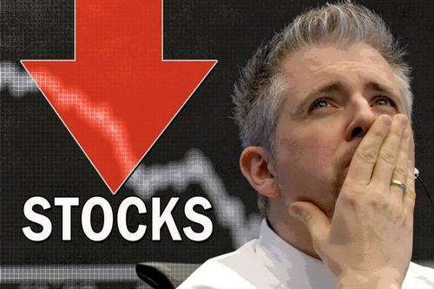
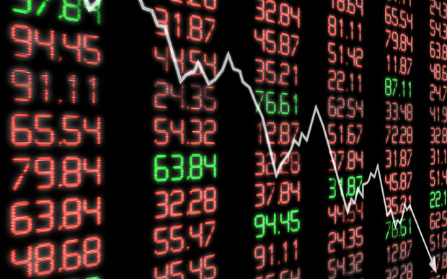

Slide 8
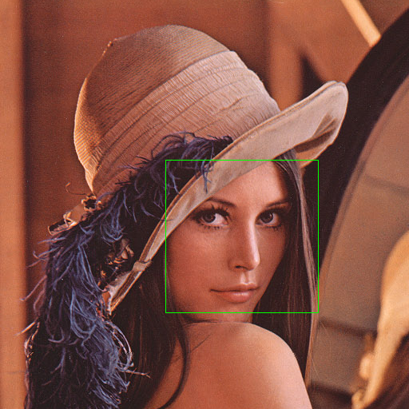
Face detection in Images / Video

Slide 9
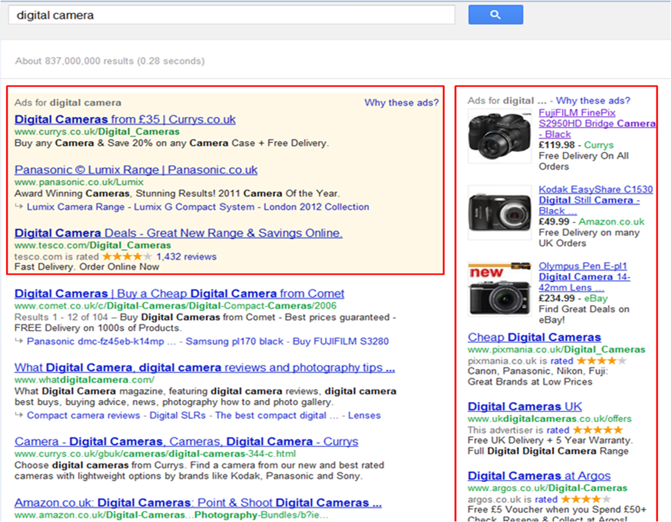
Targeted Advertisements

Slide 10
Why Machine Learning?

Slide 11
Why Machine Learning
Data size
Ability to develop algorithms which are independent of the data domain
Inability of humans to completely specify the rules for the tasks
How would you describe verbally to the computer about how a person looks like ?

Slide 12
What is Machine Learning?

Slide 13
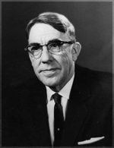
Machine Learning
“Field of study that gives computers the ability to learn without being explicitly programmed.”
- Arthur Samuel

Slide 14
How to train a model – a toy example

Slide 15
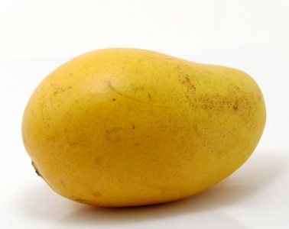
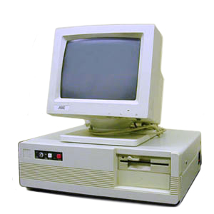
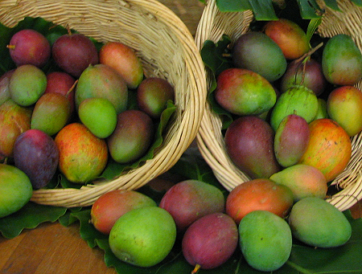
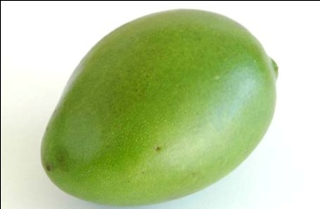
Raw Mango Vs. Ripen Mango
How do you input a mango to a computer?

Slide 16
Raw Mango Vs. Ripen Mango
Differentiate a raw mango from a ripen mango using their weights?

Slide 17
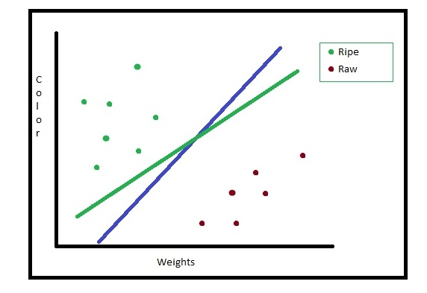
Raw Mango Vs. Ripen Mango

Slide 18
Feature Engineering
How would you encode a raw or a ripen mango to the computer ?
The idea is to represent them in an array of real number values.
Use a mathematical model to learn the separator using the real number values
Need a domain expert in designing efficient features.
Eg – Images (Signal Transformations), Genes (sequence analysis), Documents (regular expressions)

Slide 19
Classification Steps
Pick mangoes of both category to train
Identify the quantities that you want to measure
Identify a GOOD separator between the classes
Pick a new mango and find which side of the separator it falls under.

Slide 20
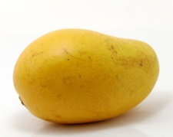
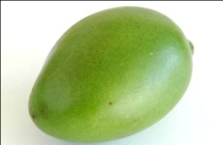
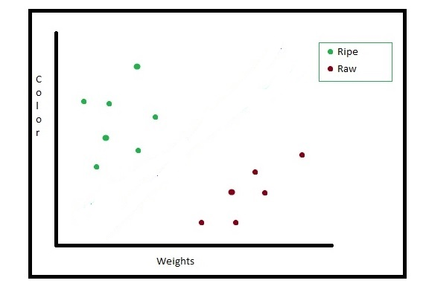
Training a classifier
Training Data
Training Labels
{y_i: I = 1,…,m}
Feature Extraction
Points in an n-dimensional space
{x_i: I = 1,… m}
Model Training
f(x_i; w)
Model (w)
The Machine is now Trained !!!

Slide 21
Testing the classifier
Unknown Data
Model (w)
(trained from the previous stage)
Feature Extraction
Points in an n-dimensional space
x_new
Evaluation
f(x_new; w)
Predicted label

Slide 22
Tips
Avoid overfitting the training data. Why ?
Generalize. Do not memorize.
Find a simple enough model which fits the data, discarding the outliers.
Optimize !!!

Slide 23
Types of Learning

Slide 24
Types of Learning
Supervised Learning
Classification – Given examples along with their corresponding classes as the label (spam filtering)
Regression – Given examples along with a Real valued label (Rain forcast)
Unsupervised Learning
Clustering – Examples are given without any labels. One has to find groups within the data
Reinforcement Learning
Learning through feedback (How to cycle !, Robot training itself to go through a Maze)

Slide 25
Examples revisited

Slide 26
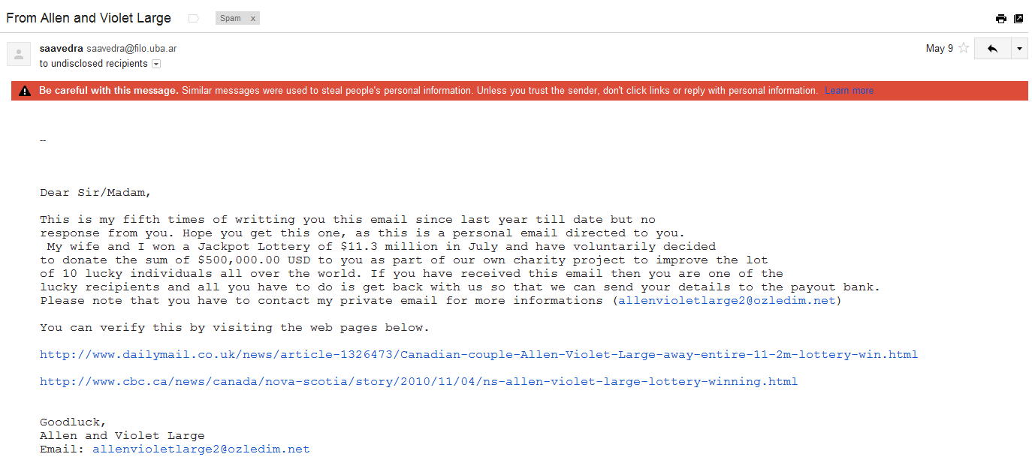
Spam Filter
Look for key words

Slide 27
Spam Filter
Dictionary Words
aardwolf | X
abacus | X
abandon | X
abbreviate | X
abdicate | X
.
.
dollar | √
.
.
jackpot | √
.
.
lottery | √
.
.
zygotic | X
zymurgy | X
0 0 0 0 . . . 1 . . 1 . . 1 . . 0 . . 0
Binary Features

Slide 28
Score Prediction
How much is Sachin expected to score against SA today ?
Current form
Past performance against this opposition
Past performance at this venue
His overall average
Is Steyn playing for SA ?

Slide 29
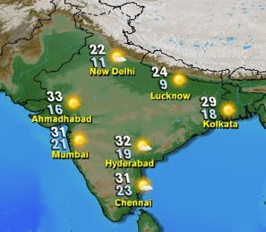
Regression: Example Weather Forecasting
Predict amount of rainfall
Features:
Temperature
Humidity
Pressure
Wind
Atmospheric Stability
Seeding Potential
…..

Slide 30
Documents Clustering
Given the set of documents, group them according to categories like Sports, Politics, etc.
No explicit label provided

Slide 31
Music Genre Identification
Categorize songs into classical, electric, jazz, pop, and rock.
Features obtained through signal processing filters/transforms.
Classical
Electric
Jazz
Pop
Rock
Notes:
http://www.css-design.com/digital-signal-processing.html

Slide 32
Exercise Can you guess the Type of Learning in the given Applications?

Slide 33
Guess the Type of Learning?
Given a bank customer’s profile, should I sanction him a loan?
Supervised Learning
Given an audio track, separate the singer’s voice from the background music.
Unsupervised Learning
Automatically group your personal collection of photographs in Picasa into categories.
Unsupervised Learning
Given a patient’s X-ray image, diagnose if he has cancer.
Supervised Learning

Slide 34
Regression
Given input features – Predict a real number value
Linear regression : y = f(x) = a*x + b
Find a, b such that, at least for the training examples f(x) = y
Is it possible always ? Can we relax this ?
Minimize the error in the training set (f(x) – y) ^2
Board workout

Slide 35
Regression
Closed form for computing the least squares solution
Iterative method – using the gradients to compute the same solution

Slide 36
Hands on Session Regression

Slide 37
Classification
Given input features – Predict the output class
Binary classification (-1 or 1)
Typically, the classifier has the form
Y = sign(f(x)) = sign(a*x + b)
Perceptron

Slide 38
Perceptron
Assume a model f(x) = sign(w x)
Training Inputs – {x_i, y_i, i = 1 … m }, alpha
Parameter to be using training – w
Repeat the steps (until w is converged, or a fixed number of iterations)
Step 0. Initialize w randonly
For each example x_i
If (sign (w x_i) == y_i) continue;
Else w = w + alpha *y_i*( x_i)

Slide 39
Nearest Neighbour
A non-parametric classifier
Training Inputs – {x_i, y_i, i = 1 … m }, k
For each new data point x_test
Find the distance(x_test, x_i) for all i.
Pick the k - nearest input data
Predict the label of x_test to be the label which is most occurring among the k-nearest neighbours

Slide 40
Classification Criteria
How good is the model
Number of training points which are correctly classified
What if the training data is very skewed ?
What if the training data has some outliers

Slide 41
Hands on Session Classification

Slide 42
Questions?

