Slide 1
Concepts of Computer Networking -- Internet
Dr. Debabrata Das
IIIT-Bangalore
24th June 2013

Slide 2
Overview
Introduction
Why Layering Structure to Study a System?
Application Layer
Transport Layer
Network Layer
Data Link Layer
Physical Layer
Research Areas
Conclusion

Slide 3
Introduction

Slide 4
Why Networking and Communication is Important → Touches all aspects of day to day of life!

Slide 5
What is A Network and Computer Networking?
A Network: system for connecting computer using a single transmission technology
Computer Networking: Study to know Principles of Operation of a Network & Inter Connecting different different Networks

Slide 6
Network Classification
According to Size – LAN/Access, MAN, WAN
Types Services – Voice (Telecom) or Data (Data Network- Internet)!
According to Physical Medium – Wireless, Wired Network
Future Trend seems to be all as ONE network, i.e., Data-Network. As there will be no discrimination between bits of voice, video & computational data.

Slide 7
Protocol and Why Layered Structure?

Slide 8
What & Why Protocol?
All communication activity in Internet governed by protocols
A network protocol or computer communication protocol is a set of rules that specify the format and meaning of messages exchanged between computers across a network
  Format is sometimes called syntax
  Meaning is sometimes called semantics
Protocols are implemented by protocol software

Slide 9


What’s a protocol?
a human protocol and a computer network protocol:
Hi
TCP connection
req.
Hi
TCP connection
reply.
Got the
time?
Get http://gaia.cs.umass.edu/index.htm
2:00
<file>
time

Slide 10
Protocol “Layers”
Networks are complex!
many “pieces”:
  hosts
  routers
  links of various media
  applications
  Rules for communications
  hardware, software
Question:
Is there any hope of organizing structure of network?
Or at least our discussion of networks?

Slide 11
How Many Protocols?
Computer communication across a network is a very hard problem
Complexity requires multiple protocols, each of which manages a part of the problem
May be simple or complex; must all work together

Slide 12
Organization of air travel
ticket (purchase)
baggage (check)
gates (load)
runway takeoff
airplane routing
ticket (complain)
baggage (claim)
gates (unload)
runway landing
airplane routing
airplane routing
a series of steps

Slide 13
Organization of air travel: a different view
ticket (purchase)
baggage (check)
gates (load)
runway takeoff
airplane routing
ticket (complain)
baggage (claim)
gates (unload)
runway landing
airplane routing
airplane routing
Layers: each layer implements a service
  via its own internal-layer actions
  relying on services provided by layer below

Slide 14
Distributed implementation of layer functionality
ticket (purchase)
baggage (check)
gates (load)
runway takeoff
airplane routing
ticket (complain)
baggage (claim)
gates (unload)
runway landing
airplane routing
Departing airport
arriving airport
intermediate air traffic sites
airplane routing
airplane routing
airplane routing

Slide 15
Why layering?
Dealing with complex systems:
Layering model is a solution to the problem of complexity in network protocols
Model suggests dividing the network protocol into layers, each of which solves part of the network communication problem
These layers have several constraints, which ease the design problem
Network protocol designed to have a protocol or protocols for each layer

Slide 16
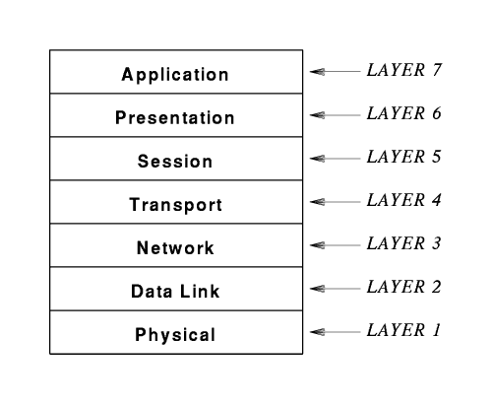
ISO’s 7-Layer Model (OSI)

Slide 17
Functions of Layers in OSI
Many modern protocols do not exactly fit the ISO model, and the ISO protocol architecture is mostly of historic interest
Concepts are still largely useful and terminology persists
Layer 7: Application
  Application-specific protocols such as HTTP, SMTP, FTP and SMTP (electronic mail)
Layer 6: Presentation
  Common formats for representation of data
Layer 5: Session
  Management of sessions such as login to a remote computer
Layer 4: Transport
  Reliable or Unreliable delivery, Multiplexing and Demultiplexing, Congestion and Flow Control of data between computers
Layer 3: Network
  Address assignment, routing, forwarding and data delivery across a network
Layer 2: Data Link
  Format of data in frames and Medium access, delivery of frames through network interface
Layer 1: Physical
  Basic network hardware – to transmit bits

Slide 18
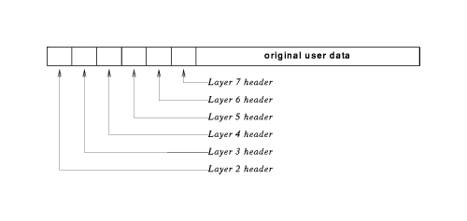
Protocol Header
The software at each layer communicates with the corresponding layer through information stored in headers
Each layer adds its header to the front of the message from the next higher layer
Headers are nested at the front of the message as the message traverses the network

Slide 19
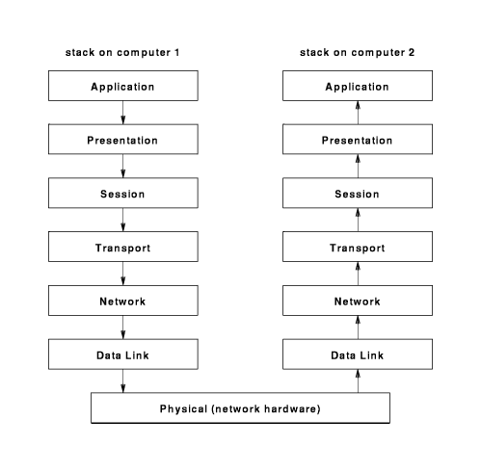
ISO-OSI Layered Architecture

Slide 20
Internet protocol stack (IETF Standard)
application: supporting network applications (OSI’s --Application+Presentation+ Session)
  ftp, smtp, http
transport: host-host data transfer
  tcp, udp
network: routing of datagrams from source to destination
  ip, routing protocols
link: data transfer between neighboring network elements
  ppp, ethernet
physical: bits “on the wire”
application
transport
network
link
physical

Slide 21
Protocol layering and data
Each layer takes data from above
adds header information to create new data unit
passes new data unit to layer below
source
destination
M
application
transport
network
link
physical
application
transport
network
link
physical
M
message
H
M
H
t
M
segment
t
H
H
H
H
M
datagram
n
t
M
n
t
H
H
H
H
H
H
M
frame
l
n
t
M
l
n
t

Slide 22
Encapsulating Data
Application
Presentation
Upper Layer Data
Session
Segment
Transport
TCP Header
Upper Layer Data
Network
Packet
IP Header
Data
LLC Header
Data
FCS
Data Link
Frame
MAC Header
Data
FCS
Physical
Bits
0101110101001000010

Slide 23
De-encapsulating Data
Application
Presentation
Session
Upper Layer Data
Transport
Upper Layer Data
TCP Header
Network
TCP+ Upper Layer Data
IP Header
IP + TCP + Upper Layer Data
Data Link
LLC Header
LLC Hdr + IP + TCP + Upper Layer Data
MAC Header
Physical
0101110101001000010

Slide 24
Application Layer Protocols

Slide 25
Areas Addressed
Our goals:
conceptual, implementation aspects of network application protocols
  client-server paradigm
  service models
learn about protocols by examining popular application-level protocols
More chapter goals
specific protocols:
  http
  ftp
  smtp
  pop
  dns
programming network applications
  socket API

Slide 26
Network applications: some definitions
Process: program running within a host.
within same host, two processes communicate using interprocess communication (defined by OS).
processes running in different hosts communicate with an application-layer protocol
user agent: software process, interfacing with user “above” and network “below”.
  implements application-level protocol
  Web: browser
  E-mail: mail reader
  streaming audio/video: media player

Slide 27
Client-server paradigm
Typical network app has two pieces: client and server
Client:
initiates contact with server (“speaks first”)
typically requests service from server,
Web: client implemented in browser; e-mail: in mail reader
application
transport
network
data link
physical
request
reply
application
transport
network
data link
physical
Server:
provides requested service to client
e.g., Web server sends requested Web page, mail server delivers e-mail

Slide 28
Application-layer protocols (cont).
API: application programming interface
defines interface between application and transport layers
socket: Internet API
  two processes communicate by sending data into socket, reading data out of socket
Q: how does a process “identify” the other process with which it wants to communicate?
  IP address of host running other process
  “port number” - allows receiving host to determine to which local process the message should be delivered

Slide 29
The Web: the http protocol
http: hypertext transfer protocol
Web’s application layer protocol
client/server model
  client: browser that requests, receives, “displays” Web objects
  server: Web server sends objects in response to requests
http1.0: RFC 1945
http1.1: RFC 2068
http request
PC running
Explorer
http response
http request
Server
running
NCSA Web
server
http response
Mac running
Navigator

Slide 30
The http protocol: more
http: TCP transport service:
client initiates TCP connection (creates socket) to server, port 80
server accepts TCP connection from client
http messages (application-layer protocol messages) exchanged between browser (http client) and Web server (http server)
TCP connection closed
http is “stateless”
server maintains no information about past client requests
aside
Protocols that maintain “state” are complex!
past history (state) must be maintained
if server/client crashes, their views of “state” may be inconsistent, must be reconciled

Slide 31
http example
Suppose user enters URL www.someSchool.edu/someDepartment/home.index
1a. http client initiates TCP connection to http server (process) at www.someSchool.edu. Port 80 is default for http server.
1b. http server at host www.someSchool.edu waiting for TCP connection at port 80. “accepts” connection, notifying client
2. http client sends http request message (containing URL) into TCP connection socket
3. http server receives request message, forms response message containing requested object (someDepartment/home.index), sends message into socket
time

Slide 32
http example (cont.)
4. http server closes TCP connection.
5. http client receives response message containing html file, displays html. Parsing html file, finds 10 referenced jpeg objects
time
6. Steps 1-5 repeated for each of 10 jpeg objects

Slide 33
Non-persistent, persistent connections
Non-persistent
http/1.0: server parses request, responds, closes TCP connection
2 RTTs to fetch object
  TCP connection
  object request/transfer
each transfer suffers from TCP’s initially slow sending rate
many browsers open multiple parallel connections
Persistent
default for http/1.1
Without Pipelining: on same TCP connection, client sends next request after the previous request’s object successfully received
With Pipelining: client sends requests for all referenced objects in one go after the tcp connection is established (i.e., handshaking is done)
fewer RTTs, less slow start.

Slide 34
Web Caches (proxy server)
Goal: satisfy client request without involving origin server
user sets browser: Web accesses via web cache
client sends all http requests to web cache
  object in web cache: web cache returns object
  else web cache requests object from origin server, then returns object to client
origin
server
Proxy
server
http request
http request
client
http response
http response
http request
http response
client
origin
server

Slide 35
Why Web Caching?
origin
servers
Assume: cache is “close” to client (e.g., in same network)
smaller response time: cache “closer” to client
decrease traffic to distant servers
  link out of institutional/local ISP network often bottleneck
public
Internet
1.5 Mbps
access link
institutional
network
10 Mbps LAN
institutional
cache

Slide 36
DNS: Domain Name System
People: many identifiers:
  SSN, name, passport #
Internet hosts, routers:
  IP address (32 bit) - used for addressing datagrams
  “name”, e.g., iiitb.ac.in - used by humans
Q: map between IP addresses and name ?
Domain Name System:
distributed database implemented in hierarchy of many name servers
application-layer protocol host, routers, name servers to communicate to resolve names (address/name translation)
  note: core Internet function, implemented as application-layer protocol
  complexity at network’s “edge”

Slide 37
Simple DNS example
root name server
host surf.eurecom.fr wants IP address of gaia.cs.umass.edu
1. contacts its local DNS server, dns.eurecom.fr
2. dns.eurecom.fr contacts root name server, if necessary
3. root name server contacts authoritative name server, dns.umass.edu, if necessary
2
4
5
3
local name server
dns.eurecom.fr
authorititive name server
dns.umass.edu
1
6
requesting host
surf.eurecom.fr
gaia.cs.umass.edu

Slide 38
Socket programming
Goal: learn how to build client/server application that communicate using sockets
Socket API
introduced in BSD4.1 UNIX, 1981
explicitly created, used, released by apps
client/server paradigm
two types of transport service via socket API:
  unreliable datagram
  reliable, byte stream-oriented
socket
a host-local, application-created/owned,
OS-controlled interface (a “door”) into which
application process can both send and
receive messages to/from another (remote or
local) application process

Slide 39
Socket-programming using TCP
Socket: a door between application process and end-end-transport protocol (UDP or TCP)
TCP service: reliable transfer of bytes from one process to another
controlled by
application
developer
controlled by
application
developer
process
process
socket
socket
TCP with
buffers,
variables
TCP with
buffers,
variables
controlled by
operating
system
controlled by
operating
system
internet
host or
server
host or
server

Slide 40
Socket programming with TCP
Client must contact server
server process must first be running
server must have created socket (door) that welcomes client’s contact
Client contacts server by:
creating client-local TCP socket
specifying IP address, port number of server process
When client creates socket: client TCP establishes connection to server TCP
When contacted by client, server TCP creates new socket for server process to communicate with client
  allows server to talk with multiple clients
application viewpoint
TCP provides reliable, in-order
transfer of bytes (“pipe”)
between client and server

Slide 41
Client/server socket interaction: TCP
Server (running on hostid)
Client
create socket,
port=x, for
incoming request:
welcomeSocket =
ServerSocket()
TCP
connection setup
create socket,
connect to hostid, port=x
wait for incoming
connection request
connectionSocket =
welcomeSocket.accept()
clientSocket =
Socket()
send request using
clientSocket
read request from
connectionSocket
write reply to
connectionSocket
read reply from
clientSocket
close
connectionSocket
close
clientSocket

Slide 42
Transport Layer

Slide 43
Transport Layer: Goals & Overview
Overview:
transport layer services
multiplexing/demultiplexing
connectionless transport: UDP
principles of reliable data transfer
connection-oriented transport: TCP
  reliable transfer
  flow control
  connection management
principles of congestion control
TCP congestion control
Our goals:
understand principles behind transport layer services:
  multiplexing/demultiplexing
  reliable data transfer
  flow control
  congestion control
instantiation and implementation in the Internet

Slide 44
Transport services and protocols
provide logical communication between app’ processes running on different hosts
transport protocols run in end systems
transport vs network layer services:
network layer: data transfer between end systems
transport layer: data transfer between processes
  relies on, enhances, network layer services
application
transport
network
data link
physical
network
data link
physical
network
data link
physical
network
data link
physical
logical end-end transport
network
data link
physical
network
data link
physical
application
transport
network
data link
physical

Slide 45
Multiplexing/demultiplexing
Recall: segment - unit of data exchanged between transport layer entities
  aka TPDU: transport protocol data unit
Demultiplexing: delivering
received segments to
correct app layer processes
receiver
P3
P4
application-layer
data
M
M
application
transport
network
segment
header
P1
P2
M
M
application
transport
network
application
transport
network
segment
H
t
M
H
segment
n

Slide 46
Multiplexing/demultiplexing: examples
source port: x
dest. port: 23
Web client
host C
host A
server B
source port:23
dest. port: x
Source IP: C
Dest IP: B
source port: y
dest. port: 80
Source IP: C
Dest IP: B
source port: x
dest. port: 80
port use: simple telnet app
Source IP: A
Dest IP: B
source port: x
dest. port: 80
Web
server B
Web client
host A
port use: Web server

Slide 47
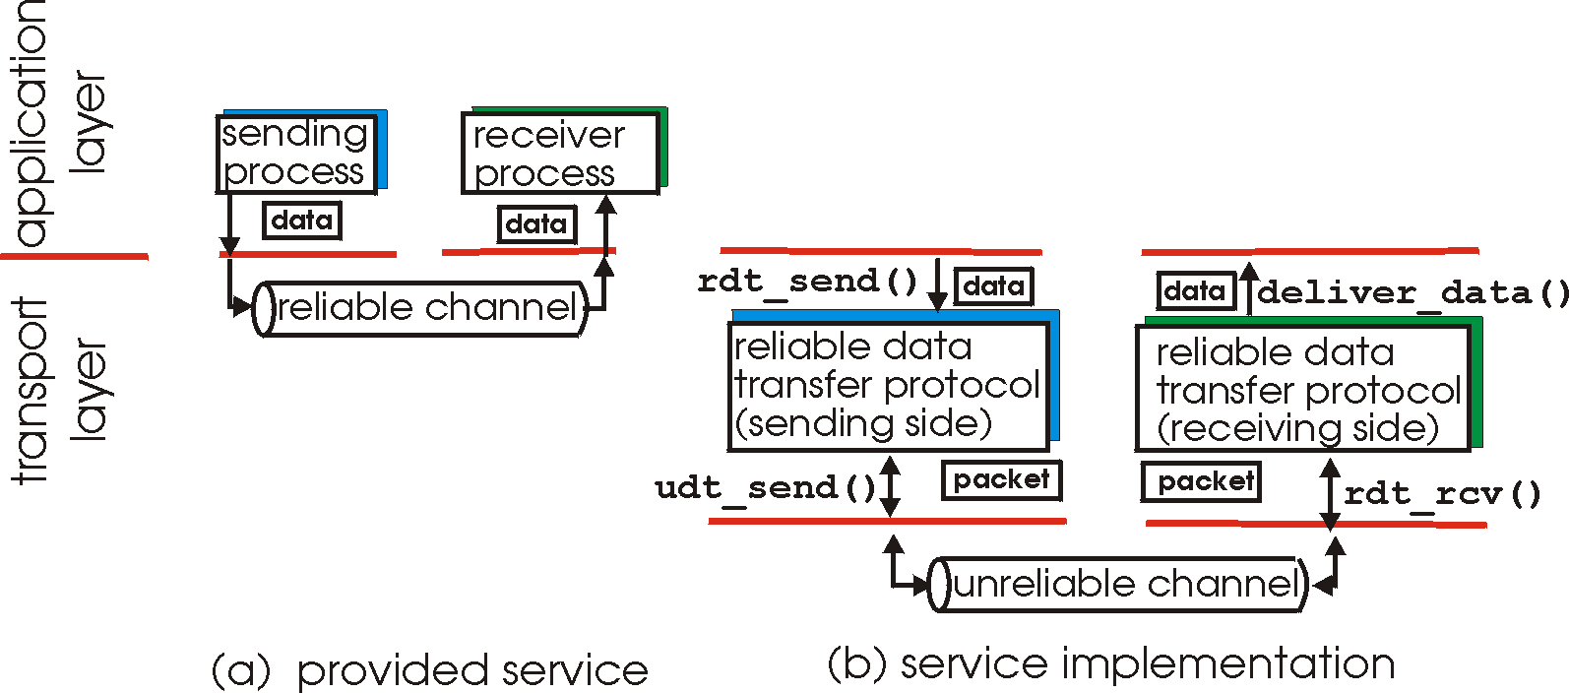
Principles of Reliable data transfer
important in app., transport, link layers
It is one of the important networking topics!
characteristics of unreliable channel will determine complexity of reliable data transfer protocol (rdt)

Slide 48
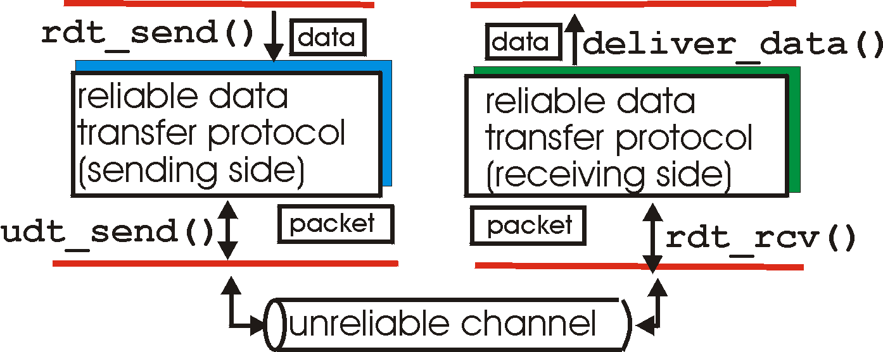
Reliable data transfer: getting started
rdt_send(): called from above, (e.g., by app.). Passed data to
deliver to receiver upper layer
deliver_data(): called by rdt to deliver data to upper
send
side
receive
side
udt_send(): called by rdt,
to transfer packet over
unreliable channel to receiver
rdt_rcv(): called when packet arrives on rcv-side of channel

Slide 49
rdt2.0: operation with no errors
rdt_send(data)
snkpkt = make_pkt(data, checksum)
udt_send(sndpkt)
rdt_rcv(rcvpkt) &&
isNAK(rcvpkt)
Wait for call from above
Wait for ACK or NAK
rdt_rcv(rcvpkt) &&
corrupt(rcvpkt)
udt_send(sndpkt)
udt_send(NAK)
rdt_rcv(rcvpkt) && isACK(rcvpkt)
Wait for call from below
Λ
rdt_rcv(rcvpkt) &&
notcorrupt(rcvpkt)
extract(rcvpkt,data)
deliver_data(data)
udt_send(ACK)

Slide 50
rdt2.0: error scenario
rdt_send(data)
snkpkt = make_pkt(data, checksum)
udt_send(sndpkt)
rdt_rcv(rcvpkt) &&
isNAK(rcvpkt)
Wait for call from above
Wait for ACK or NAK
rdt_rcv(rcvpkt) &&
corrupt(rcvpkt)
udt_send(sndpkt)
udt_send(NAK)
rdt_rcv(rcvpkt) && isACK(rcvpkt)
Wait for call from below
Λ
rdt_rcv(rcvpkt) &&
notcorrupt(rcvpkt)
extract(rcvpkt,data)
deliver_data(data)
udt_send(ACK)

Slide 51
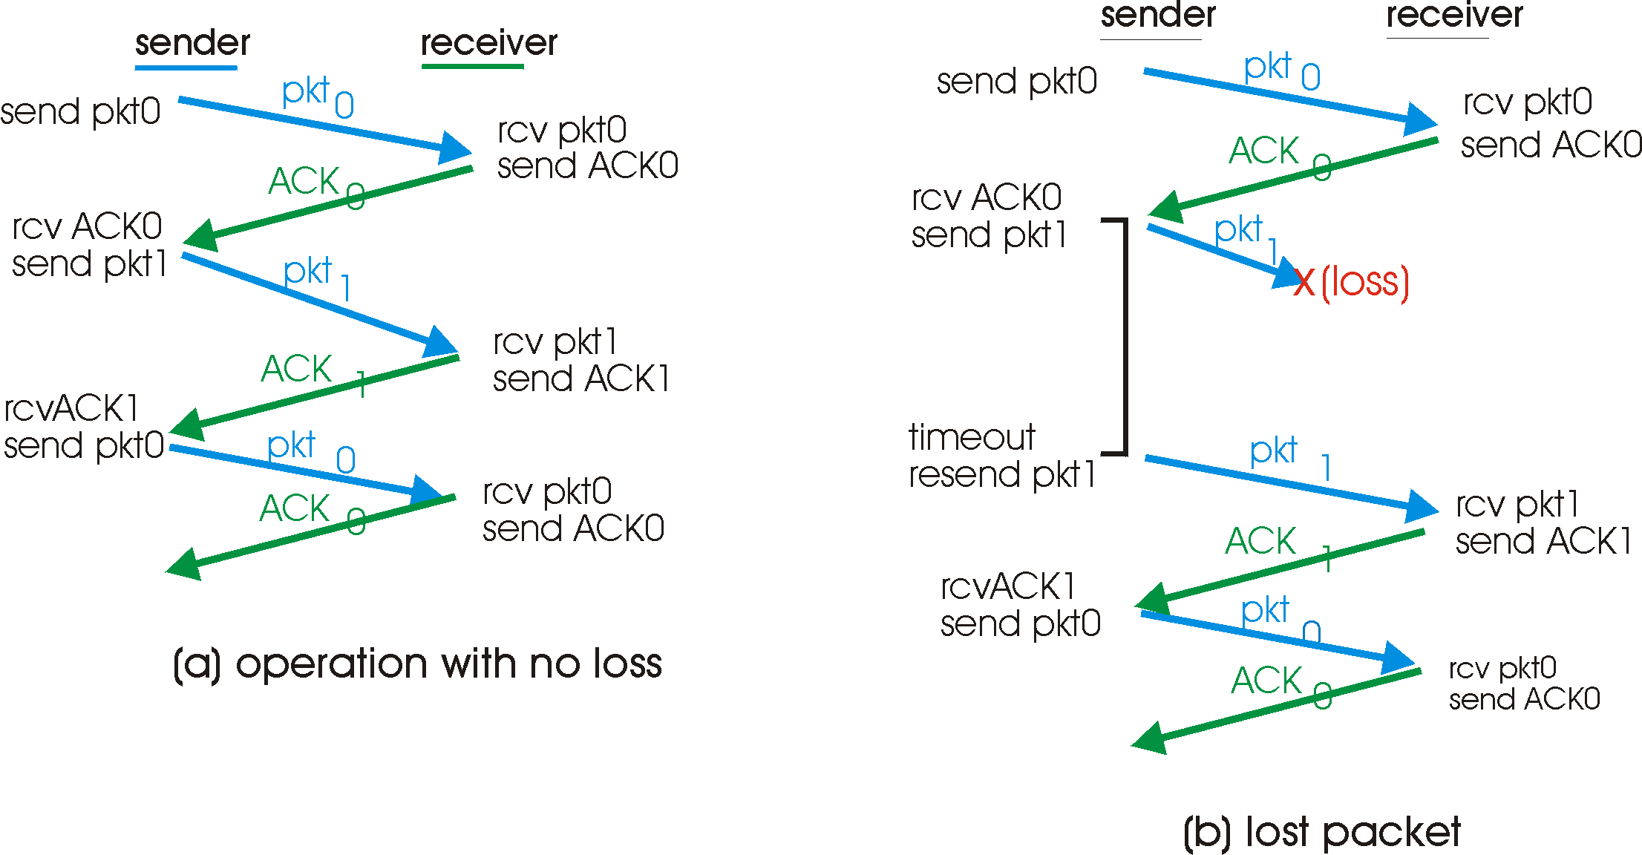
rdt3.0 in action

Slide 52
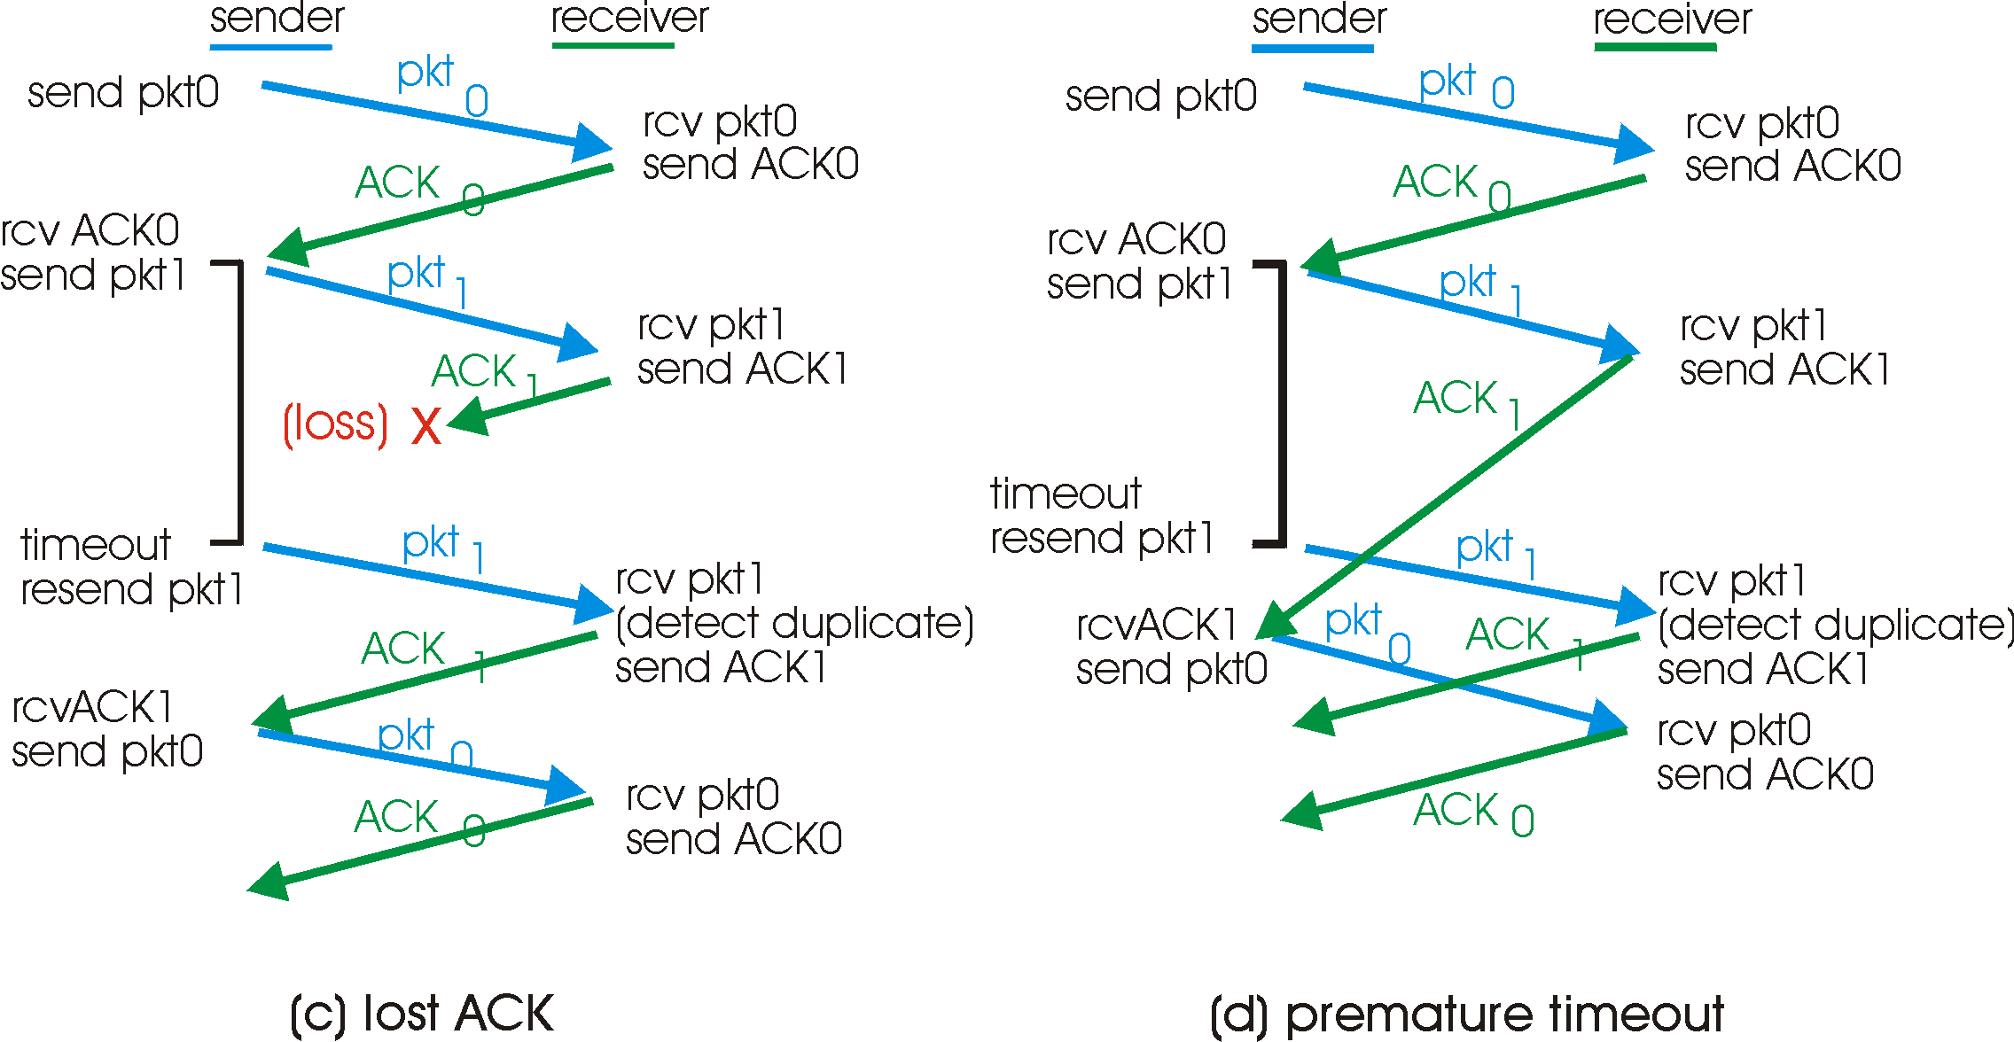
rdt3.0 in action

Slide 53
Performance of rdt3.0
rdt3.0 works, but performance unimpressive.
example: 1 Gbps link, 15 ms end to end prop. delay, 1KB packet:
T
=
L (packet length in bits)
8kb/pkt
transmit
=
= 8 microsec
R (transmission rate, bps)
10**9 b/sec
  U _{sender}: utilization – fraction of time sender busy sending
  1KB pkt every 30 msec -> 33kB/sec throughput over 1 Gbps link
  network protocol limits use of physical resources!

Slide 54
rdt3.0: stop-and-wait operation
sender
receiver
first packet bit transmitted, t = 0
last packet bit transmitted, t = L / R
first packet bit arrives
RTT
last packet bit arrives, send ACK
ACK arrives, send next
packet, t = RTT + L / R

Slide 55
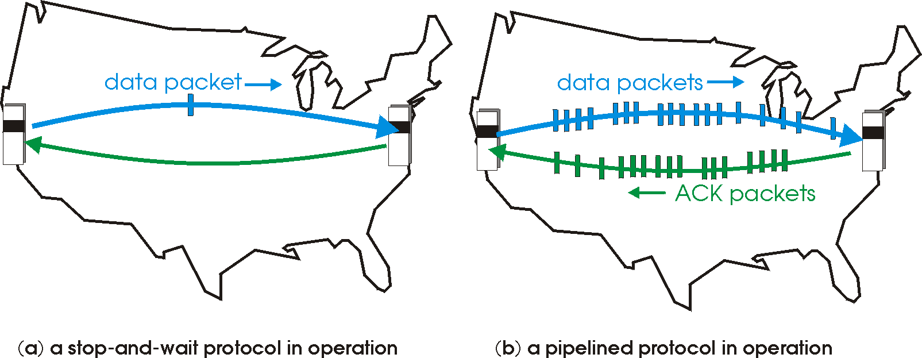
Pipelined protocols
Pipelining: sender allows multiple, “in-flight”, yet-to-be-acknowledged pkts
  range of sequence numbers must be increased
  buffering at sender and/or receiver
Two generic forms of pipelined protocols: go-Back-N, selective repeat

Slide 56
Pipelining: increased utilization
sender
receiver
first packet bit transmitted, t = 0
last bit transmitted, t = L / R
first packet bit arrives
RTT
last packet bit arrives, send ACK
last bit of 2nd packet arrives, send ACK
ACK arrives, send next
packet, t = RTT + L / R
last bit of 3rd packet arrives, send ACK
Increase utilization
by a factor of 3!

Slide 57
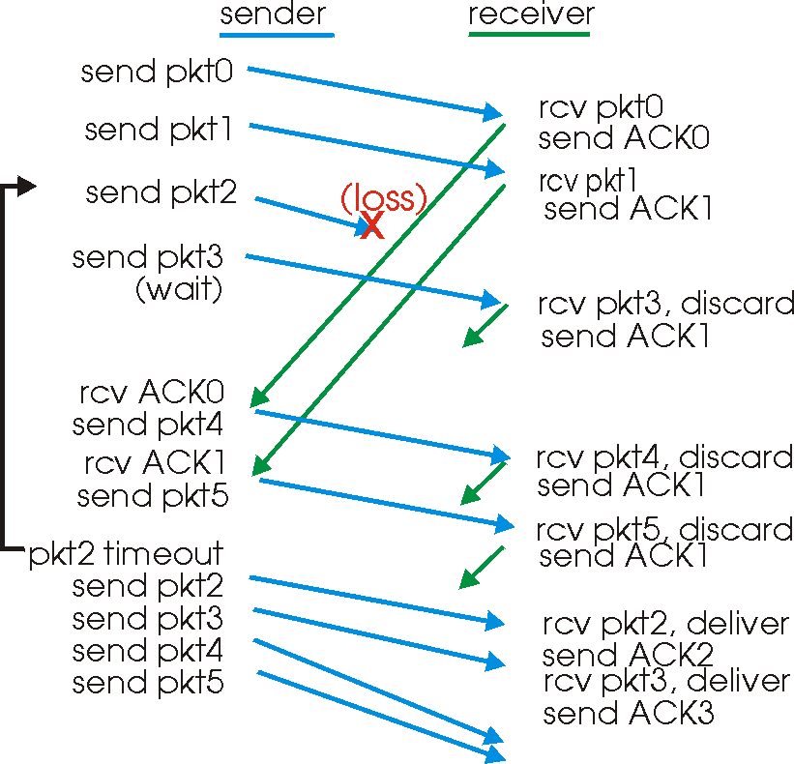
GBN in action

Slide 58
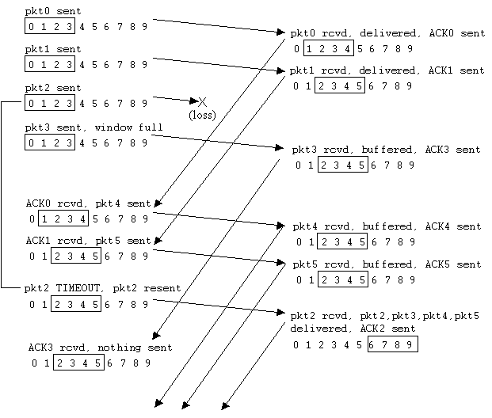
Selective repeat in action

Slide 59
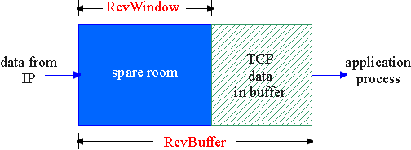
TCP Flow Control
flow control
receiver: explicitly informs sender of (dynamically changing) amount of free buffer space
  RcvWindow field in TCP segment
sender: keeps the amount of transmitted, unACKed data less than most recently received RcvWindow
sender won’t overrun
receiver’s buffers by
transmitting too much,
too fast
RcvBuffer = size or TCP Receive Buffer
RcvWindow = amount of spare room in Buffer
receiver buffering

Slide 60
Principles of Congestion Control
Congestion:
informally: “too many sources sending too much data too fast for network to handle”
different from flow control!
manifestations:
  lost packets (buffer overflow at routers)
  long delays (queueing in router buffers)
a top-10 problem!

Slide 61
TCP Slowstart
Host A
Host B
Slowstart algorithm
one segment
initialize: Congwin = 1
for (each segment ACKed)
Congwin++
until (loss event OR
CongWin > threshold)
RTT
two segments
four segments
exponential increase (per RTT) in window size (not so slow!)
loss event: timeout (Tahoe TCP) and/or or three duplicate ACKs (Reno TCP)
time

Slide 62
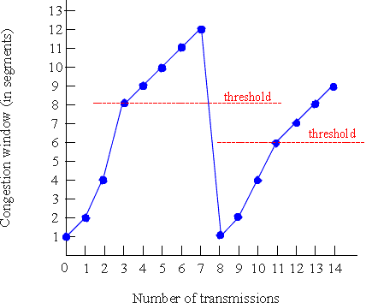
TCP Congestion Avoidance: Tahoe
TCP Tahoe Congestion avoidance
/* slowstart is over */
/* Congwin > threshold */
Until (loss event) {
every w segments ACKed:
Congwin++
}
threshold = Congwin/2
Congwin = 1
perform slowstart

Slide 63
Congestion Avoidance: Reno
increase window by one per RTT if no loss: Congwin++
decrease window by half on detection of loss by triple duplicate ACK: CongWin = Congwin/2 W <- W/2
receiver
W
sender
receiver
W
sender

Slide 64
TCP Reno versus TCP Tahoe:

Slide 65
Why is TCP fair?
Two competing sessions:
Additive increase gives slope of 1, as throughout increases
multiplicative decrease decreases throughput proportionally
R
equal bandwidth share
loss: decrease window by factor of 2
congestion avoidance: additive increase
Connection 2 throughput
loss: decrease window by factor of 2
congestion avoidance: additive increase
Connection 1 throughput
R

Slide 66
Network Layer

Slide 67
Network Layer: Goals & Overview
Goals:
understand principles behind network layer services:
  routing (path selection)
  dealing with scale
  how a router works
  advanced topics: IPv6, mobility
instantiation and implementation in the Internet
Overview:
network layer services
routing principle: path selection
hierarchical routing
IP
Internet routing protocols reliable transfer
  intra-domain
  inter-domain
what’s inside a router?
IPv6
mobility

Slide 68
Network layer functions
transport packet from sending to receiving hosts
network layer protocols in every host, router
Four important functions:
Routing Protocol: Path determination and Switching: route taken by packets from source to dest. Routing algorithms and switching to move packets from router’s input to appropriate router output
Internet Protocol (IP Protocol): addressing convention, Datagram format, Packet handling convention
application
transport
network
data link
physical
network
data link
physical
network
data link
physical
network
data link
physical
network
data link
physical
network
data link
physical
network
data link
physical
network
data link
physical
network
data link
physical
application
transport
network
data link
physical

Slide 69
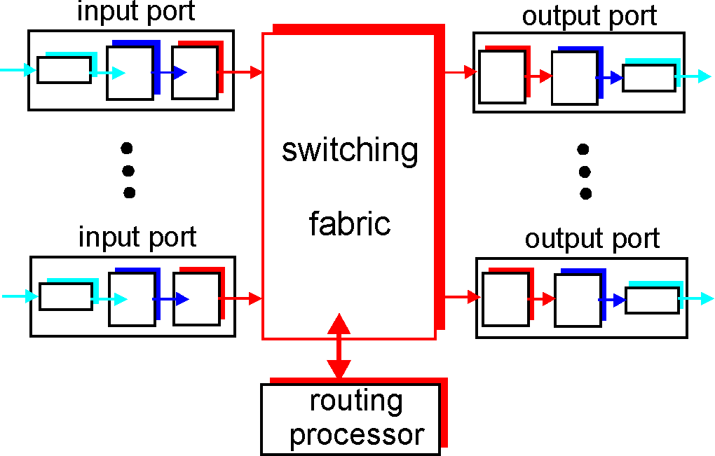
Router Architecture Overview
Two key router functions:
run routing algorithms/protocol (RIP, OSPF, BGP)
switching datagrams from incoming to outgoing link

Slide 70
Datagram networks: the Internet model
no call setup at network layer
routers: no state about end-to-end connections
  no network-level concept of “connection”
packets typically routed using destination host ID
  packets between same source-dest pair may take different paths
application
transport
network
data link
physical
application
transport
network
data link
physical
1. Send data
2. Receive data

Slide 71
Routing
Routing protocol
Goal: determine “good” path
(sequence of routers) thru
network from source to dest.
5
B
3
C
2
5
A
2
1
F
Graph abstraction for routing algorithms:
graph nodes are routers
graph edges are physical links
  link cost: delay, $ cost, or congestion level
3
1
2
D
E
1
“good” path:
  typically means minimum cost path
  other def’s possible

Slide 72
Routing Algorithm classification
Global or decentralized information?
Global:
all routers have complete topology, link cost info
“link state” algorithms
Decentralized:
router knows physically-connected neighbors, link costs to neighbors
iterative process of computation, exchange of info with neighbors
“distance vector” algorithms
Static or dynamic?
Static:
routes change slowly over time
Dynamic:
routes change more quickly
  periodic update
  in response to link cost changes

Slide 73
A Link-State Routing Algorithm
Dijkstra’s algorithm
net topology, link costs known to all nodes
  accomplished via “link state broadcast”
  all nodes have same info
computes least cost paths from one node (‘source”) to all other nodes
  gives routing table for that node
iterative: after k iterations, know least cost path to k dest.’s
Notation:
c(i,j): link cost from node i to j. cost infinite if not direct neighbors
D(v): current value of cost of path from source to dest. V
p(v): predecessor node along path from source to v, that is next v
N: set of nodes whose least cost path definitively known

Slide 74
Dijsktra’s Algorithm
1 Initialization:
2 N = {A}
3 for all nodes v
4 if v adjacent to A
5 then D(v) = c(A,v)
6 else D(v) = infinity
7
8 Loop
9 find w not in N such that D(w) is a minimum
10 add w to N
11 update D(v) for all v adjacent to w and not in N:
12 D(v) = min( D(v), D(w) + c(w,v) )
13 /* new cost to v is either old cost to v or known
14 shortest path cost to w plus cost from w to v */
15 until all nodes in N

Slide 75
Dijkstra’s algorithm: example
Step
0
1
2
3
4
5
start N
A
AD
ADE
ADEB
ADEBC
ADEBCF
D(B),p(B)
2,A
2,A
2,A
D(C),p(C)
5,A
4,D
3,E
3,E
D(D),p(D)
1,A
D(E),p(E)
infinity
2,D
D(F),p(F)
infinity
infinity
4,E
4,E
4,E
5
B
3
C
2
5
A
2
1
F
3
1
2
D
E
1

Slide 76
Distance Vector Routing Algorithm
iterative:
continues until no nodes exchange info.
self-terminating: no “signal” to stop
asynchronous:
nodes need not exchange info/iterate in lock step!
distributed:
each node communicates only with directly-attached neighbors
Distance Table data structure
each node has its own routing table
row for each possible destination
column for each directly-attached neighbor to node
example: in node X, for dest. Y via neighbor Z:
distance from X to
Y, via Z as next hop
X
=
D (Y,Z)
Z
=
c(X,Z) + min {D (Y,w)}
w

Slide 77
Distance Table: example
1
cost to destination via
B
C
E
7
D ()
A
B
C
D
A
1
7
6
4
B
14
8
9
11
D
5
5
4
2
A
8
2
1
E
D
2
E
D
D (C,D)
=
c(E,D) + min {D (C,w)}
destination
w
=
2+2 = 4
E
D
D (A,D)
=
c(E,D) + min {D (A,w)}
w
=
2+3 = 5
loop!
E
B
D (A,B)
=
c(E,B) + min {D (A,w)}
w
=
8+6 = 14
loop!

Slide 78
Distance table gives routing table
cost to destination via
E
Outgoing link
to use, cost
D ()
A
B
C
D
A
1
7
6
4
B
14
8
9
11
D
5
5
4
2
A
B
C
D
A,1
D,5
D,4
D,4
destination
destination
Distance table
Routing table

Slide 79
Distance Vector Routing: overview
Iterative, asynchronous: each local iteration caused by:
local link cost change
message from neighbor: its least cost path change from neighbor
Distributed:
each node notifies neighbors only when its least cost path to any destination changes
  neighbors then notify their neighbors if necessary
Each node:
wait for (change in local link cost of msg from neighbor)
recompute distance table
if least cost path to any dest has changed, notify neighbors

Slide 80
Distance Vector Algorithm:
At all nodes, X:
1 Initialization:
2 for all adjacent nodes v:
3 D (*,v) = infinity /* the * operator means "for all rows" */
4 D (v,v) = c(X,v)
5 for all destinations, y
6 send min D (y,w) to each neighbor /* w over all X's neighbors */
X
X
X
w

Slide 81
Distance Vector Algorithm (cont.):
8 loop
9 wait (until I see a link cost change to neighbor V
10 or until I receive update from neighbor V)
11
12 if (c(X,V) changes by d)
13 /* change cost to all dest's via neighbor v by d */
14 /* note: d could be positive or negative */
15 for all destinations y: D (y,V) = D (y,V) + d
16
17 else if (update received from V wrt destination Y)
18 /* shortest path from V to some Y has changed */
19 /* V has sent a new value for its min DV(Y,w) */
20 /* call this received new value is "newval" */
21 for the single destination y: D (Y,V) = c(X,V) + newval
22
23 if we have a new min D (Y,w)for any destination Y
24 send new value of min D (Y,w) to all neighbors
25
26 forever
X
X
w
X
X
w
X
w

Slide 82
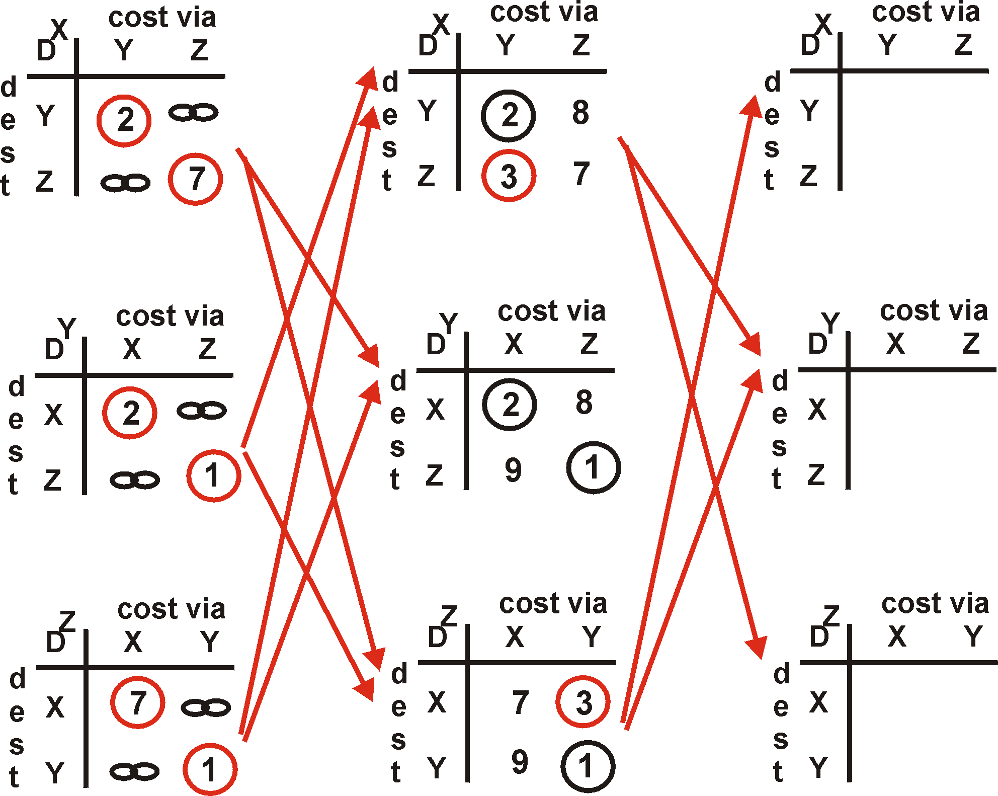
Distance Vector Algorithm: example
Y
2
1
X
Z
7

Slide 83
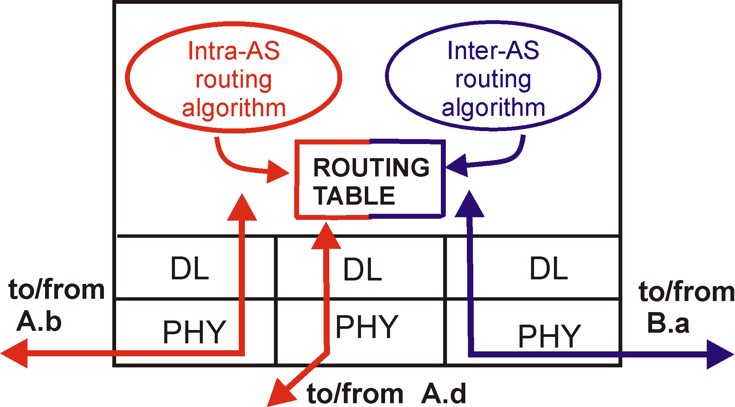
Intra-AS and Inter-AS routing
C.b
Gateways:
  perform inter-AS routing amongst themselves
  perform intra-AS routers with other routers in their AS
B.a
A.a
b
A.c
c
a
C
a
b
a
B
d
c
A
b
network layer
inter-AS, intra-AS routing in
gateway A.c
link layer
physical layer

Slide 84
Intra-AS and Inter-AS routing
Inter-AS
routing
between
A and B
C.b
B.a
A.a
Host
h2
b
A.c
c
a
C
a
b
a
B
Host
h1
d
c
Intra-AS routing
within AS B
A
b
Intra-AS routing
within AS A
We’ll examine specific inter-AS and intra-AS Internet routing protocols shortly

Slide 85
IP datagram format
IP protocol version
number
32 bits
total datagram
length (bytes)
header length
(bytes)
head.
len
type of
service
ver
length
for
fragmentation/
reassembly
“type” of data
flgs
fragment
offset
16-bit identifier
max number
remaining hops
(decremented at
each router)
time to
live
upper
layer
Internet
checksum
32 bit source IP address
upper layer protocol
to deliver payload to
32 bit destination IP address
Options (if any)
E.g. timestamp,
record route
taken, specify
list of routers
to visit.
data
(variable length,
typically a TCP
or UDP segment)

Slide 86
IP Fragmentation & Reassembly
network links have MTU (max.transfer size) - largest possible link-level frame.
  different link types, different MTUs
large IP datagram divided (“fragmented”) within net
  one datagram becomes several datagrams
  “reassembled” only at final destination
  IP header bits used to identify, order related fragments
fragmentation:
in: one large datagram
out: 3 smaller datagrams
reassembly

Slide 87
IP Fragmentation and Reassembly
length
=4000
ID
=x
fragflag
=0
offset
=0
One large datagram becomes
several smaller datagrams
length
=1500
ID
=x
fragflag
=1
offset
=0/8
length
=1500
ID
=x
fragflag
=1
offset
=1480/8
length
=1040
ID
=x
fragflag
=0
offset
=2960/8

Slide 88
Data Link Layer

Slide 89
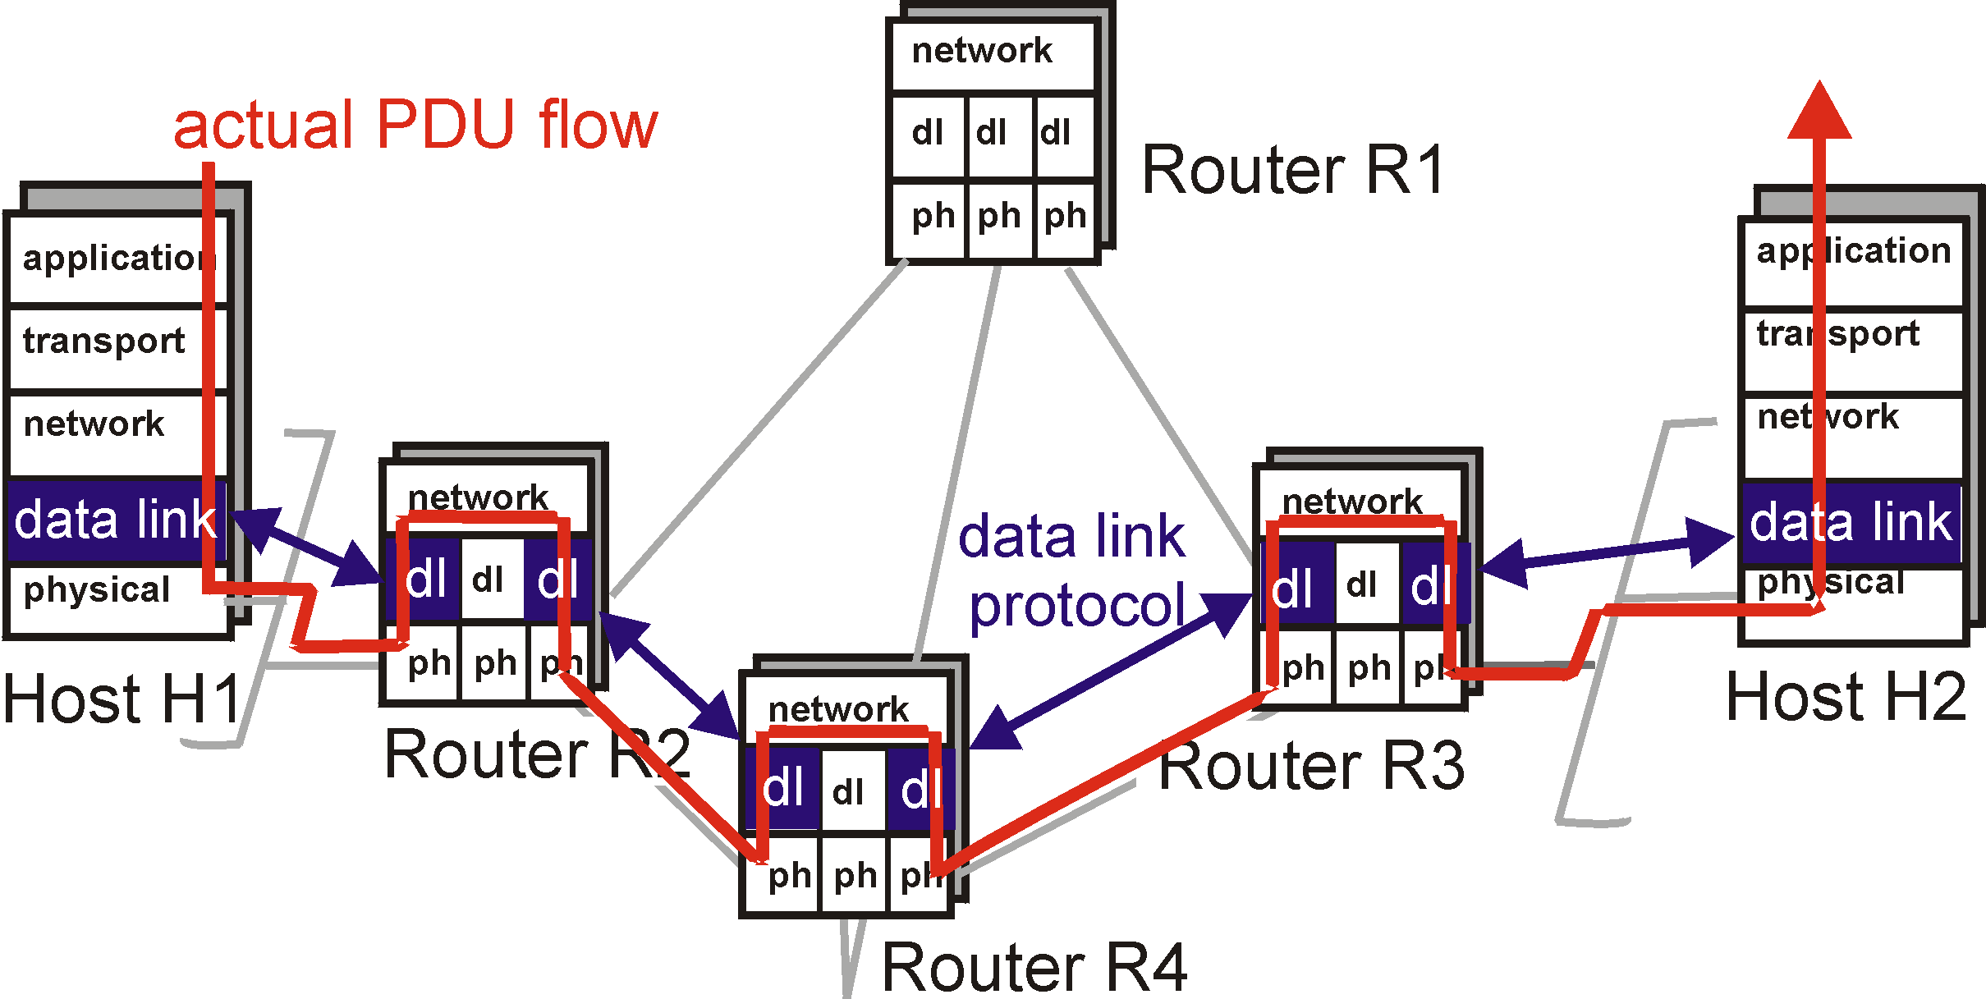
Link Layer: setting the context

Slide 90
Link Layer: Implementation
implemented in “adapter”
  e.g., PCMCIA card (Personal Computer Memory Card International Association), Ethernet card
  typically includes: RAM, DSP chips, host bus interface, and link interface
M
application
transport
network
link
physical
network
link
physical
H
t
M
H
H
M
data link
protocol
n
t
H
H
H
H
H
H
M
l
n
t
M
l
n
t
frame
phys. link
adapter card

Slide 91
MAC Protocols: a taxonomy
Three broad classes:
Channel Partitioning
  divide channel into smaller “pieces” (time slots, frequency, code)
  allocate piece to node for exclusive use
Random Access
  Flexible with respect to number of users join LAN
  allow collisions
  “recover” from collisions
“Taking turns”
  tightly coordinate shared access to avoid collisions
Goal: efficient, fair, simple, decentralized

Slide 92

Channel Partitioning MAC protocols: TDMA
TDMA: time division multiple access
access to channel in "rounds"
each station gets fixed length slot (length = pkt trans time) in each round
unused slots go idle
example: 6-station LAN, 1,3,4 have pkt, slots 2,5,6 idle
TDM (Time Division Multiplexing): channel divided into N time slots, one per user; inefficient with low duty cycle users and at light load.
FDM (Frequency Division Multiplexing): frequency subdivided.

Slide 93
Channel Partitioning MAC protocols: FDMA
FDMA: frequency division multiple access
channel spectrum divided into frequency bands
each station assigned fixed frequency band
unused transmission time in frequency bands go idle
example: 6-station LAN, 1,3,4 have pkt, frequency bands 2,5,6 idle
time
frequency bands

Slide 94
Random Access protocols
When node has packet to send
  transmit at full channel data rate R.
  no a priori coordination among nodes
two or more transmitting nodes -> “collision”,
random access MAC protocol specifies:
  how to detect collisions
  how to recover from collisions (e.g., via delayed retransmissions)
Examples of random access MAC protocols:
  Pure ALOHA
  Slotted ALOHA
  CSMA, CSMA/CD, CSMA/CA

Slide 95
Pure Aloha (cont.)
P(success by given node) = P(node transmits) .
P(no other node transmits in [p₀-1,p₀] .
P(no other node transmits in [p₀-1,p₀]
= p . (1-p) . (1-p)
P(success by any of N nodes) = N p . (1-p) . (1-p)
… choosing optimum p as n -> infty ...
^{= 1/(2e) = .18}
0.4
0.3
S = throughput = “goodput”
(success rate)
protocol constrains
effective channel
throughput!
Slotted Aloha
0.2
0.1
Pure Aloha
0.5
1.0
1.5
2.0
G = offered load = Np

Slide 96
CSMA: Carrier Sense Multiple Access
CSMA: listen before transmit:
If channel sensed idle: transmit entire pkt
If channel sensed busy, defer transmission
  p-Persistent CSMA: retry immediately with probability p when channel becomes idle (may cause instability)
  1-Persistent CSMA: retry immediately with probability 1 when channel becomes idle
  Non-persistent CSMA: retry after random interval

Slide 97
CSMA/CD (Collision Detection)
CSMA/CD: carrier sensing, deferral as in CSMA
  collisions detected within short time
  colliding transmissions aborted, reducing channel wastage
  persistent or non-persistent retransmission
collision detection:
  easy in wired LANs: measure signal strengths, compare transmitted, received signals
  difficult in wireless LANs: receiver shut off while transmitting

Slide 98
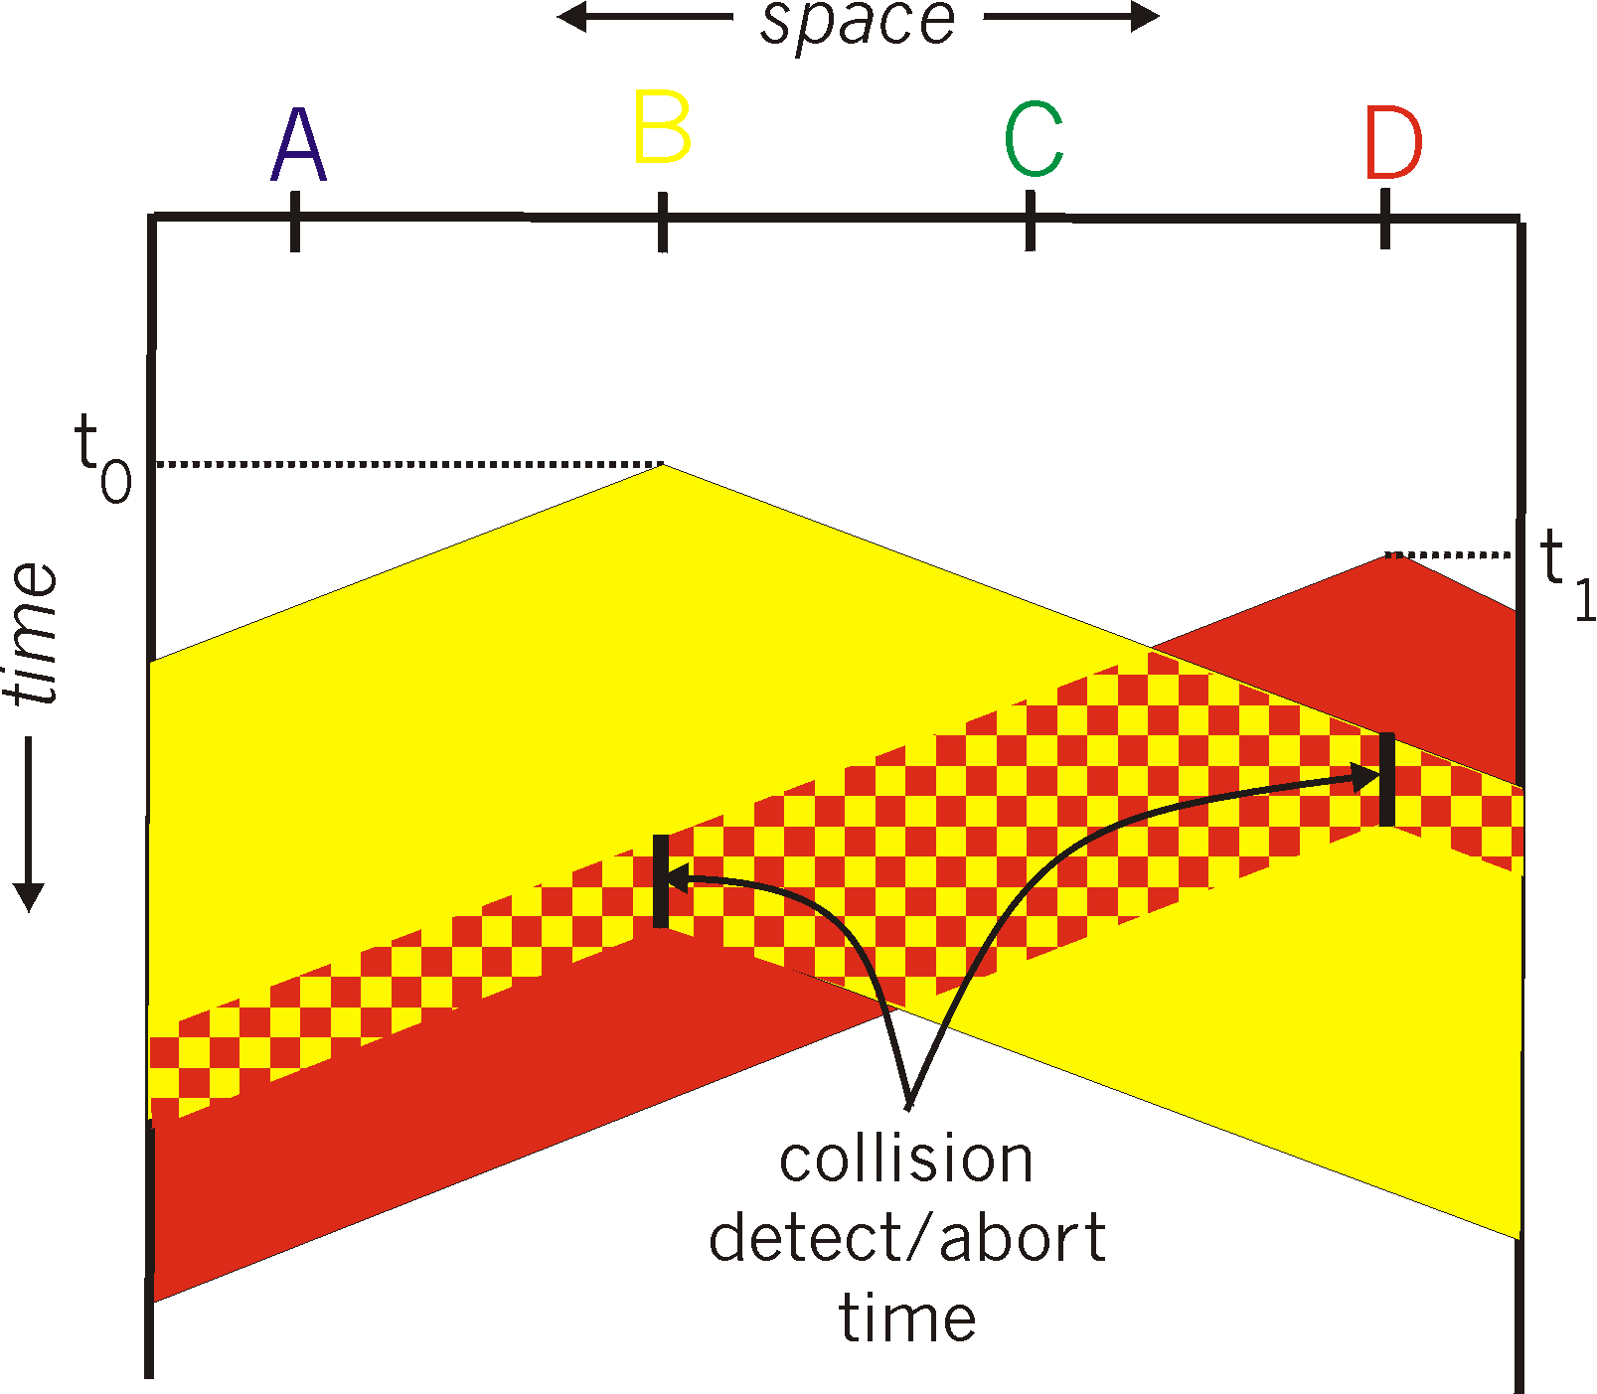
CSMA/CD collision detection

Slide 99
“Taking Turns” MAC protocols
channel partitioning MAC protocols:
  share channel efficiently at high load
  inefficient at low load: delay in channel access, 1/N bandwidth allocated even if only 1 active node!
Random access MAC protocols
  efficient at low load: single node can fully utilize channel
  high load: collision overhead
“taking turns” protocols
  look for best of both worlds!

Slide 100
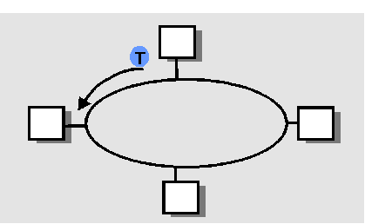
“Taking Turns” MAC protocols
Polling:
master node “invites” slave nodes to transmit in turn
Request to Send, Clear to Send msgs
concerns:
  polling overhead
  latency
  single point of failure (master)
Token passing:
control token passed from one node to next sequentially.
token message
concerns:
  token overhead
  latency
  single point of failure (token)

Slide 101
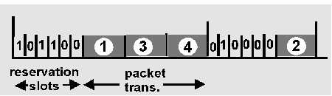
Reservation-based protocols
Distributed Polling:
time divided into slots
begins with N short reservation slots
  reservation slot time equal to channel end-end propagation delay
  station with message to send posts reservation
  reservation seen by all stations
after reservation slots, message transmissions ordered by known priority

Slide 102
LAN Addresses and ARP
32-bit IP address:
network-layer address
used to get datagram to destination network (recall IP network definition)
LAN (or MAC or physical) address:
used to get datagram from one interface to another physically-connected interface (same network)
48 bit MAC address (for most LANs)
burned in the adapter ROM

Slide 103
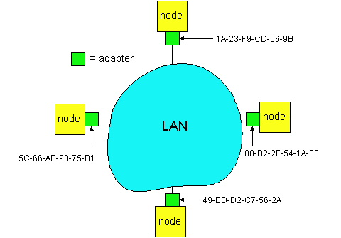
LAN Addresses and ARP
Each adapter on LAN has unique LAN address

Slide 104
LAN Address (more)
MAC address allocation administered by IEEE
manufacturer buys portion of MAC address space (to assure uniqueness)
Analogy:
(a) MAC address: like your voter identification number
(b) IP address: like postal address
MAC flat address => portability
  can move LAN card from one LAN to another
IP hierarchical address NOT portable
  depends on network to which one attaches

Slide 105
Recall earlier routing discussion
Starting at A, given IP datagram addressed to B:
look up net. address of B, find B on same net. as A
link layer send datagram to B inside link-layer frame
A
223.1.1.1
223.1.2.1
223.1.1.2
223.1.1.4
223.1.2.9
B
223.1.2.2
E
223.1.1.3
223.1.3.27
223.1.3.1
223.1.3.2
frame source,
dest address
datagram source,
dest address
B’s MAC
addr
A’s MAC
addr
A’s IP
addr
B’s IP
addr
IP payload
datagram
frame

Slide 106
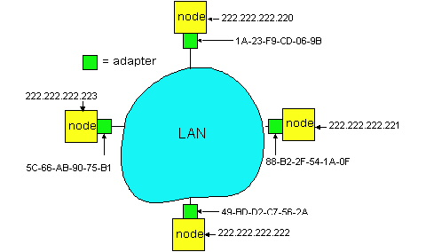
ARP: Address Resolution Protocol
Question: how to determine
MAC address of B
given B’s IP address?
Each IP node (Host, Router) on LAN has ARP module, table
ARP Table: IP/MAC address mappings for some LAN nodes
< IP address; MAC address; TTL>
< ………………………….. >
  TTL (Time To Live): time after which address mapping will be forgotten (typically 20 min)

Slide 107
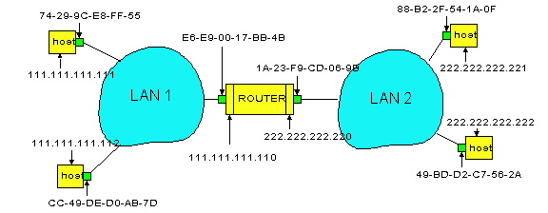
Routing to another LAN
walkthrough: routing from A to B via R
In routing table at source Host, find router 111.111.111.110
In ARP table at source, find MAC address E6-E9-00-17-BB-4B, etc
A
R
B

Slide 108
A creates IP packet with source A, destination B
A uses ARP to get R’s physical layer address for 111.111.111.110
A creates Ethernet frame with R's physical address as dest, Ethernet frame contains A-to-B IP datagram
A’s data link layer sends Ethernet frame
R’s data link layer receives Ethernet frame
R removes IP datagram from Ethernet frame, sees its destined to B
R uses ARP to get B’s physical layer address
R creates frame containing A-to-B IP datagram sends to B
A
R
B

Slide 109
Major Steps involved to Take a Packet from Source to Destination Over Internet
Example: Say you have typed the URL on your browser and pressed “GO”
  From DNS (may be local or root or authoritative DNS) it will find out the destination node’s IP address
  From routing algorithm (OSPF/RIP/BGP) finds out the next hop the packet has to be pushed
  After knowing the next hop, it will have the IP address of next hop as back bone routers know the IP address of connected node.
  If it does not know the MAC-address of next hope/node runs ARP protocol to find it out
  Then packet is pushed to next hop
  Like this Packet goes from hop to hop to reach the destination!

Slide 110
Research Areas
As we saw – Internet traffic slow due to routing decision at each node for each packet, no bandwidth allocation for real time packet
  Software Defined Network a very new area, where world wide researchers trying to develop a control plane
Security over Internet
Fast IP-based mobility in case of Heterogeneous network
Low powered High Performance Routers/Switches

Slide 111
References
Computer Networking by Kurose and Ross
Network Security by Starling

Slide 112
Thank You!

