Slide 1
Second order methods for bandit convex optimization and control
Praneeth Netrapalli
Google Research India
Joint work with
Arun Sai Suggala (Google Research India)
Jennifer Yu (Princeton University)
Elad Hazan (Priniceton University and Google Research Princeton)

Slide 2
Outline
Bandit convex optimization
History and related work
Second order algorithm and results
Main ideas of the proof
Application to Control
Conclusion and open questions

Slide 3
Bandit convex optimization
Two players: Player and adversary.
In each round, play picks $x_{t}$ and adversary picks a convex function $f_{t}$.
Player suffers loss $f_{t}(x_{t})$ and observes only this value.
Player’s objective: Sublinear regret compared to best fixed point in hindsight.
$$\sum_{t=1}^{T}{f_{t}(x_{t})}−\min_{x∈X}{\sum_{t=1}^{T}{f_{t}\left(x\right)}}=o\left(T\right)$$
Proper if $x_{t}∈X$ and improper otherwise.
Much more general than multi-armed bandits.

Slide 4
Rich history
[Flaxman, Kalai, McMahan, 2004] $\tilde{O}\left(T^{5/6}\right)$ for bounded functions and $\tilde{O}\left(T^{3/4}\right)$ for Lipschitz continuous functions.
[Tewari and Saha, 2011] $\tilde{O}\left(T^{2/3}\right)$ for smooth functions (i.e., those with Lipschitz continuous gradients)
Long line of work aiming to obtain optimal rate of $\tilde{O}\left(\sqrt{T}\right)$
Initially for very special cases e.g., linear losses, but culminating in a very general result by [Eldan, Lee, Bubeck, 2017].
Catch: Dimension dependence of the general result extremely large.

Slide 5
Overview of previous results
Adversarial
Stochastic
Running time and/or regret very high polynomials in $d$, except for linear functions.
Question I: Simple, efficient (low $d$ dependence) regret and runtime algorithm for a large class of convex functions.

Slide 6
This work – $κ$-convex functions
A function is called $κ$-convex if there exists constants $c$ and $C$, and a positive semidefinite (PSD) matrix $H$ such that:
$cH≼∇^{2}f\left(x\right)≼CH ∀ x$ and
$$\frac{C}{c}≤κ$$
Examples: linear functions – $f\left(x\right)=⟨c,x⟩$, generalized linear functions – $f\left(x\right)=φ\left(⟨c,x⟩\right)$, quadratic functions – $f\left(x\right)=x^{⊤}Ax+⟨c,x⟩$.

Slide 7
Main Result I
Efficient bandit Newton algorithm for $κ$-convex functions.
Theorem (Informal): $O\left(d^{2.5}κ^{2}\sqrt{T}\right)$ regret + $O\left(d^{2}\right)$ per step complexity.

Slide 8
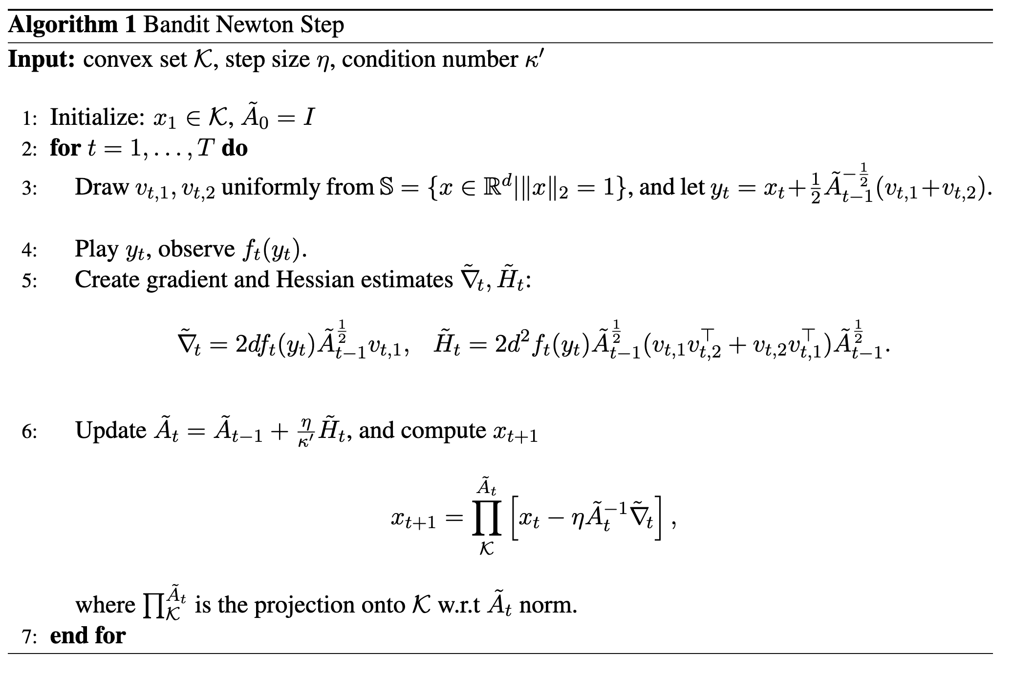
The bandit Newton algorithm

Slide 9
Main Ideas of the proof I
Consider for simplicity, quadratic functions: $f_{t}\left(x\right)=\frac{1}{2}x^{⊤}H_{t}x+\left\langle c_{t},x\right\rangle$
Initialize ${\tilde{A}}_{0}=I_{d×d}$.
Gradient and Hessian estimates ${\tilde{g}}_{t}$ and ${\tilde{H}}_{t}$ are unbiased.
${\tilde{A}}_{t}={\tilde{A}}_{t−1}+η{\tilde{H}}_{t}$
Consider the potential function ${\left\|x_{t}−x\right\|}_{{\tilde{A}}_{t}}^{2}$.

Slide 10
Main Ideas of the proof II
$${\left\|x_{t}−x\right\|}_{{\tilde{A}}_{t}}^{2}={\left\|x_{t−1}−η{\tilde{A}}_{t}^{−1}{\tilde{g}}_{t}−x\right\|}_{{\tilde{A}}_{t}}^{2}$$
$$={\left\|x_{t−1}−x\right\|}_{{\tilde{A}}_{t}}^{2}−η\left\langle {\tilde{g}}_{t},x_{t−1}−x\right\rangle +η^{2}⟨{\tilde{g}}_{t},{\tilde{A}}_{t}^{−1}{\tilde{g}}_{t}⟩$$
$$={\left\|x_{t−1}−x\right\|}_{{\tilde{A}}_{t−1}}^{2}+η{\left\|x_{t−1}−x\right\|}_{{\tilde{H}}_{t}}^{2}−η\left\langle {\tilde{g}}_{t},x_{t−1}−x\right\rangle +η^{2}⟨{\tilde{g}}_{t},{\tilde{A}}_{t}^{−1}{\tilde{g}}_{t}⟩$$
$$𝔼\left[{\left\|x_{t−1}−x\right\|}_{{\tilde{H}}_{t}}^{2}\right]={\left\|x_{t−1}−x\right\|}_{H_{t}}^{2}$$
We have: $η{\left\|x_{t−1}−x\right\|}_{H_{t}}^{2}−η\left\langle {\tilde{g}}_{t},x_{t−1}−x\right\rangle ≤−η\left(f_{t}\left(x_{t}\right)−f\left(x\right)\right)$
And: $\left\langle {\tilde{g}}_{t},{\tilde{A}}_{t}^{−1}{\tilde{g}}_{t}\right\rangle =O\left(1\right)$

Slide 11
Main ideas of the proof III
Telescoping, we obtain: $\sum_{t=1}^{T}{\left(f_{t}\left(x_{t}\right)−f_{t}\left(x\right)\right)≤\frac{{\left\|x_{0}−x\right\|}^{2}}{η}+ηT}$.
However, $x_{t}$ is not the point we played but rather
$$y_{t}=x_{t}+\frac{1}{2}{\tilde{A}}_{t−1}^{−\frac{1}{2}}\left(v_{t,1}+v_{t,2}\right)$$
But $𝔼 \left[f_{t}\left(y_{t}\right)\right]−f_{t}\left(x_{t}\right)=Tr(H_{t}{\tilde{A}}_{t−1}^{−1})$, and a standard argument bounds
$\sum_{t=1}^{T}{Tr(H_{t}{\tilde{A}}_{t−1}^{−1})}=O\left(\sqrt{T}\right)$ since $𝔼\left[{\tilde{A}}_{t}\right]=\sum_{s=1}^{t}{H_{s}}$.

Slide 12
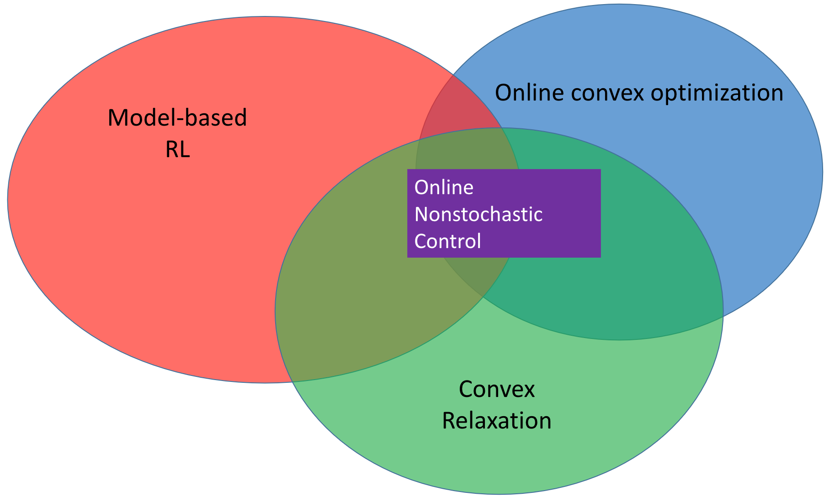
Application to control

Slide 13
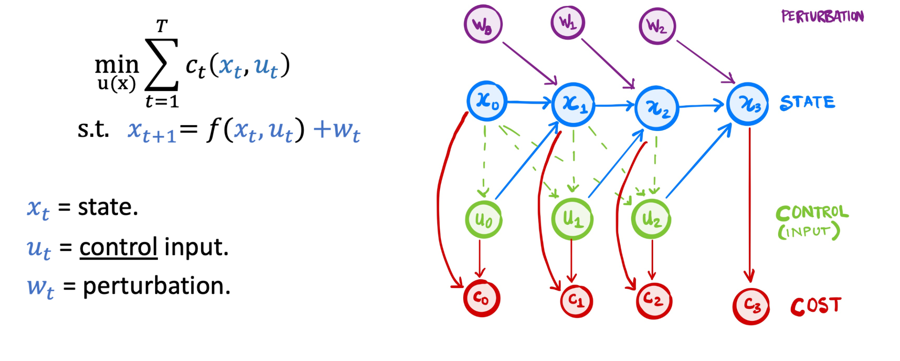
Control: basic formulation

Slide 14
Control: basic formulation (Lyapunov)

Slide 15
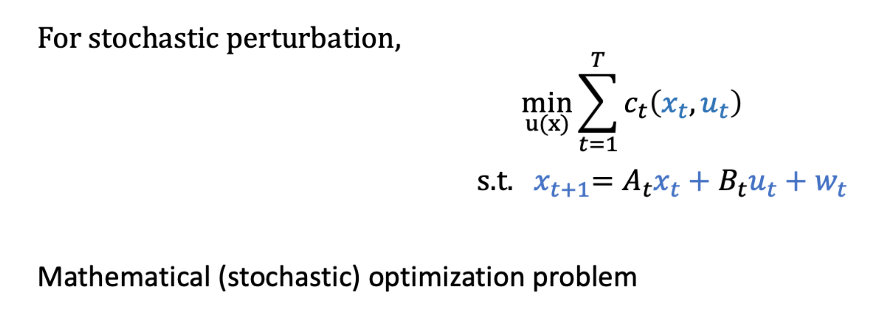
Optimal control for stochastic noise

Slide 20
Online nonstochastic control
For $t=1, 2,⋯$
Observe $y_{t}$ and play control $u_{t}$
Incur loss $c_{t}\left(y_{t},u_{t}\right)$
Goal: minimize regret vs. best policy in class
$$\sum_{t=1}^{T}{c_{t}\left(y_{t},u_{t}\right)}−\min_{π}{\sum_{t=1}^{T}{c_{t}\left(y_{t}^{π},u_{t}^{π}\right)}}$$ vs. best policy in hindsight in certain class, with different states

Slide 23
Ingredient 2: Bandit Convex Optimization with Memory
Player chooses $y_{t}$ and adversary chooses $f_{t+m}$ independently.
Player suffers loss $f_{t}\left(y_{t−m+1},⋯,y_{t}\right)$ and observes only that value.
Adversary can choose loss functions adaptively, but $m$ steps earlier.
Regret with respect to best fixed point in hindsight:
$$\sum_{t=m}^{T}{f_{t}\left(y_{t−m+1},⋯,y_{t}\right)}−\min_{y∈Y}{\sum_{t=m}^{T}{f_{t}\left(y,⋯,y\right)}}$$

Slide 24
Main Result II: A lower bound
There exists an instance such that the best loss achieved by any algorithm is significantly larger than $\tilde{Ω}\left(T^{2/3}\right)≫\tilde{Ω}\left(\sqrt{T}\right)$.
Our hard instance builds upon that introduced in [Dekel et al. 2014], who only consider $0−1$ costs.
Matching upper bound in [Cassel and Koren, 2020].
Is this the best regret we can get for control?

Slide 25
Bandit convex optimization – Affine memory (BCO-AM)
Player chooses $y_{t}$ and adversary chooses $f_{t}$.
Player observes $\sum_{i=0}^{m−1}{H_{ii}}$ and
$$f_{t}\left(y_{t−m+1},⋯,y_{t}\right)=\frac{1}{2}\sum_{i,j=0}^{m−1}{\left(y_{t−i}^{⊤}H_{ij}y_{t−j}\right)}+\sum_{i=0}^{m−1}{⟨c_{i},y_i⟩ }$$
Full information of the Hessian but only partial information of the linear component.
Crucial reduction of control problem to BCO-AM due to [Simchowitz, 2020]

Slide 26
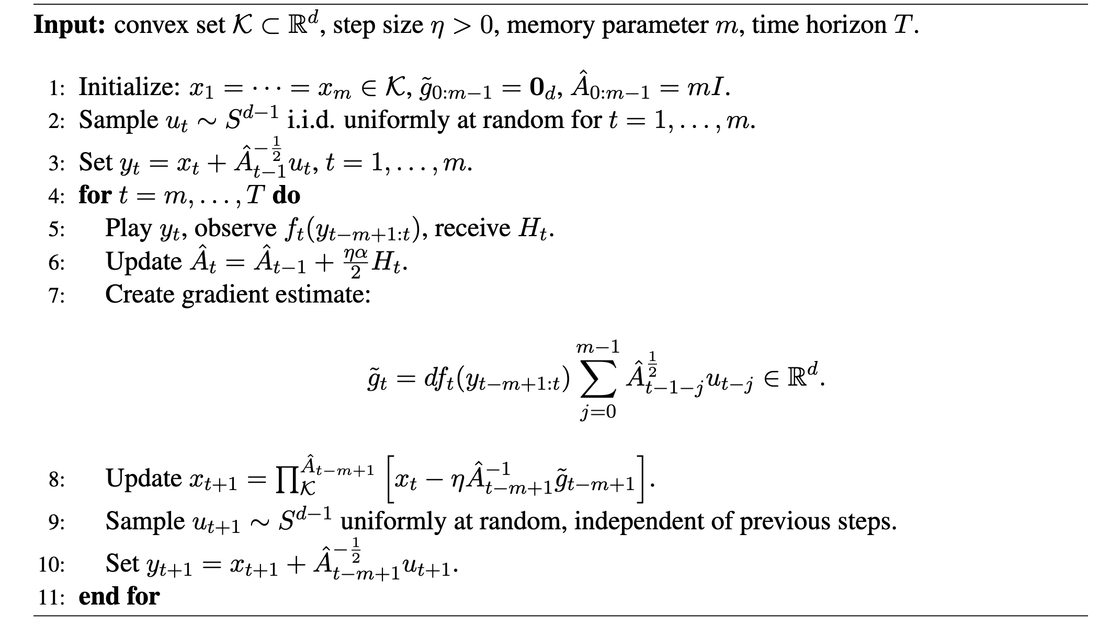
Bandit Newton Algorithm with Affine Memory (BNS-AM)

Slide 27
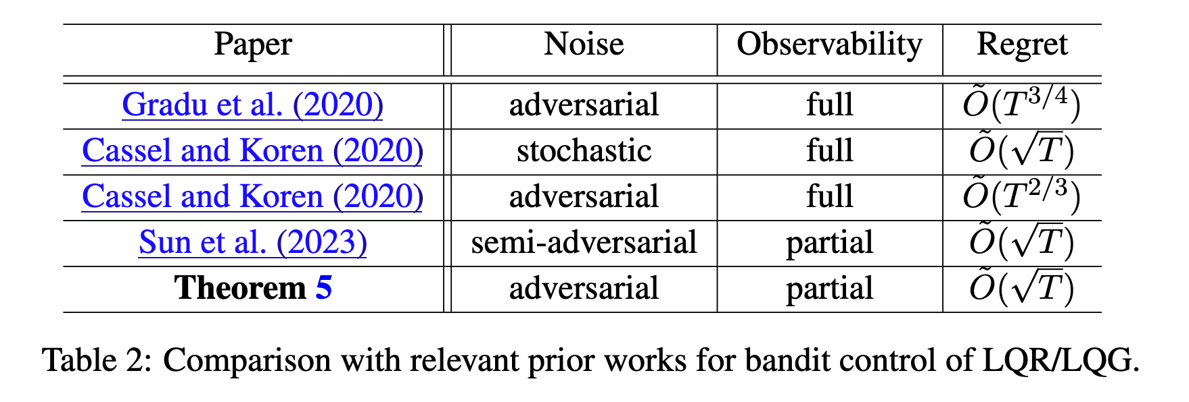
Main result III: Optimal regret for control
Theorem (Informal): For bandit linear control problems (under appropriate assumptions), BNS-AM achieves $\tilde{O}\left(\sqrt{T}\right)$ regret.

Slide 28
Conclusions
Simple and efficient Newton algorithm for bandit optimization of $κ$-convex functions with regret $\tilde{Ω}\left(d^{2.5}κ^{2}\sqrt{T}\right)$.
Efficient algorithm achieving optimal regret of $\tilde{Ω}\left(\sqrt{T}\right)$ for LQR/LQG, through bandit convex optimization with affine memory.
Strictly worse lower bound of $\tilde{Ω}\left(T^{2/3}\right)$ for the general problem of bandit convex optimization with memory $≥2$.

Slide 29
Open problems
Proper BCO algorithm – need to tackle challenges with the barrier.
Going beyond $κ$ convexity – Hessian is only useful locally.
Non-stochastic control with more general losses e.g., generalized linear losses?
Extending the bandit quadratic optimization with memory lower bound to oblivious adversaries.

