Slide 1
Sequential decision making in large systems – RL with partial observability, multiple agents and dynamic environments
Jayakumar Subramanian
Senior Research Scientist, MDSR Lab, Adobe India
Acknowledgments: researchers at McGill, Adobe, MIT, MSR and Vector Institute
27th Feb 2024
Reinforcement Learning: Recent Trends and Future Challenges, IISc Bangalore

Slide 2
Agenda
RL with partial observability
RL with multiple agents
RL with large and dynamic action spaces

Slide 3
Some Challenges in Real-World RL
Partial observations
Dynamic environments:
Changing spaces – state, action, observation
Changing mappings – transitions, rewards
Multiple agents:
Cooperative – Teams / DecPOMDPs
Competitive – Games / POSGs

Slide 4
Classification of Decision Making Problems
Impact
Math Framework
Complexity
Effect over time
Frequency
Monetary impact
Externalities
Bandit
MDP
POMDP
Dec-POMDP
POSG
Info structure
Solution definition
Reliability
Controllability!

Slide 5




RL – Notation and basic set up
$$A_{t}$$
System / World Boundary
$${Y_{t}, R}_{t}$$
Pixel based observations
Other domains with rich observations
Healthcare
Marketing (Retail, Advertisement)
Finance (Portfolio management)
Decision making in self-driving cars

Slide 6








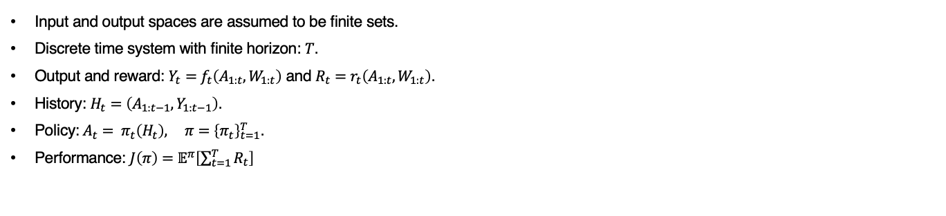




Sequences of Events in RL
$$Y_{1}$$
$$Y_{2}$$
$$Y_{t}$$
Stochastic input: $W_{t}$
System
Output: $Y_{t}$
Controlled input: $A_{t}$
$$A_{1}$$
$$W_{2}$$
$$A_{t}$$
$$W_{t}$$
$$W_{1}$$
$$A_{2}$$
Input and output spaces are assumed to be finite sets.
Discrete time system with finite horizon: $T$.
Output and reward: $Y_{t}=f_{t}\left(A_{1:t},W_{1:t}\right)$ and $R_{t}=r_{t}\left(A_{1:t},W_{1:t}\right)$.
History: $H_{t}=\left(A_{1:t−1},Y_{1:t−1}\right)$.
Policy:${A_{t}= π}_{t}\left(H_{t}\right), π={\left\{π_{t}\right\}}_{t=1}^{T}$.
Performance: $J\left(π\right)=𝔼^{π}\left[\sum_{t=1}^{T}{R_{t}}\right]$

Slide 7





RL as a Sequence Modeling Problem
Construct a state-space representation of the partially observed process.
Define a posterior belief over this state space – called the belief state.
Write a dynamic program based on this belief state.
Drawback in use of belief state in RL: Requires knowledge of the system dynamics in order to estimate the belief state and its evolution
Approach in traditional RL for partially observable systems
$$Y_{t−1}$$
RNN
(LSTM/GRU) or Transformers
$$A_{t−1}$$
$$A_{t}$$
$$C_{t−1}$$
Hidden state: $C_{t}$
No theoretical error bounds at convergence.

Slide 8
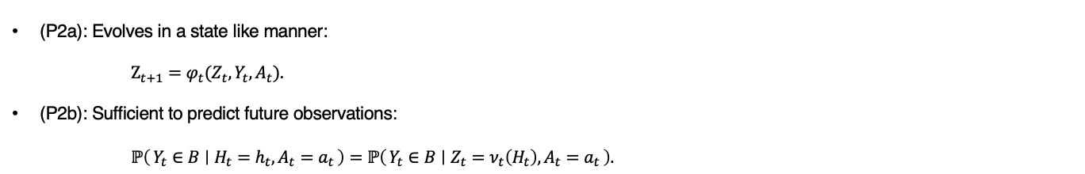
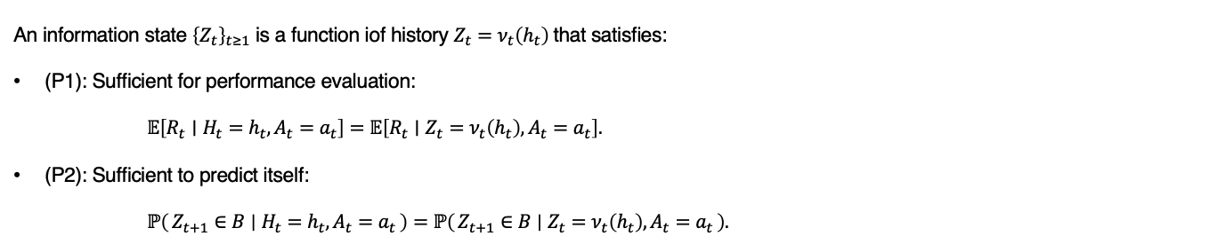
Statistically Sufficient Summary – Information State
An information state ${\left\{Z_{t}\right\}}_{t≥1}$ is a function iof history $Z_{t}=ν_{t}\left(h_{t}\right)$that satisfies:
(P1): Sufficient for performance evaluation:
$𝔼\left[R_{t}∣H_{t}=h_{t}, A_{t}=a_{t}\right]=𝔼\left[R_{t}∣Z_{t}=ν_{t}\left(h_{t}\right), A_{t}=a_{t}\right].$
(P2): Sufficient to predict itself:
$ℙ\left(Z_{t+1}∈B ∣ H_{t}=h_{t}, A_{t}=a_{t}\right)=ℙ\left(Z_{t+1}∈B ∣ Z_{t}=ν_{t}\left(h_{t}\right), A_{t}=a_{t}\right).$
(P2a): Evolves in a state like manner:
$Z_{t+1}=φ_{t}(Z_{t},Y_{t},A_{t}).$
(P2b): Sufficient to predict future observations:
$ℙ\left(Y_{t}∈B ∣ H_{t}=h_{t}, A_{t}=a_{t}\right)=ℙ\left(Y_{t}∈B ∣ Z_{t}=ν_{t}\left(H_{t}\right), A_{t}=a_{t}\right).$
Subramanian, J, et al. "Approximate information state for approximate planning and reinforcement learning in partially observed systems" JMLR (2022).

Slide 9
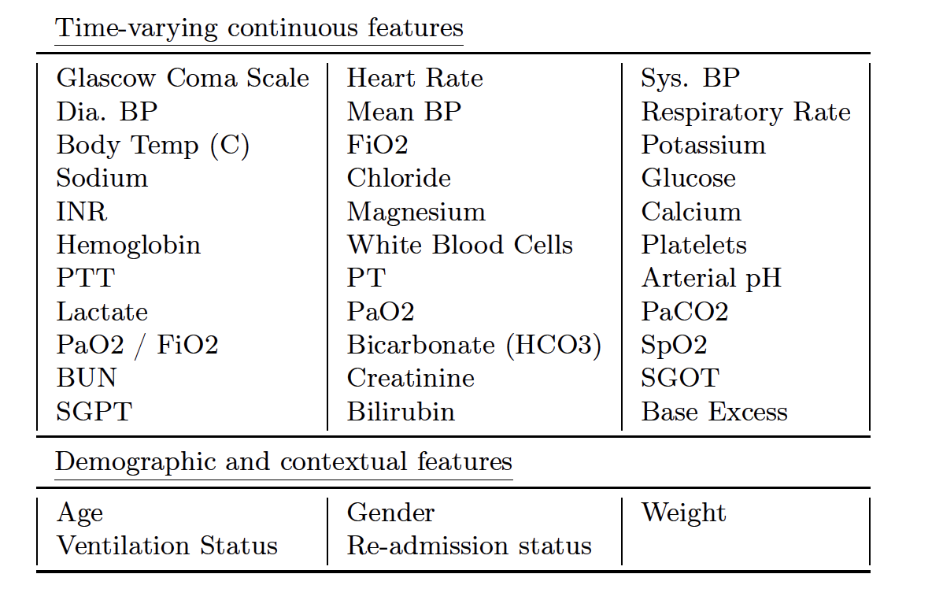
Sepsis, MIMIC-III Dataset and the problem to be solved
Cohort of 19,418 patients, observed mortality rate ~9%
Observations: 72h span around presumed sepsis onset (24h before to 48h after)
Observation space: 33 Vital signs and lab measurements + 5 demographic features
Action space – 25 discrete combinations of fluid and vasopressor
We remove all binary or categorical variables.
Demographic context is set aside.
Acuity scores (SOFA, SAPSII and OASIS) used to constrain the learning process.
Preprocessing of EHR is non-trivial; few healthcare problems can be treated as isolated ones
Problem: Offline RL with observational data
Killian, T.W., et al. "An Empirical Study of Representation Learning for Reinforcement Learning in Healthcare" ML4H (2020).

Slide 10
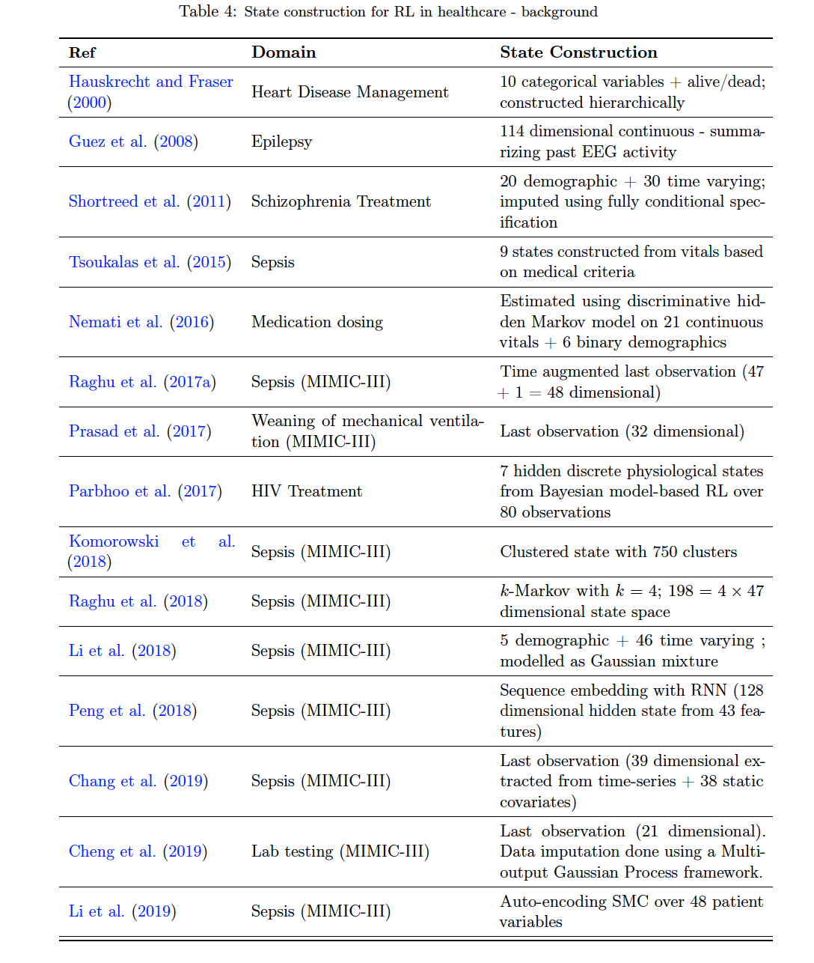
Partial observability and information state
Information state: compression of history of observations and actions
Satisfies additional conditions: i) Predicting next observation ii) Predicting reward
Killian, T.W., et al. "An Empirical Study of Representation Learning for Reinforcement Learning in Healthcare" ML4H (2020).

Slide 11
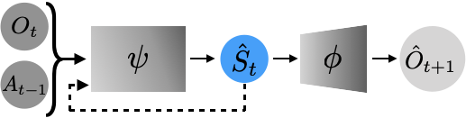
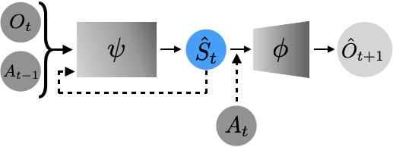
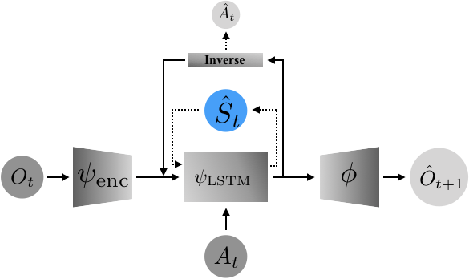
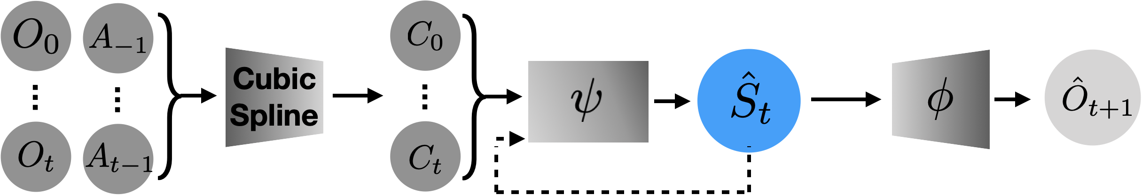
Different state representations considered – 1 of 2
RNN
AIS
CDE
DDM
Killian, T.W., et al. "An Empirical Study of Representation Learning for Reinforcement Learning in Healthcare" ML4H (2020).

Slide 12
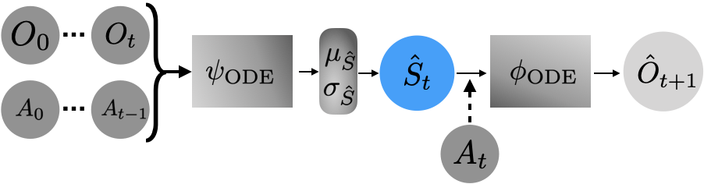
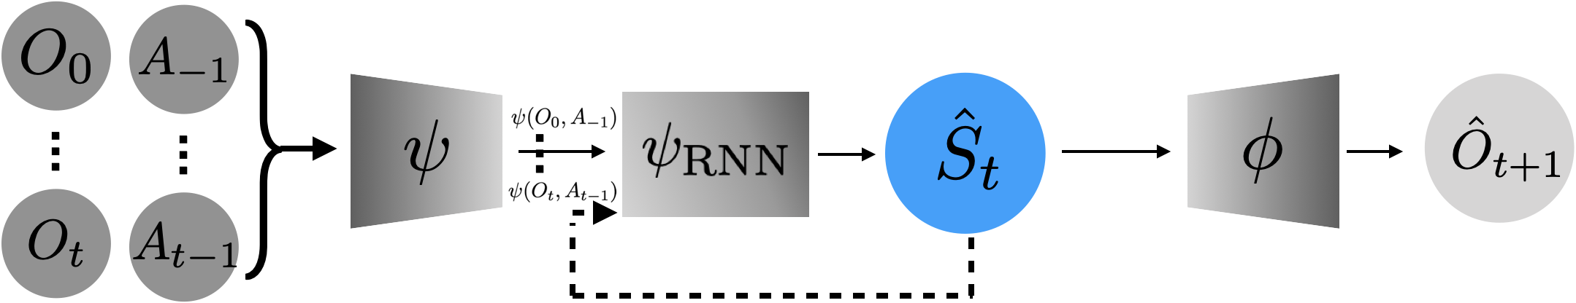
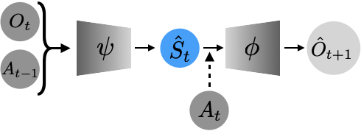
Different state representations considered – 2 of 2
DST
ODE
AE
Killian, T.W., et al. "An Empirical Study of Representation Learning for Reinforcement Learning in Healthcare" ML4H (2020).

Slide 13
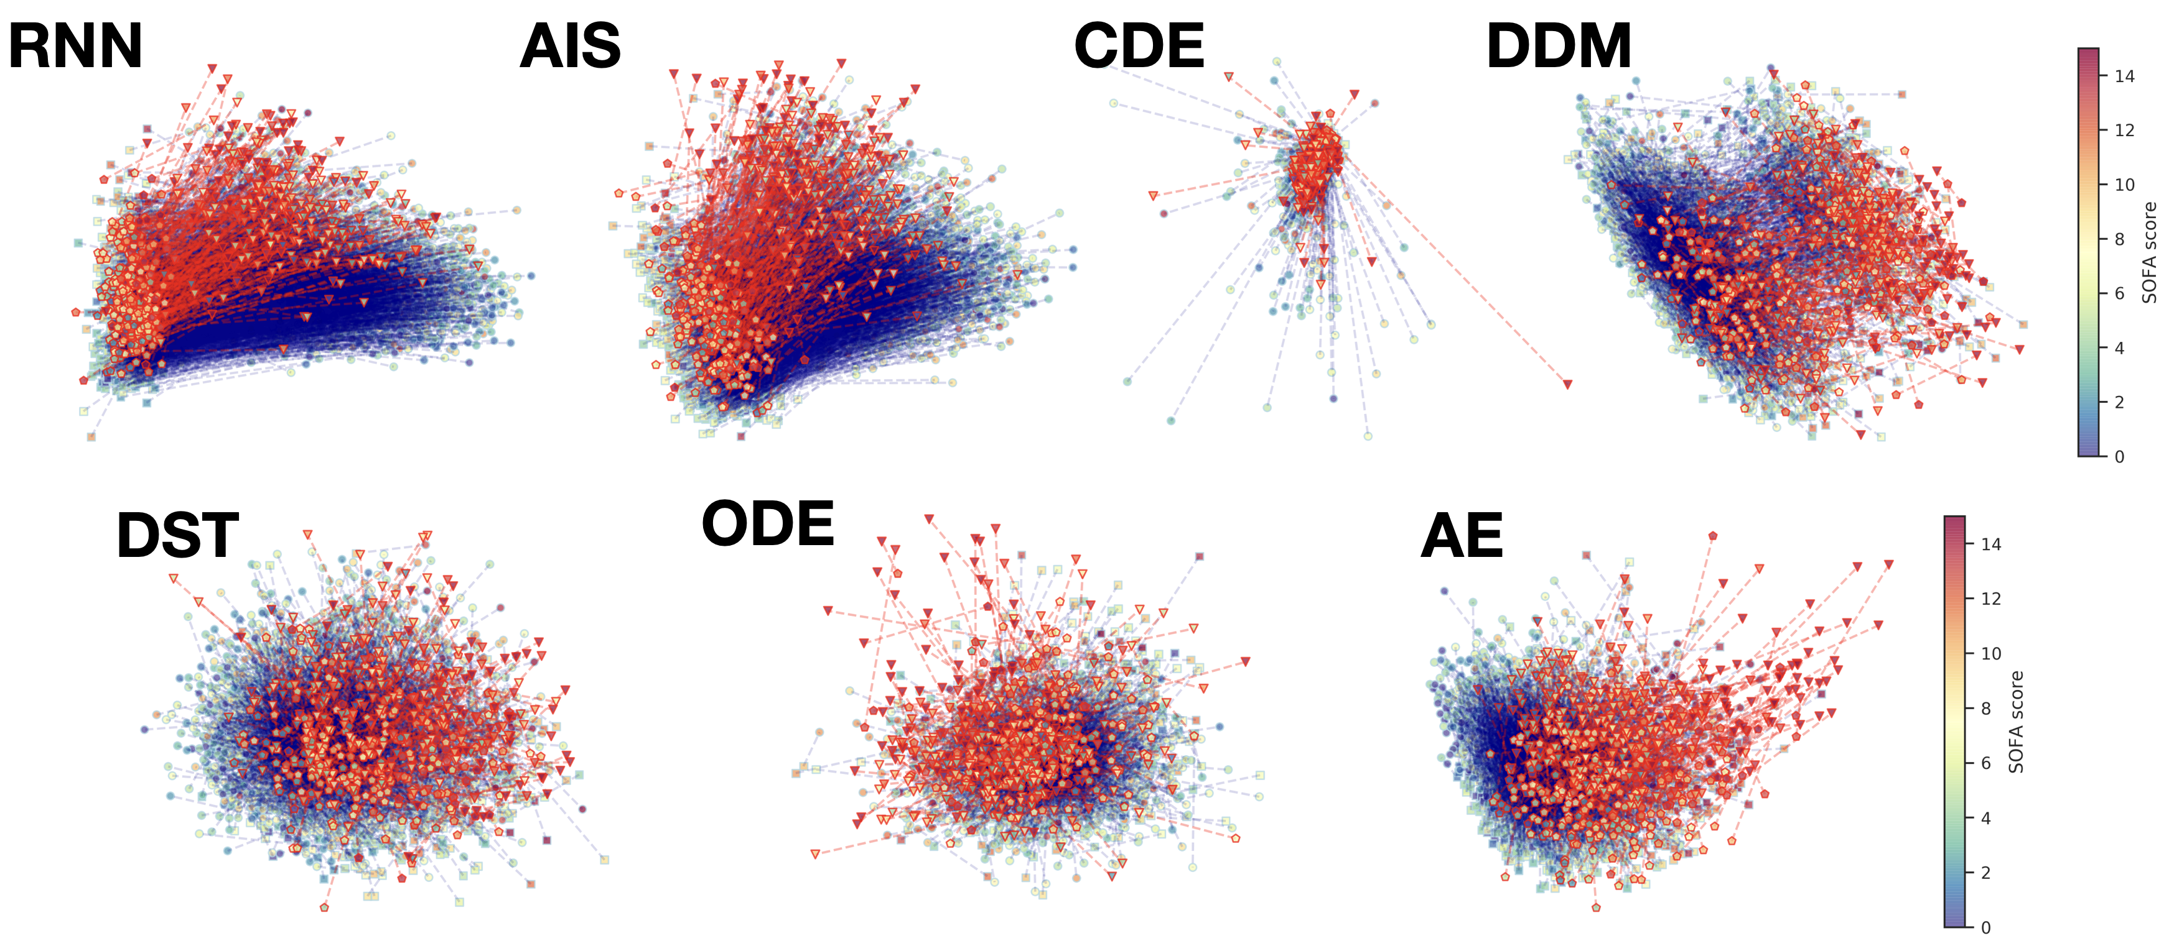
Representations learnt
RNN, AIS able to separate recovery & death cases; different algos generate different representations…
Killian, T.W., et al. "An Empirical Study of Representation Learning for Reinforcement Learning in Healthcare" ML4H (2020).

Slide 14
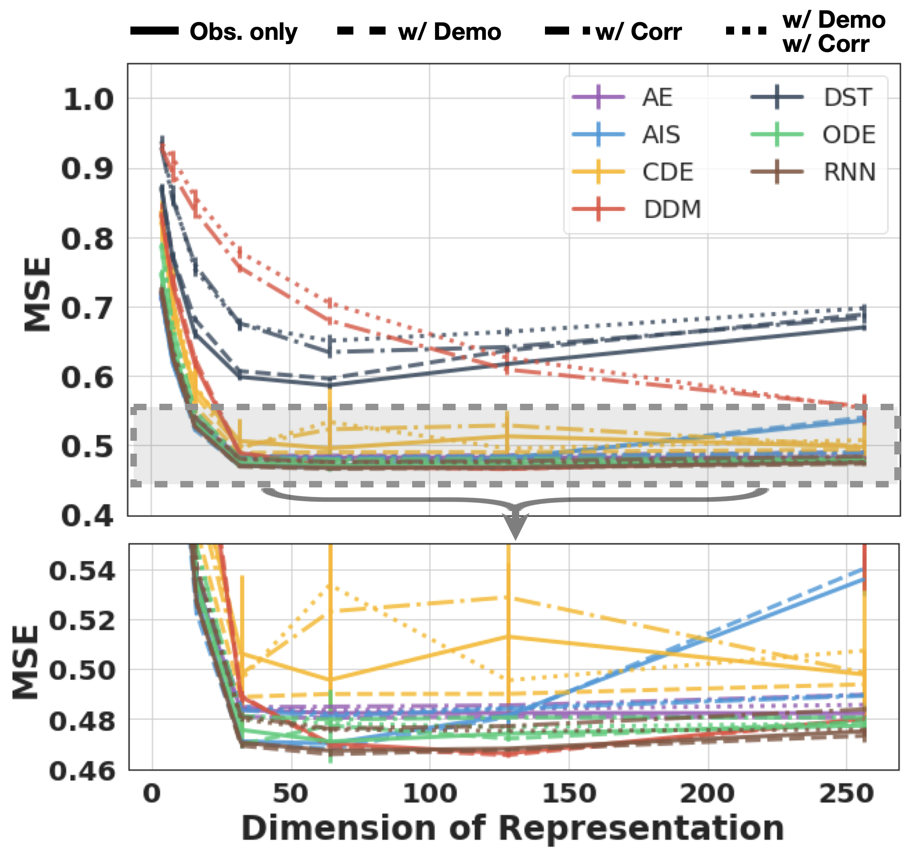
Next observation prediction
…but almost all algorithms predict next observations with similar accuracy…
Killian, T.W., et al. "An Empirical Study of Representation Learning for Reinforcement Learning in Healthcare" ML4H (2020).

Slide 15
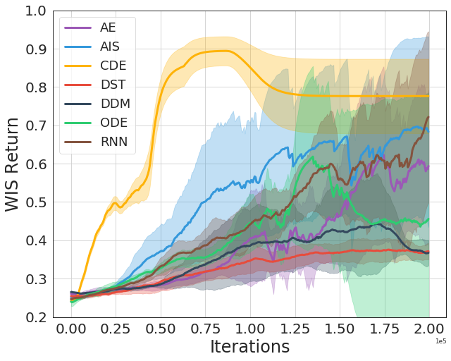
BCQ algorithm – Policy performance – overview
…which does not necessarily reflect policy performance (sparse reward also plays a role)
Killian, T.W., et al. "An Empirical Study of Representation Learning for Reinforcement Learning in Healthcare" ML4H (2020).

Slide 16
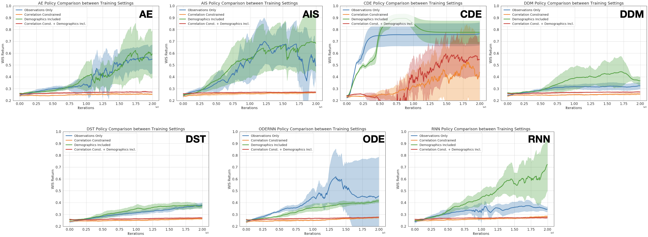
BCQ algorithm – Policy performance - under different settings
Killian, T.W., et al. "An Empirical Study of Representation Learning for Reinforcement Learning in Healthcare" ML4H (2020).

Slide 17
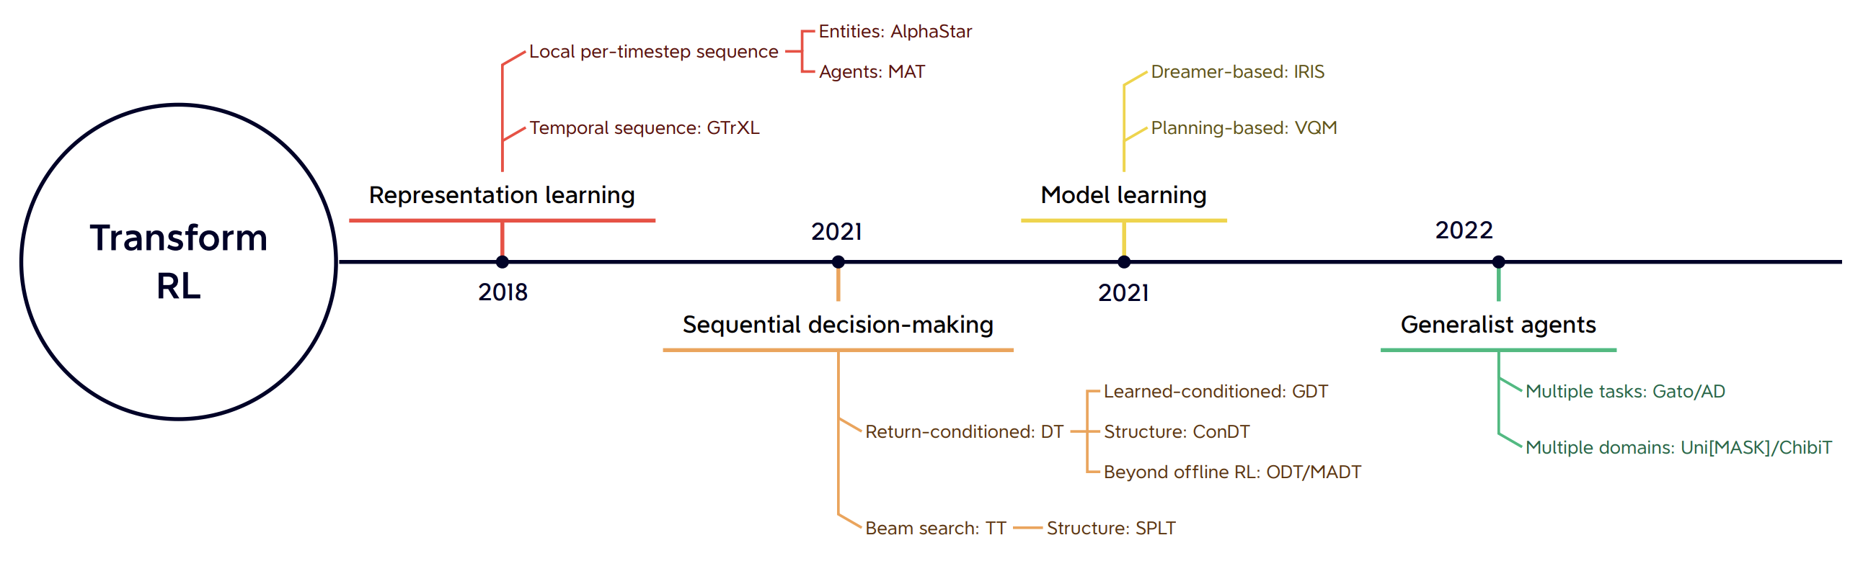
Transformers + RL: Overview

Slide 18
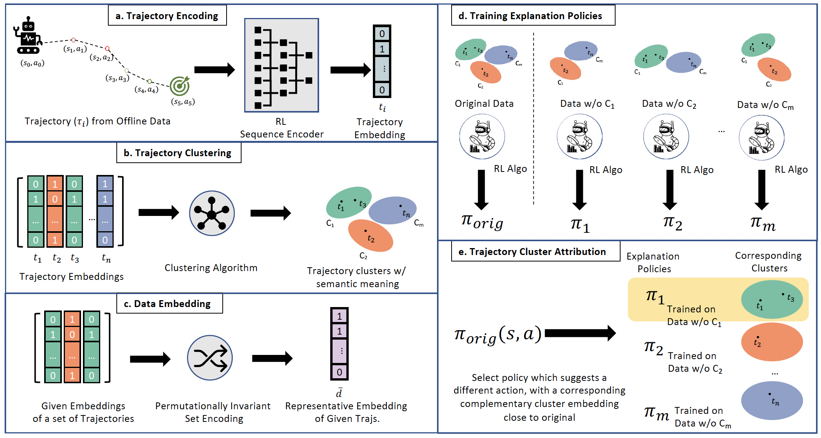
Transformers for Explainable RL
Our Team
Deshmukh, S.V., et al. ”Explaining RL Decisions with Trajectories" ICLR (2023).

Slide 19
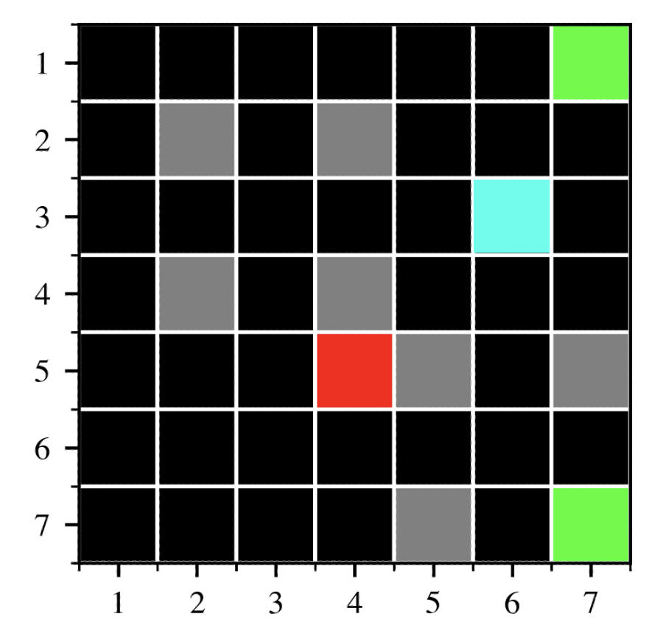
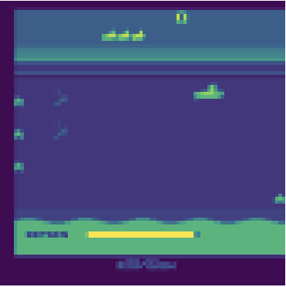
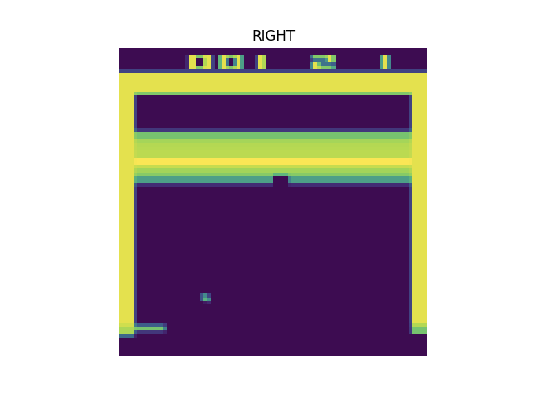
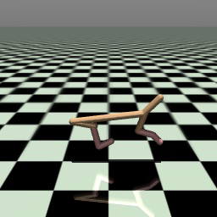
Experiments
Gridworld
Seaquest
Breakout
Half-Cheetah
RL Algorithms: SAC[1] & BCQ[2]
[1] Haarnoja et al. “Soft Actor Critic”
[2] Fujimoto et al. ”Off-policy deep RL without exploration”
Sequence Encoders: Decision Transformer[3] & Trajectory Transformer[4]
[3] Chen, Lili, et al. "Decision transformer"
[4] Janner, Michael, et al. "Offline RL as sequence modeling."
Deshmukh, S.V., et al. ”Explaining RL Decisions with Trajectories" ICLR (2023).

Slide 20
Agenda
RL with partial observability
RL with multiple agents
RL with large and dynamic action spaces

Slide 21
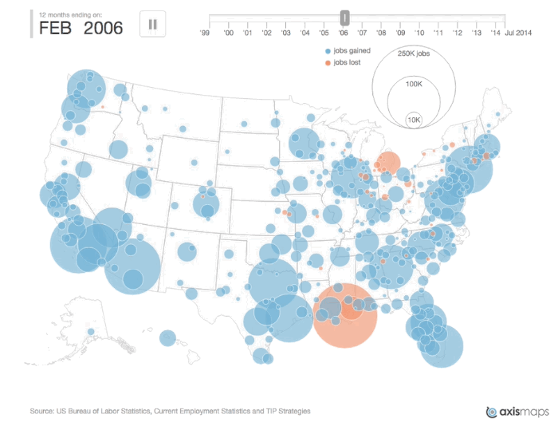
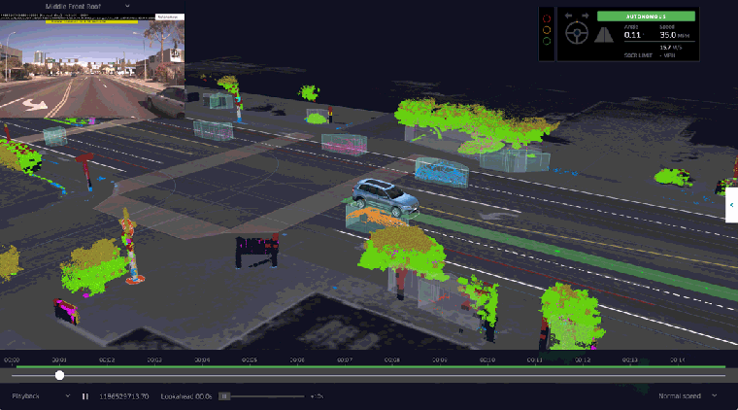
Use of digital twins/agent-based models
Wiki-definition: Agent-based Model (ABM)
A class of computational models for simulating the actions and interactions of autonomous agents (both individual or collective entities such as organizations or groups) with a view to assessing their effects on the system as a whole.
Source: https://thelastdriverlicenseholder.com/2017/09/03/waymo-and-uber-reveal-autonomous-driving-simulator/
Source:https://www.vox.com/2014/11/3/7151009/watch-the-recession-hit-the-us-in-one-terrifying-30-second-gif

Slide 22
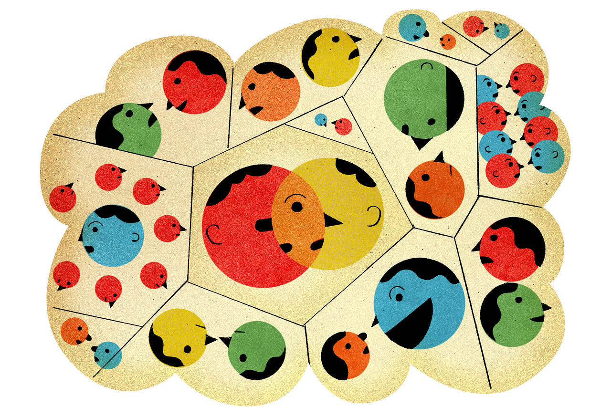
Heterogeneous populations can be modeled using Agent-based Models (ABMs)
Heterogeneous population network
ABMs are useful for:
Representing interactions of heterogeneous populations
Supporting complex, time-varying actions and interactions
But ABMs are also:
Computationally expensive
Prohibitive to implement
Difficult to configure and parameterize
Source: https://www.wsj.com/articles/a-new-crystal-ball-to-predict-consumer-and-investor-behavior-11560218820
However, practical utility of ABMs requires making them scalable, efficient and high performant

Slide 23

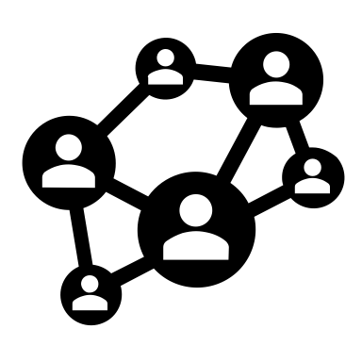


User Behavior Modeling
User Behavior
User Network
Available products/services

Slide 24





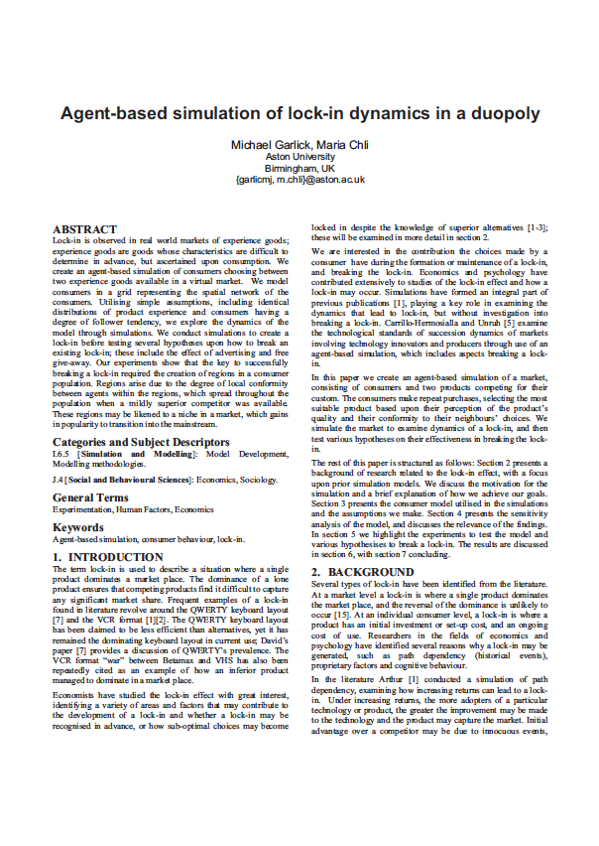
Systems Marketing: A Case Study – VHS vs Betamax
First Mover
Quality
Price
Almost similar
VHS completely dominated the market due to greater inter-user compatibility due to higher customer base after a threshold → lock-in effect can be modelled using Systems Marketing with ABMs
AAMAS 2010

Slide 25
Scale, Efficiency & Performance achieved by reimagining ABMs in ML frameworks
We do this by:
Thus, we achieve:
Bringing together our expertise in deep learning and multi-agent systems
Introduce a tensor-calculus based implementation that models local agent interactions through graph convolutions
Scale (supporting large agent populations (>100,000))
Efficiency (executing in real-time and on a GPU)
Performance (jointly utilizing diverse data sources)
Learnability (using autograd)
Our ML framework based enables faster evaluation of a large number of diverse decisions

Slide 26
Disease dynamics and networks help in COVID-19 simulations
Configurable features added to DeepABM^{[2, 3]}
Interaction networks
Disease dynamics
Interventions
Household
Occupation
Random
Multiple stages of infection
Age stratified
Diverse strains
Quarantine
Exposure notification
Testing
Vaccination
Configurable parameters to enable experts to conduct experiments with diverse scenarios
Romero-Brufau, S., et al. ” Public health impact of delaying second dose of BNT162b2 or mRNA-1273 covid-19 vaccine: simulation agent based modeling study" BMJ (2021).

Slide 27
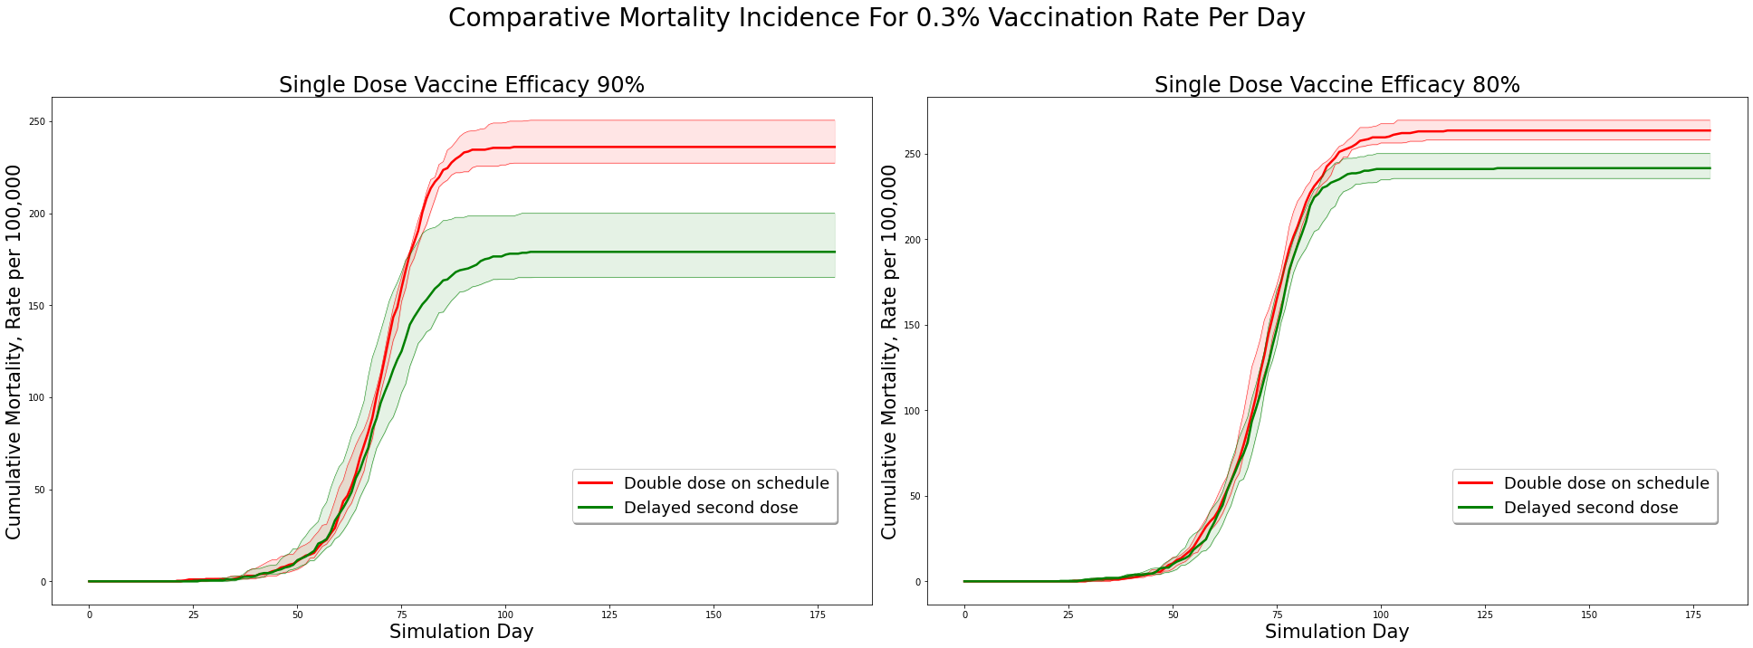
What if we delay the 2nd vaccination dose?
Under current parameter configuration, delaying second dose in favour of the first
can lead to ~20% reduction in deaths
Romero-Brufau, S., et al. ” Public health impact of delaying second dose of BNT162b2 or mRNA-1273 covid-19 vaccine: simulation agent based modeling study" BMJ (2021).
Notes:
Dr Thomas Kingsley, Mayo Clinic and PathCheck
Should we delay the 2nd dose?
Complex interaction of
a) population distribution
b) efficacy of the first dose
c) delivery rate
d) vaccination characteristics

Slide 28
RL in ABMs
RL: Agent interactively learns to maximize its expected cumulative (discounted) rewards
Observation (Transition + Observation functions)
Reward (Reward function)
Agent
Environment
Action (Policy function)
Mathematical framework: Markov decision process
Solution concept: Optimality

Slide 29


Decoupling to solve the Multi-Agent Problem
Decoupling
Minimax
Q-Learning
Competitive
Performance
Estimation
IGA, WoLF IGA, Nash Q, MADDPG
Opponent model
Common critic
Common info
Mean-field
Mean-field RL
Decoupling object
Cooperative
JAL, Team Q, Distributed Q, MADDPG, COMA
2
50
…
∞
Number of agents

Slide 30
Multi-agent Reinforcement Learning (MARL)
MARL: Each agent interactively learns to maximize its expected cumulative (discounted) rewards
Observation (Transition + Observation functions)
Reward (Reward function)
Agent 2
Agent 1
Environment
Agent 3
Action (Policy function)
Agent n
Effective environment for Agent 1
Mathematical framework: Partially observable stochastic game (POSG)
Solution concept: Equilibrium (Nash + refinements)

Slide 31
Agenda
Decision making in the real-world
RL with partial observability
RL with large and dynamic action spaces

Slide 32
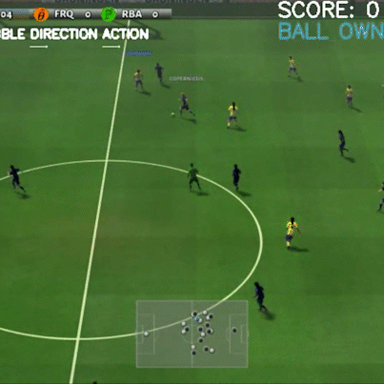
LLMs for Decision Making
Complex Strategy – Combination of passing and shooting
Sparse Reward - Success determined at the end of the pass
Partial Observability – Need not be aware of every teammates position
Our Team
A clip of our Decision-Making Agent playing football

Slide 33
Optimizing Image Generation With Behavior
How to create not just better-looking images but also “better-performing” images?
Khurana, V. et al. "Behavior Optimized Image Generation." arXiv preprint arXiv:2311.10995 (2023).

Slide 34
Behavior Optimized Image Generation
Khurana, V. et al. "Behavior Optimized Image Generation." arXiv preprint arXiv:2311.10995 (2023).

Slide 35
Behavior Optimized Image Generation - Results
Khurana, V. et al. "Behavior Optimized Image Generation." arXiv preprint arXiv:2311.10995 (2023).

Slide 36
Thanks

