Slide 1
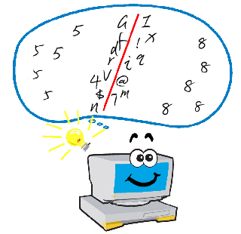
Overcoming intractability for Unsupervised Learning
Maryland Theory Day 2014
Sanjeev Arora Princeton University
Computer Science + Center for Computational Intractability
(Funding: NSF and Simons Foundation)

Slide 2
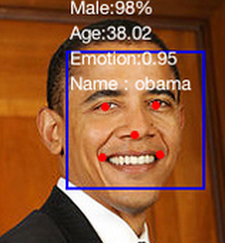

Supervised vs Unsupervised learning
Supervised: Given many photos labeled with
whether or not they contain a face, generate
labels for new photos. (STOC/FOCS: PAC learning. In ML: Support vector machines, online prediction, logistic regression, Neural nets etc…)
Unsupervised: Use google news corpus to answer analogy queries King: Queen :: Waiter : ??
Unlabeled data >> labeled data. (“Big data” world)
CMU
Notes:
NELL is a CMU system that keeps learning (infering) facts about the world in unsupervised fashion by trawling the web. Challenging to even formalize!

Slide 3
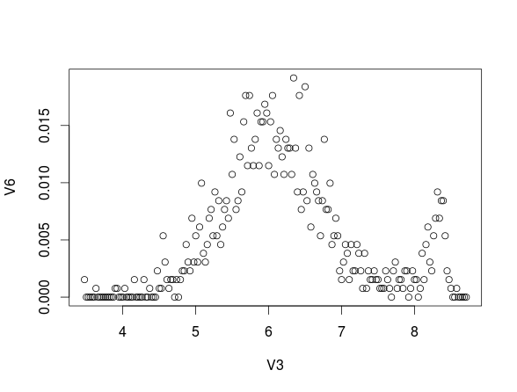
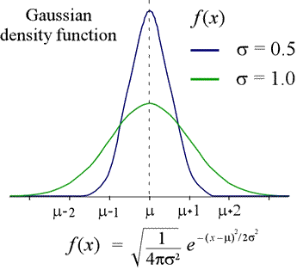
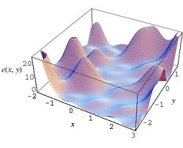
Main paradigm for unsupervised Learning
Given: Data
Assumption: Is generated from prob. distribution with small # of
parameters. (“Model”).
HMMs, Topic Models, Bayes nets, Sparse Coding, …
Learning ≅ Find good fit to parameter values (usually, “Max-Likelihood”)
Difficulty: NP-hard in many cases. Nonconvex; solved via heuristics

Slide 4
Is NP-hardness an obstacle for theory?
NP-hard instances (encodings of SAT)
New York Times corpus
(want thematic structure)
Learning
Topic Models
Tractable
subset??
(“Going beyond worst-case.”
“Replacing heuristics with algorithms with provable bounds”)

Slide 5
Example: Inverse Moment Problem
X ε R^{n} : Generated by a distribution D with vector of unknown parameters A.
For many distributions, A may in principle be determined by
these moments, but finding it may be NP-hard.
Recent progress: Can find A in poly time in many settings
under mild “nondegeneracy” conditions on A. “Tensor decomposition” [Anandkumar, Ge, Hsu, Kakade, Telgarsky 2012]
Notes:
There are distributions that are not identifiable from their moments.

Slide 6
Part 1:
“How to make assumptions and simplify problems.”
Example: Topic Modeling.
(Unsupervised Method for uncovering thematic
structure in a corpus of documents.)
Goal: Algorithm that runs (under clearly specified conditions on input) in time polynomial in all relevant parameters, and produces solution of specified quality/accuracy.

Slide 7

“Bag of words” Assumption in Text Analysis
.
Banana 3
.
.
Snow 1
Soccer 0
.
.
Walnut 5
.
=
=
words
Document Corpus = Matrix (i^{th} column = i^{th} document)
Notes:
Bag of words
Doc1 = ½ politics ½ economics 2/3 sports + 1/3 entertainment
Hidden variable

Slide 8
Hidden Variable Explanation
Document = Mixture of Topics
.
Banana 3
.
.
Snow 1
Soccer 0
.
.
Walnut 5
.
3%
.
.
0
0
.
.
5%
.
0
.
.
4%
0
.
.
0
= 0.8 + 0.2

Slide 9
Hidden Variable explanation (geometric view)
Topic 1
0.4 x Topic 1 + 0.3 x Topic 2 + 0.2 x Topic 3
Topic 2
Topic 3

Slide 10
Nonnegative Matrix Factorization (NMF) [Lee Seung’99]
Given: Nonnegative n x m matrix M (all entries ≥ 0)
M
A
W
=
NP-hard [Vavasis 09]
Want: Nonnegative matrices A (n x r) and W (r x m), s.t. M = AW. (Aside: Given W, easy to find A via linear programming.)
Applications: Image Segmentation, Info Retrieval, Collaborative filtering, document classification.

Slide 11
“Separable” Topic Matrices
.
.
.
.
0
.
.
.
.
.
.
Banana 0
.
.
Snow 4%
Soccer 0
.
.
Walnut 0
.
.
0
.
.
0
8%
.
.
0
.
.
.
.
.
0
.
.
.
.
.

Slide 12
Geometric restatement of NMF (after some trivial rescaling)
Given n nonnegative vectors (namely, rows of M)
Find r-dimensional simplex with nonnegative vertices that contains all. (rows of W = vertices of this simplex;
Rows of A = convex combinations)
Separable → Vertices of simplex appear among rows of M

Slide 13
Finding Separable Factorization [A,Ge, Kannan, Moitra STOC’12]
Algorithm: Remove a row, test if it is in the convex hull of other rows
Case 1: Inside Row
Can be represented by other rows
Case 2: Row at a vertex
Cannot be represented by other rows
“Robustly Simplicial”
Important: Procedure can tolerate “noisy data” if simplex is “not too flat.”
Notes:
Describe algorithms first.

Slide 14
Learning Topic Models [Papadimitriou et al.’98, Hoffman’99, Blei et al.’03]
M
A
Sampled from columns of A
W
Max-likelihood solution is NP-hard for adversarial data, even for r=2 (AGM’12)
Topic matrix A (n x r) arbitrary, nonnegative. Stochastic W (r x m). Columns iid from unknown distrib.
Given: M (n x m). i^{th} column has 100 samples from distribution given by i^{th} column of AW.
Goal: Find A and parameters of distribution that generated W.
Popular choice of distribution: Dirichlet. (“LDA” Blei, Jordan, Ng ‘03.)

Slide 15
The main difficulty (why LDA learning ≠ NMF)
.
Banana 0.03
.
.
Snow 0.02
Soccer 0
.
.
Walnut 0.07
.
Banana 3
.
.
Snow 1
Soccer 0
.
.
Walnut 5
NMF
LDA
X
Small sample is poor representation of distribution; cannot be treated as “noise”.

Slide 16
Reducing topic modeling to NMF [A, Ge , Moitra FOCS’12]
M
A
Sampled from
W
Word-word co-occurence matrix = MM^{T} (2nd Moment) ≈ AWW^{T}A^{T} (up to scaling)
= AW_{new} where W_{new} = WW^{T}A^{T}
Can factorize using noise tolerant NMF algorithm!
Important: Need for separability assumption removed by [Anandkumar, Hsu, Kakade’12] (slower algorithm).
Notes:
Anandkumar et al result uses 3rd moments and is not as practical.

Slide 17
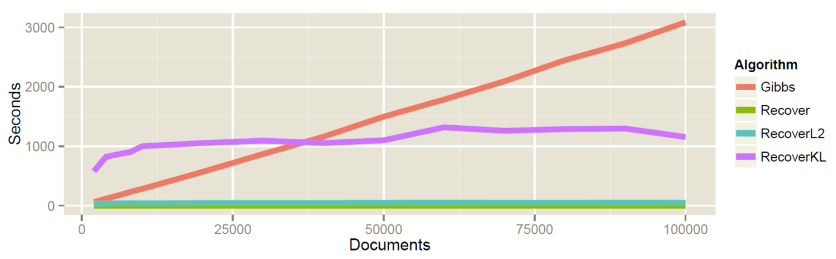
Empirical Results [A, Ge, Halpern, Mimno, Moitra, Sontag, Wu, Zhu ICML’13]
50x faster on realistic data sizes.
Comparable error on synthetic data
Similar quality scores on real-life data (NYT corpus).
Works better than theory can explain.

Slide 18
Part 2:
“The unreasonable effectiveness of nonconvex heuristics.”

Slide 19
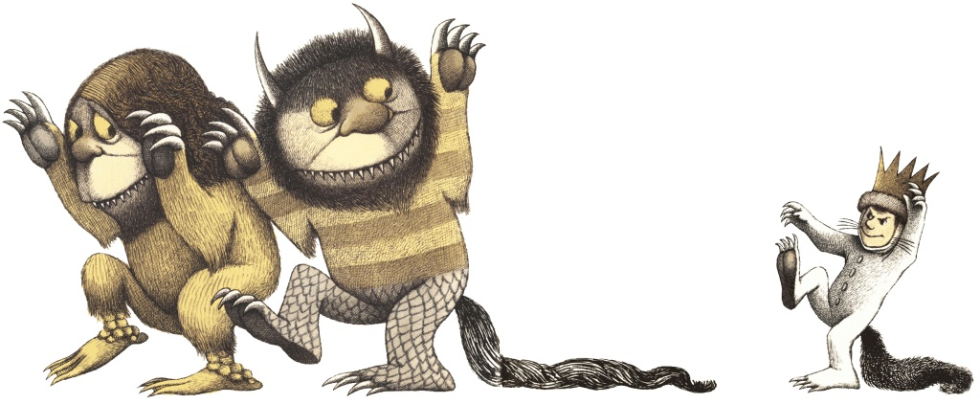
Real life instances must have special structure… Shrug..
Heuristics
Theorist
Branch & Bound for integer programming, DPLL-family for SAT solving/Software verification.
Markov Chain Monte Carlo for counting problems (#P),
Belief propagation for Bayes Nets,..

Slide 20

ML : Great setting to study heuristics
Clean models of how data was generated
Heuristics so “natural” that even natural systems use them (e.g., neurons).
Theorists understand hardness; hence well-equipped to identify assumptions that provably simplify the problem.

Slide 21
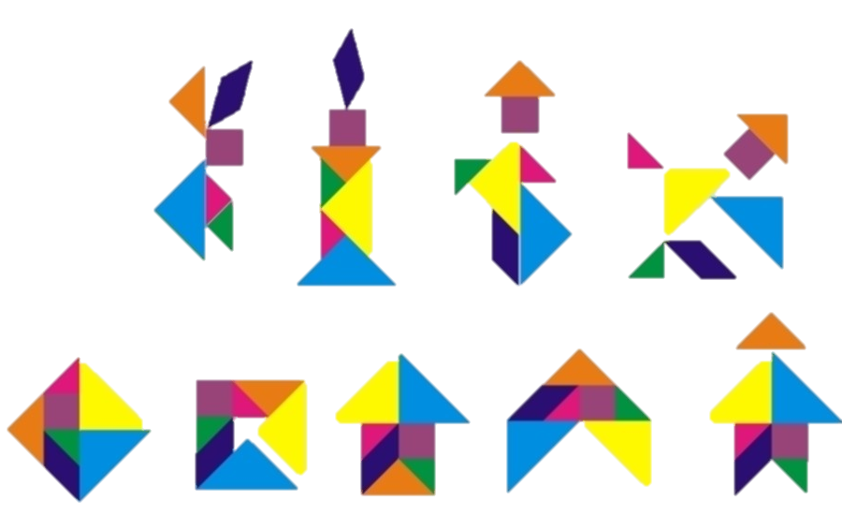
Example 1: Dictionary Learning (aka Sparse Coding)
Simple “dictionary elements” build complicated objects.
Each object composed of small # of dictionary elements (sparsity assumption)
Given the objects, can we learn the dictionary?
Notes:
many things can be represented by sparsely combination of dictionary elements.
goal: try to learn the “dictionary” (and the representation)

Slide 22
Dictionary Learning: Formalization
Given samples of the form Y = AX
X is unknown matrix with sparse columns; m X S
A (dictionary): n x m, unknown. Has to be learnt
Interesting case: m > n (overcomplete)
Assumption: Columns of X iid from suitable distrib.
Samples
Dictionary Element
Sparse Combination
……
=
……
n
Y
m
A
X

Slide 23
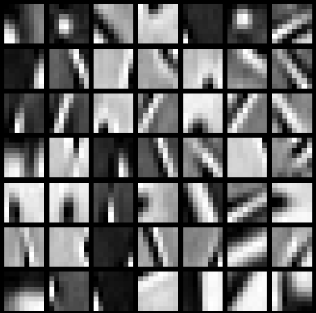
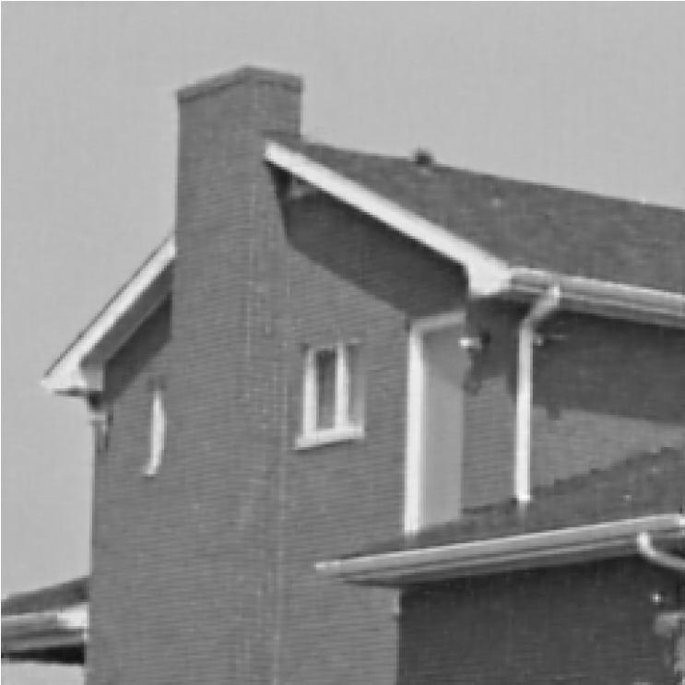
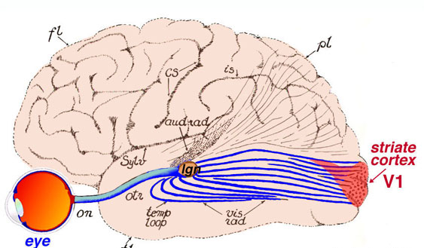
Why dictionary learning? [Olshausen Field ’96]
dictionary learning
Gabor-like Filters
natural image patches
Other uses: Image Denoising, Compression, etc. Good example of “neural algorithm”
Notes:
Olshausen Field, visual cortex, Gabor filters. Suggest effectiveness in classification

Slide 24
“Energy minimization” heuristic
Nonconvex; heuristics use approximate gradient descent (“neural” algorithm)
[A., Ge,Ma,Moitra’14] Finds approx. global optimum in poly time. (updates will steadily decrease distance to optimum)
Assumptions:
unknown A is “incoherent” (columns have low pairwise inner product) and has low matrix norm.
X has pairwise indep. coordinates; is √n-sparse.
Notes:
\min_{B, x_1, x_2, \ldots,} \sum_i ||y_i - B x_i||_2^2 \\
\mbox{ $x_i$'s are $k$-sparse}\\

Slide 25
Builds upon recent progress in Dictionary Learning
Poly-time algorithm when dictionary is full-rank (m =n); sparsity of X < √n. (Uses LP; not noise-tolerant) [Spielman, Wang, Wright, COLT’12]
Polytime algorithm for overcomplete case (m > n) . A has to be “incoherent;” sparsity << √n [A., Ge, Moitra’13], [Agarwal, Anankumar, Netrapalli’13]
New algorithms that allow almost-dense X [A., Bhaskara, Ge, Ma’14], [Barak, Kelner, Steurer’14]
Alternating minimization works in poly time. [A., Ge, Ma, Moitra ‘14]
Crucial idea in all: Stability of SVD/PCA; allows digging for “signal”

Slide 26
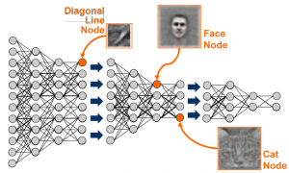
Example 2: Deep Nets
Deep learning: learn multilevel representation of data (nonlinear)
(inspired e.g. by 7-8 levels of
visual cortex)
Successes: speech recognition, image recognition, etc.
[Krizhevsky et al NIPS’12.] 600K variables; Millions of training images. 84% success rate on IMAGENET (multiclass prediction). (Current best: 94% [Szegedy et al’14])
1 iff Σ_{i} w_{i} x_{i} > Θ
w₁
w_{n}
x₁
x₂
x_{n-1}
x_{n}
Notes:
Aside: Exact nonlinearity is not going to be important.

Slide 27
Deep Nets at a glance
Classifier
Layer-L
Features
“Hierarchy of features; each layer defined using thresholded weighted sums of previous layers”
…Neural Nets….
Layer-1
Features
Observed Variables

Slide 28
Understanding “randomly-wired” deep nets
Inspirations: Random error correcting codes, expanders, etc…
[A.,Bhaskara, Ge, Ma, ICML’14] Provable learning in Hinton’s generative model. Proof of hypothesized “autoencoder” property.
No nonlinear optimization.
Combinatorial algorithm that leverages correlations.
“Inspired and guided” Google’s leading deep net code [Szegedy et al., Sept 2014]

Slide 29
Part 3:
“Linear Algebra++”
Mathematical heart of these ML problems (extends classical Linear Algebra, problems usually NP-hard)

Slide 30
Classical linear algebra
Solving linear systems: Ax =b
Matrix factorization/rank M =AB; (A has much fewer columns than M)
Eigenvalues/eigenvectors. (“Nice basis”)

Slide 31
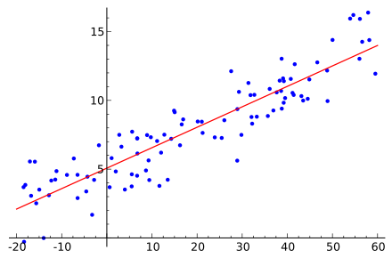
Classical Lin. Algebra: least square variants
Solving linear systems: Ax =b
Matrix factorization/rank M = AB; (A has much fewer columns than M)
(“PCA” [Hotelling, Pearson, 1930s])
(“Finding a better basis”)

Slide 32
Semi-classical linear algebra
Can be solved via LP if A is random/incoherent/RIP (Candes,Romberg, Tao;06) (“l₁-trick”)
Goal in several machine learning settings: Matrix factorization analogs of above: Find M =AB with such constraints on A, B (NP-hard in worst case)
(Buzzwords: Sparse PCA, Nonnegative matrix factorization, Sparse coding, Learning PCFGs,…)
Notes:
\min_x \|Ax -b\|^2 \quad \mbox{(Least squares fit)}
Ax = b \quad \mbox{s.t.}~x \geq 0. \quad\mbox{(LP)}

Slide 33

Matrix factorization: Nonlinear variants
Given M produced as follows: Generate low-rank A, B, apply nonlinear operator f on each entry of AB.
Goal: Recover A, B “Nonlinear PCA”[Collins, Dasgupta, Schapire’03]
Deep Learning | f(x) = sgn(x) or sigmoid(x)
Topic Modeling | f(x) = output 1 with Prob. x . (Also, columns of B are iid.)
Matrix completion | f(x) = output x with prob. p, else 0
Possible general approach? Convex relaxation via nuclear norm minimization [Candes,Recht’09] [Davenport,Plan,van den Berg, Wooters’12]

Slide 34
Concluding Thoughts
Can circumvent intractability by novel assumptions between avg case and worst case): e.g., separability; randomly wired neural nets, etc.
Thinking of provable bounds often leads to new kinds of algorithms. (Sometimes can analyse existing heuristics ..)
Algorithms with provable bounds can be practical, or give new insights.
Time to rethink ugrad/grad algorithms courses? An attempt: http://www.cs.princeton.edu/courses/archive/fall13/cos521/
THANK YOU

Slide 35
Part 4:
“Some favorite open problems/research directions”

Slide 36
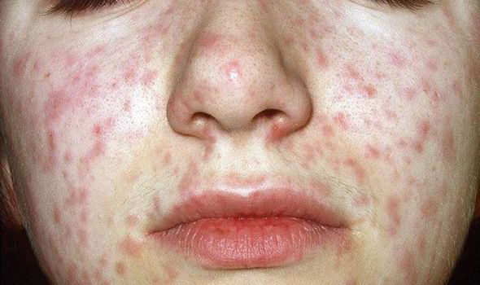
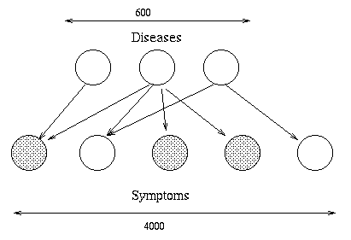
Inference via Bayes Nets [Pearl’88]
Your symptoms: fever + red spots.
Probability that you have measles??
Desired: Posterior
Pr[disease| symptom s₁, s₂,..]
#P-complete, currently estimated via heuristics (MCMC, Variational Inf.,
Message Propagation..)
Bayes net succinctly describes
Pr[symptom| diseases d₁, d₂,..]
Realistic assumptions that simplify?

Slide 37
Provable versions of Variational Inference? (reference: [Jaakola, Jordan] survey)
Very general setting: Prob. Distribution p(x, z) (explicit formula)
z is observed. Estimate Bayesian Posterior p(x|z) (#P-hard!)
Method: Hypothesize simple functional form q(x, v) where v is a small set of “variational parameters.” (akin to Mean Field Assumption from statistical physics)
Minimize KL(q(x, v) || p(x|z)) using a series of “simplifications”
Suggested 1st step: Analyse V.I. in settings where we already have provable algorithms: Topic Models, Dictionary Learning, HMMs etc.

Slide 38
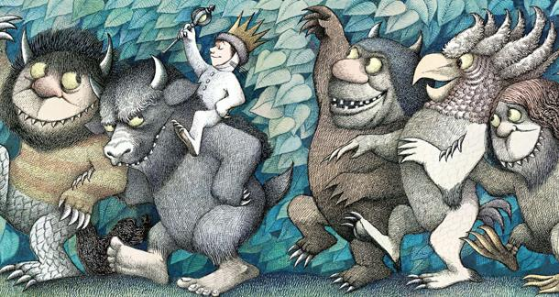
A hope for the future….
Variational Inference
Back Propagation
MCMC
Variational Bayes

