Slide 1
Provable Submodular Minimization using Wolfe’s Algorithm
Deeparnab Chakrabarty (Microsoft Research)
Prateek Jain (Microsoft Research)
Pravesh Kothari (U. Texas)

Slide 2
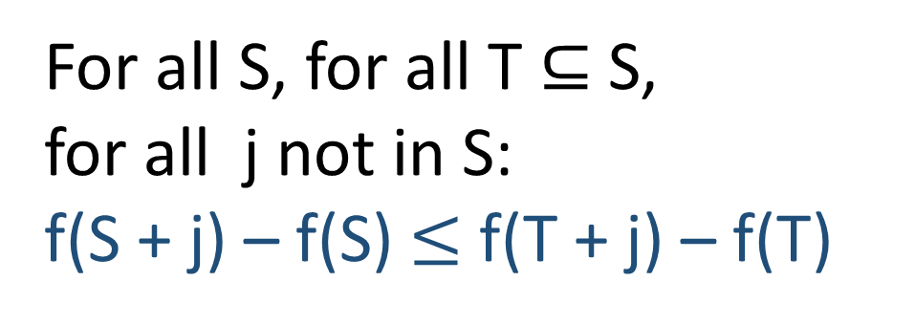
Submodular Functions
f : Subsets of {1,2,..,n} → integers
Diminishing Returns Property.
T
For all S, for all T $⊆$S, for all j not in S:
f(S + j) – f(S) $≤$ f(T + j) – f(T)
S
f(S+j) – f(S)
T
j
f(T+j) – f(T)
f may or may not be monotone.

Slide 3
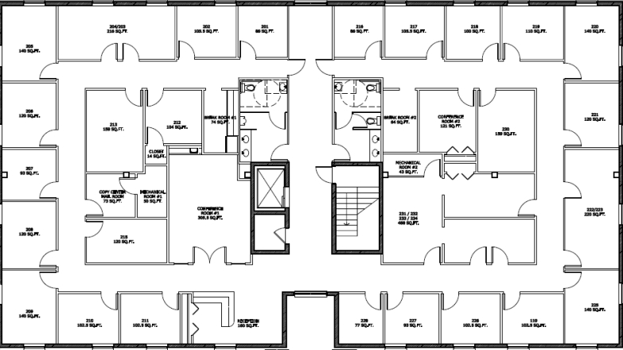


Sensor Networks
j
1
3
2
Universe: Sensor Locations. f(A) = “Area covered by sensors”

Slide 4
Telecomm Networks
Biology
Economics
Information Theory
Computer Vision
Submodularity
Everywhere
Probability
Document
Summarization
Machine
Scheduling
Speech
Processing

Slide 5
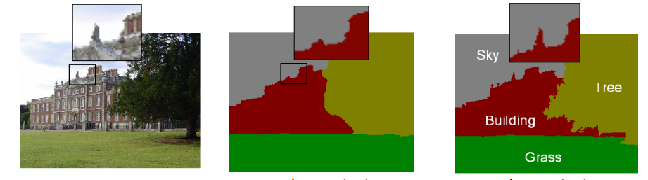
Image Segmentation
Labelling
“Energy” function
Observed Image
X = arg min E(X|D)
Energy minimization done via
reduction to submodular
function minimization.
(Boykov, Veksler, Zabih 2001) (Kolmogorov Boykov 2004) (Kohli, Kumar, Torr 2007) (Kohli Ladicky Torr 2009)

Slide 6
Submodular Function Minimization
Find set S which minimizes f(S)
P Ellipsoid
Combinatorial
Poly
Current Best
NP∩ co-NP.
1970 Edmonds
1981 Grotschel Lovasz
Schrijver
2001
Iwata
Fleischer
Fujishige
+
Schrijver
2006
Orlin
O(n⁵ T_{f} + n⁶)
1976
Wolfe’s Projection Heuristic
Time taken to evaluate f.
1984
Fujishige’s
Reduction
To SFM
Fujishige-Wolfe Heuristic for SFM.

Slide 7
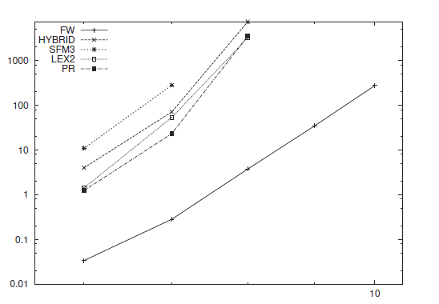
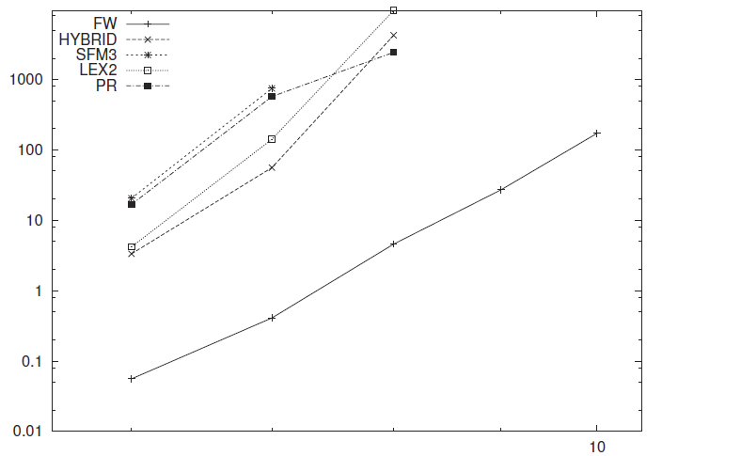
Theory vs Practice
Running time (log-scale)
#vertices: power of 2
#vertices: power of 2
Cut functions from DIMACS Challenge
(Fujishige, Isotani 2009)

Slide 8

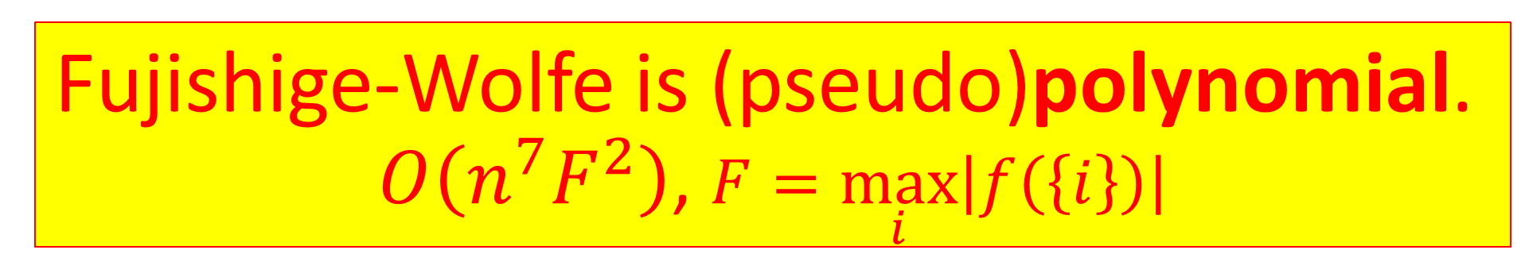
Is it good in theory?
Theoretical guarantee so far
$2^{{O(n}^{2})}$
Today
Fujishige-Wolfe is (pseudo)polynomial.
$O\left(n^{7}F^{2}\right)$, $F=\max_{i}\left|f\left(\left\{i\right\}\right)\right|$

Slide 9
Fujishige-Wolfe Heuristic
Fujishige Reduction. Submodular minimization reduced to finding nearest-to-origin point (i.e., a projection) of the base polytope.
Wolfe’s Algorithm. Finds the nearest-to-origin point of any polytope. Reduces to linear optimization over that polytope.

Slide 10
Our Results
First convergence analysis of Wolfe’s algorithm for projection on any polytope. How quickly can we get within ε of optimum? (THIS TALK)
Robust generalization of Fujishige Reduction. When small enough, ε-close points can give exact submodular function minimization.

Slide 11
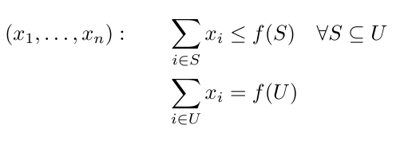
Base Polytope
Submodular
function f
B_{f}
Linear Optimization in almost linear time!

Slide 12
Fujishige’s Theorem
B_{f}
x*
0
If x* is the closest-to-origin point of B_{f} , then A = {j : x*_{j} ≤ 0} is a minimizer of f.

Slide 13
A Robust Version
Let x satisfy ||x-x*|| ≤ ε.
Can read out a set B from x such that: f(B) ≤ f(A) + 2nε
B_{f}
x*
x
0
If f is integral, ε < 1/2n implies exact SFM.

Slide 14

0
Wolfe’s Algorithm: Projection onto a polytope

Slide 15
Geometrical preliminaries
Convex Hull: conv(S)
Finding closest-to-origin point on aff(S) is easy Finding it on conv(S) is not.
Affine Hull: aff(S)

Slide 16
Corrals
Set S of points s.t. the min-norm point in aff(S) lies in conv(S).
Trivial Corral
Corral
Not a Corral

Slide 17
Wolfe’s algorithm in a nutshell
Moves from corral to corral till optimality.
In the process it goes via “non-corrals”.

Slide 18
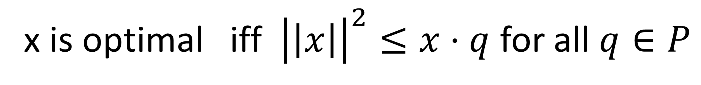
Checking Optimality
x
x*
Not Optimal
Optimal
x is optimal iff ${\left|\left|x\right|\right|}^{2}≤x⋅q$ for all $q∈P$

Slide 19
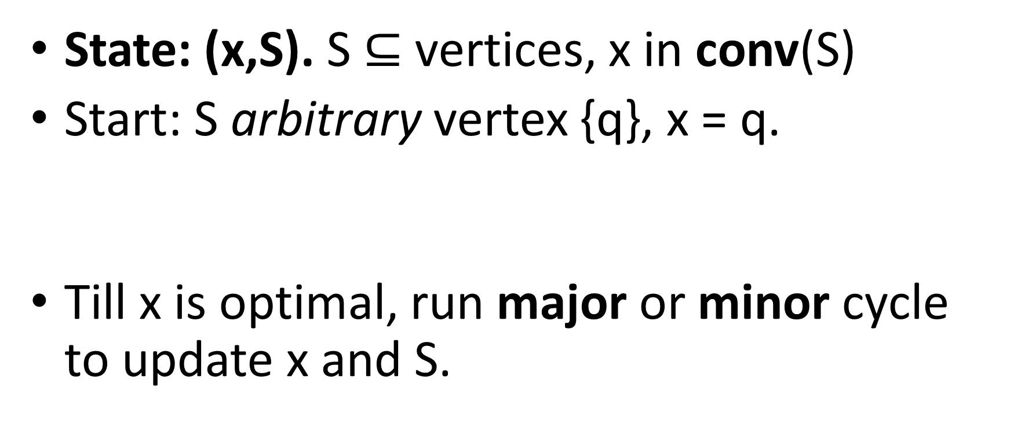
Wolfe’s Algorithm: Details
State: (x,S). S $⊆$vertices, x in conv(S)
Start: S arbitrary vertex {q}, x = q.
Till x is optimal, run major or minor cycle to update x and S.

Slide 20
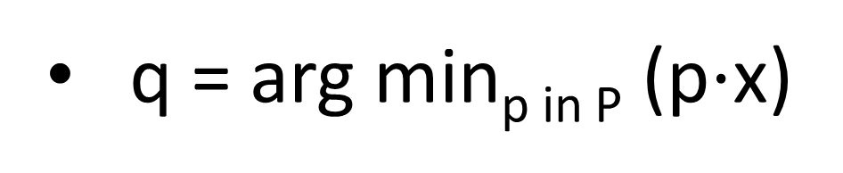
If S is a corral: Major Cycle
x = min norm point in aff(S).
q = arg min_{p in P} (p$⋅$x)
x
S = S + q.
q
Major cycle increments |S|.

Slide 21
If S is not a corral: Minor Cycle
y = min-norm point in aff(S)
x_{old}
x = pt on [y,x_{old}] ∩ conv(S) closest to y
x
Remove irrelevant points from S.
y
Minor cycle decrements |S|.

Slide 22
Summarizing Wolfe’s Algorithm
State: (x,S). x lies in conv(S).
Each iteration is either a major or a minor cycle.
Linear Programming and Matrix Inversion.
Major cycles increment and minor cycles decrement |S|.
In < n minor cycles, we get a major cycle, and vice versa.
Norm strictly decreases. Corrals can’t repeat. Finite termination.

Slide 23
Our Theorem
For any polytope P, for any ε > 0, in O(nD²/ ε²) iterations Wolfe’s algorithm returns a point x such that ||x – x*|| ≤ ε where D is the diameter of P.
For SFM, the base polytope has diameter D² < nF².

Slide 24
Outline of the Proof
Significant norm decrease when far from optimum.
Will argue this for two major cycles with at most one minor cycle in between.

Slide 25
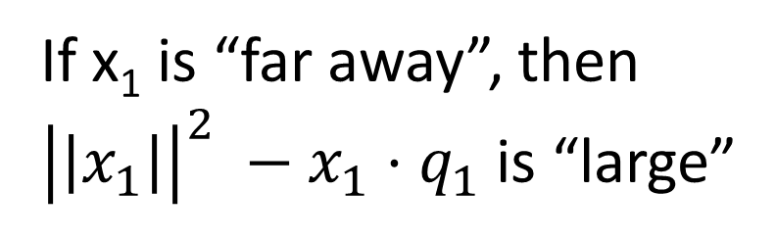
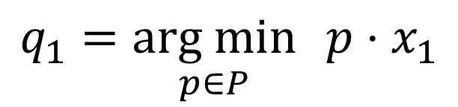
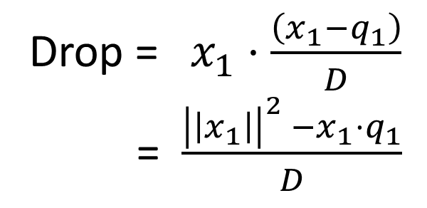
Two Major Cycles in a Row
Drop
x₂
q₁
q₁
x₁
x₁
$$q_{1}=\underset{p∈P}{arg min}{{p⋅x}_{1}}$$
Drop = $x_{1}⋅\frac{\left(x_{1}−q_{1}\right)}{D}$
= $\frac{{\left|\left|x_{1}\right|\right|}^{2} −x_{1}⋅q_{1}}{D}$
If x₁ is “far away”, then ${\left|\left|x_{1}\right|\right|}^{2} −x_{1}⋅q_{1}$ is “large”

Slide 26
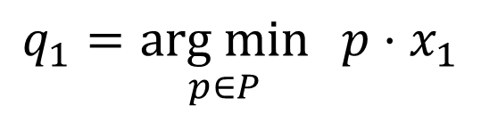
Major-minor-Major
x₁
x₁
x₂
q₁
Corral
$$q_{1}=\underset{p∈P}{arg min}{{p⋅x}_{1}}$$
aff(S + q₁) is the whole 2D plane. Origin is itself closest-to-origin

Slide 27
Major-minor-Major
x₁
x₁
x₁
x₂
x₂
x₃
q₁
q₁
Corral
Corral
Either x₂ “far away” from x₁ implying ||x₁||² - ||x₂||² is large.
Or, x₂ “behaves like” x₁, and ||x₂||² - ||x₃||² is large.

Slide 28
Outline of the Proof
Significant norm decrease when far from optimum.
Will argue this for two major cycles with at most one minor cycle in between.
Simple combinatorial fact: in 3n iterations there must be one such “good pair”.

Slide 29
Take away points.
Analysis of Wolfe’s algorithm, a practical algorithm.
Can one remove dependence on F?
Can one change the Fujishige-Wolfe algorithm to get a better one, both in theory and in practice?

Slide 30
Thank you.

