Slide 1
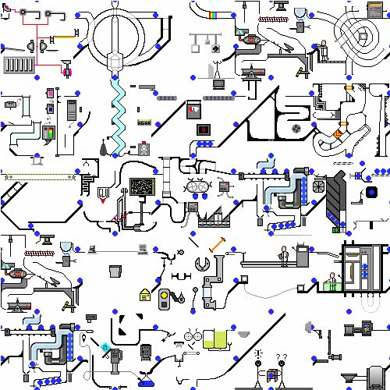


The Geometry of Machine Learning Problems
Bob Williamson
Bob.Williamson@nicta.com.au
Skype: bobwilliamson1962
http://users.cecs.anu.edu.au/~williams/NMI

Slide 2
Technologies help us do stuff
They are a means to an end
Machine Learning is a technology
Machine Learning can learn
from older technologies

Slide 3
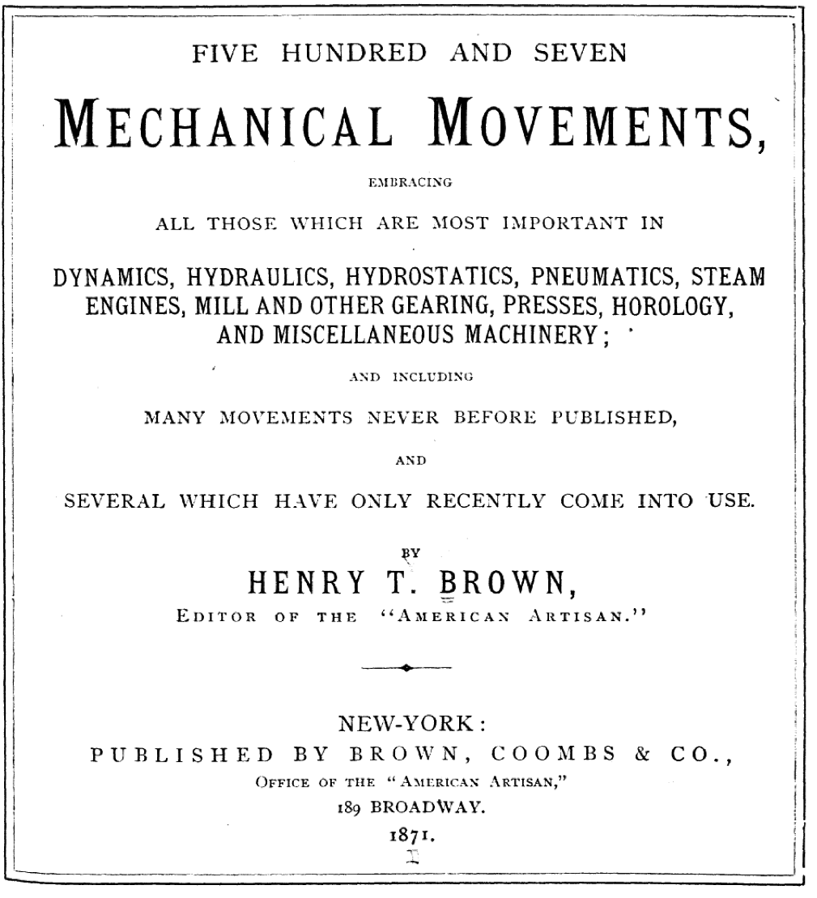
Systematization of machines

Slide 4
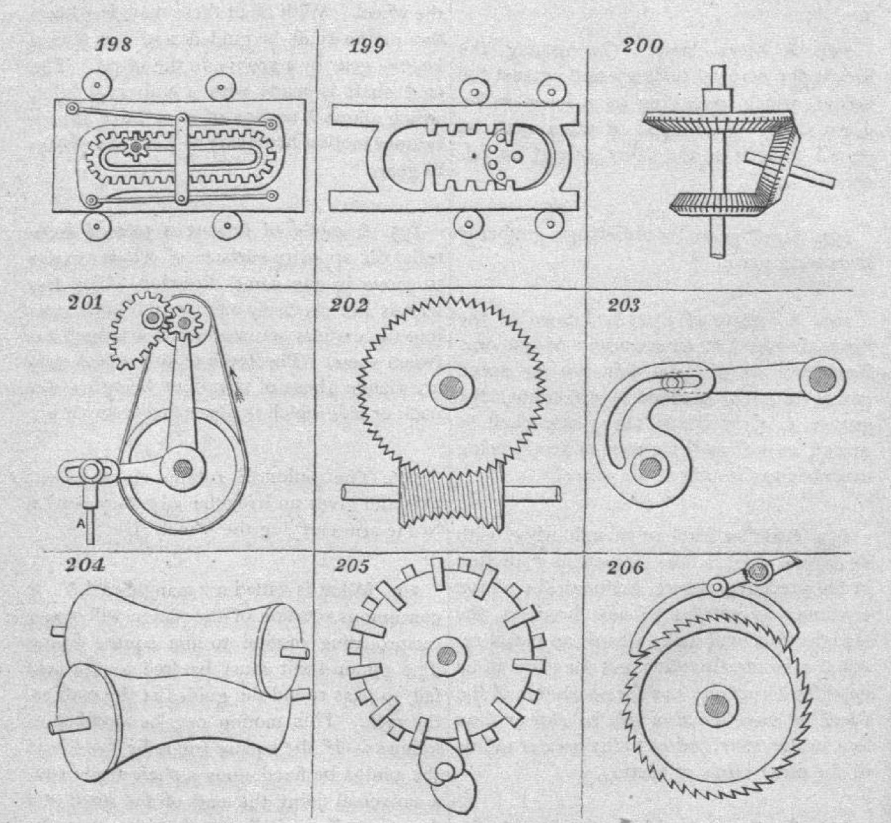
…via geometry!

Slide 5
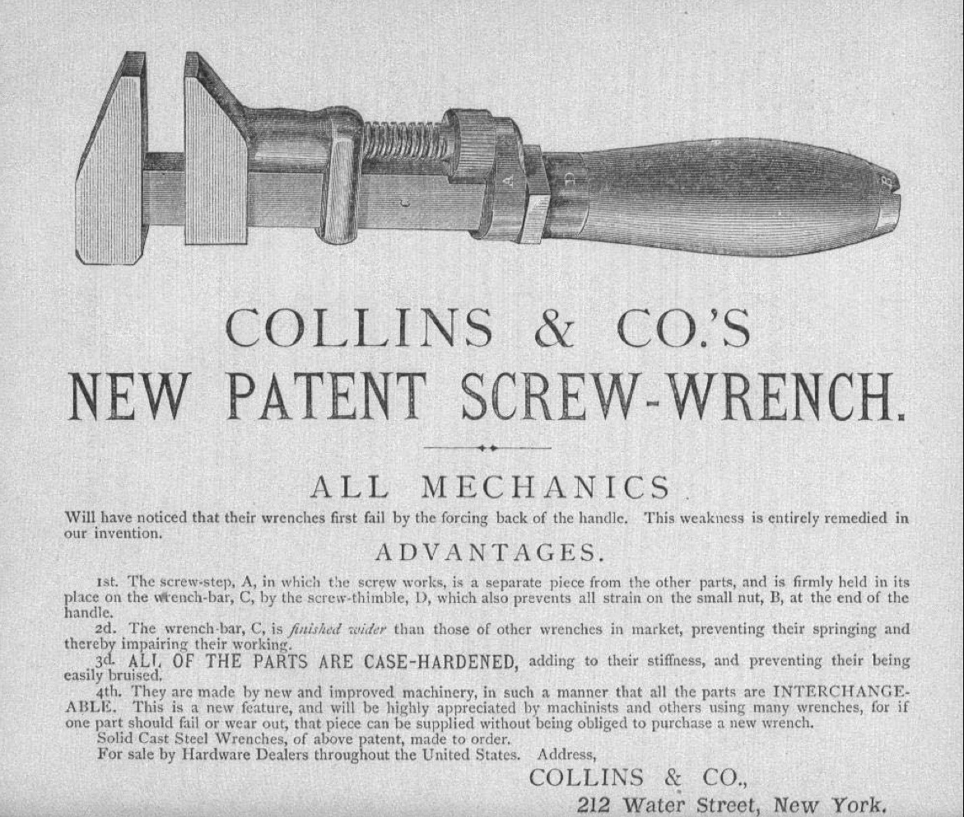

Slide 6
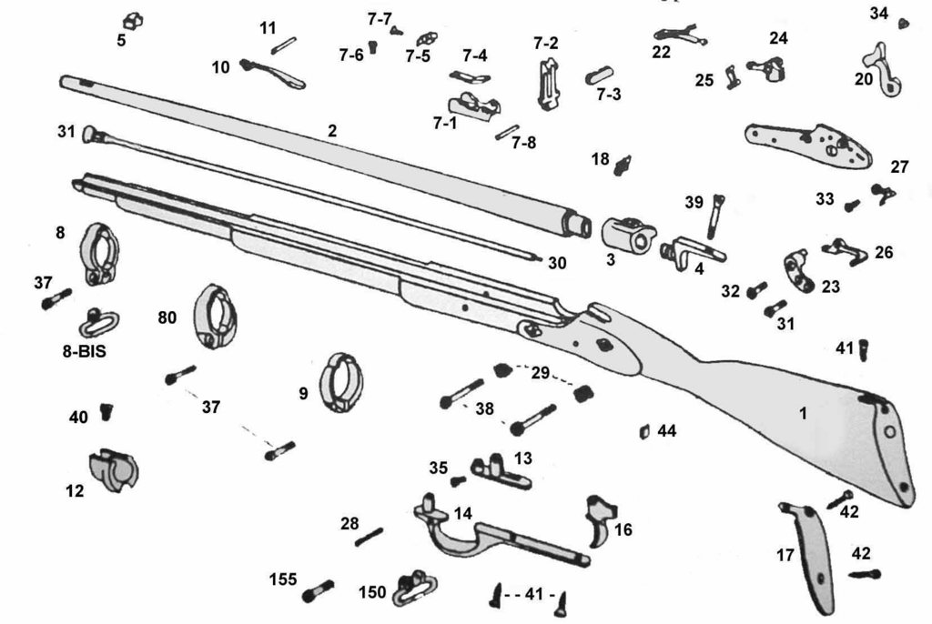
Compositionality: interchangeable parts

Slide 7
Nowadays it is taken for granted at least for some types of machines…

Slide 8
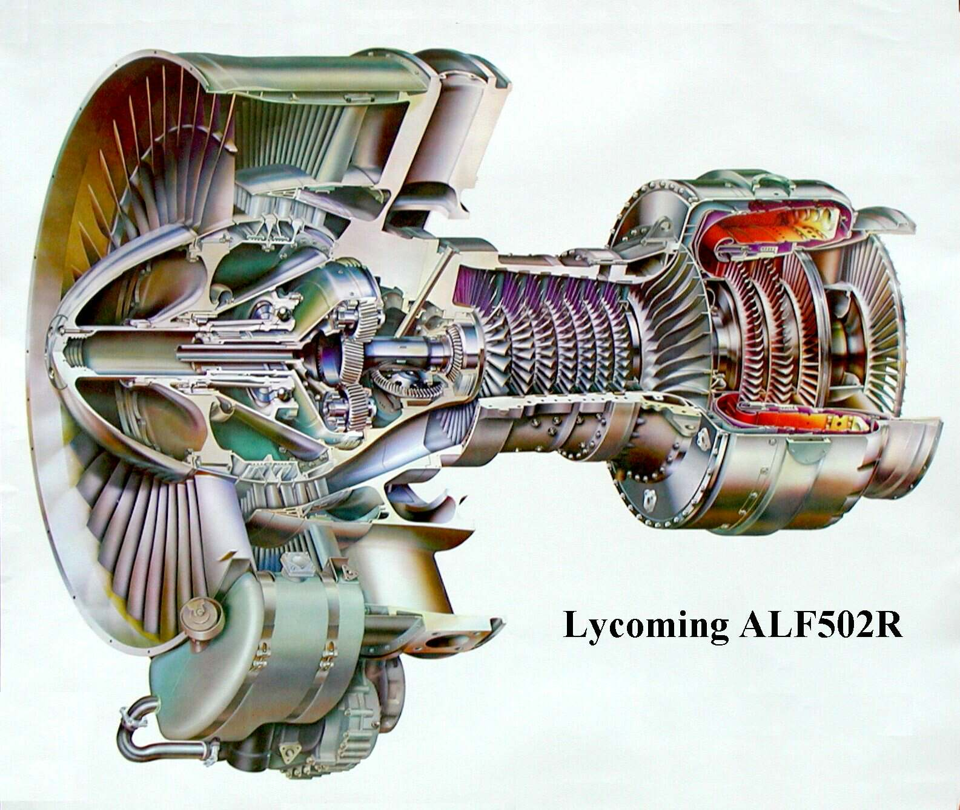
Modularity fights complexity

Slide 9

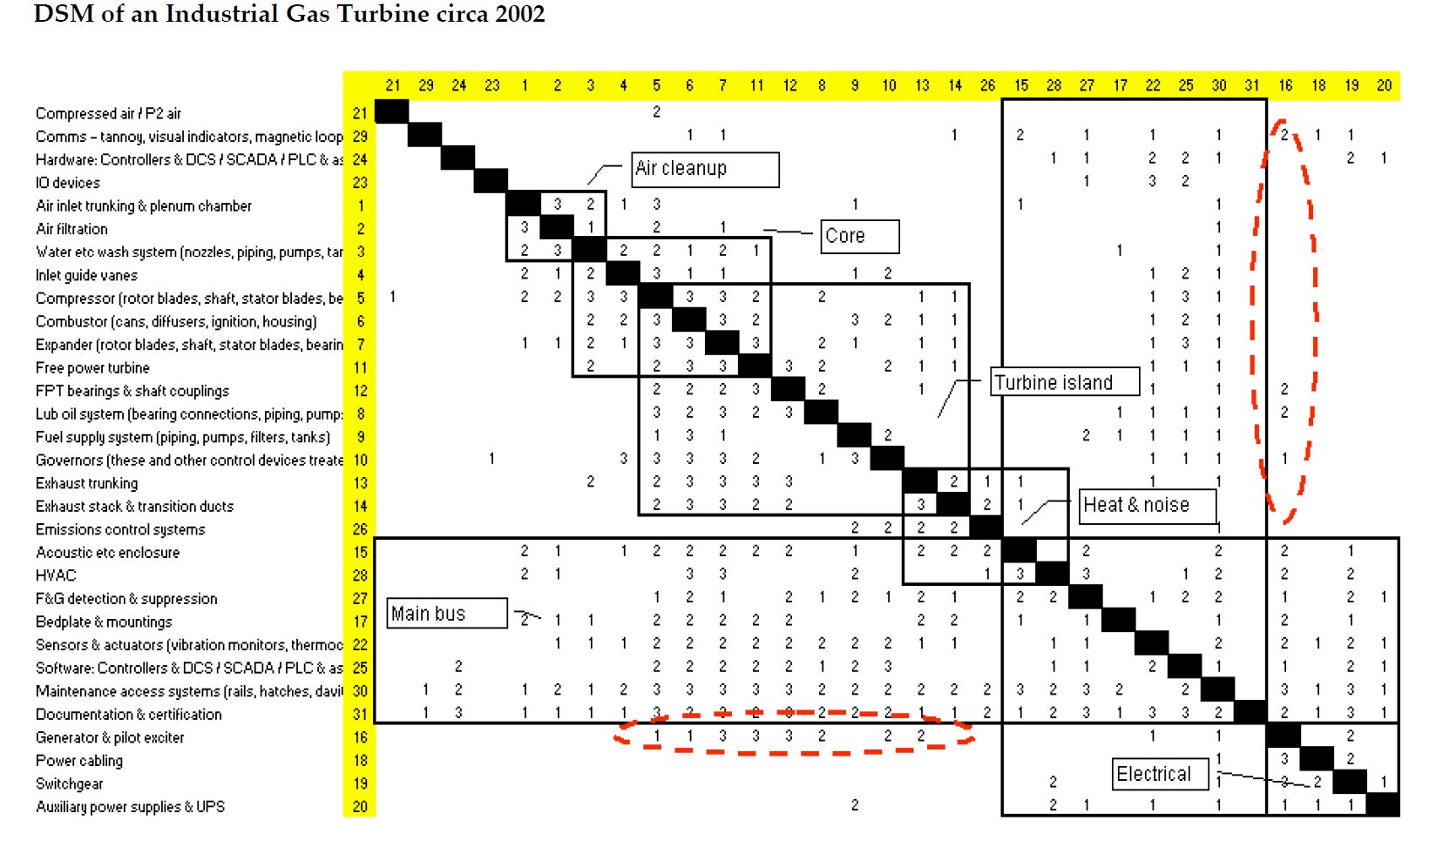
Design Structure Matrix
Notes:
Carliss Baldwin

Slide 10
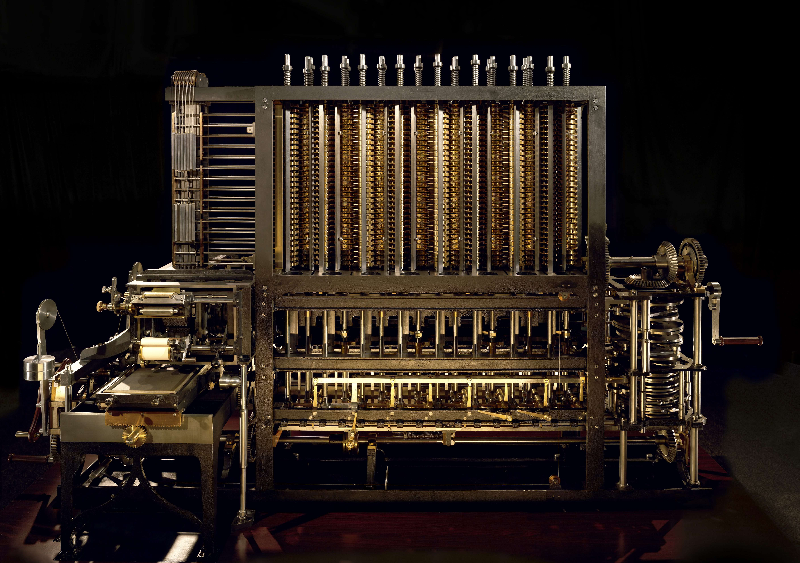

Slide 11
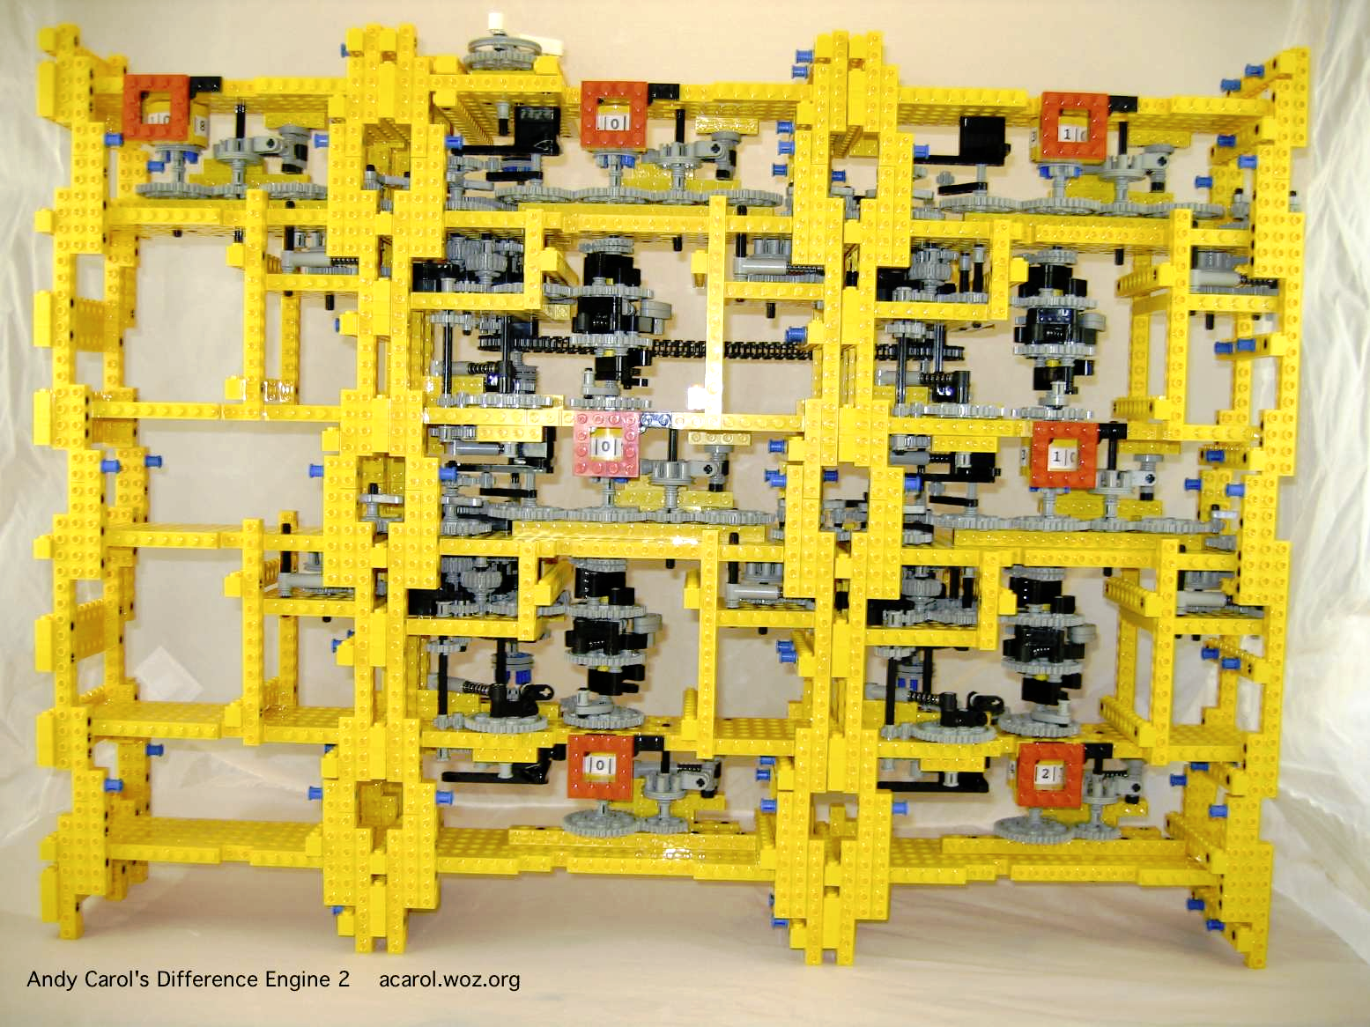
Modularity is an abstraction

Slide 12
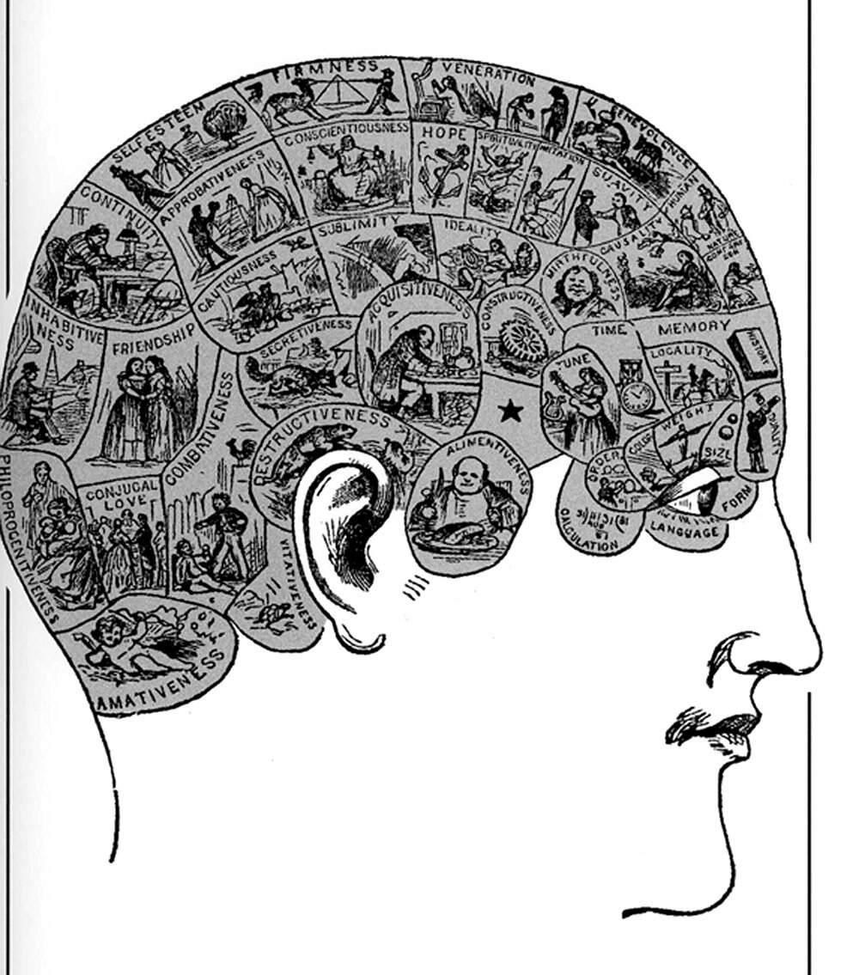
Bad abstractions hurt
Methods matter (of course)
Systematising methods is inadequate
Ultimate end use: what is the problem being solved?
Rather than how it is being done

Slide 13
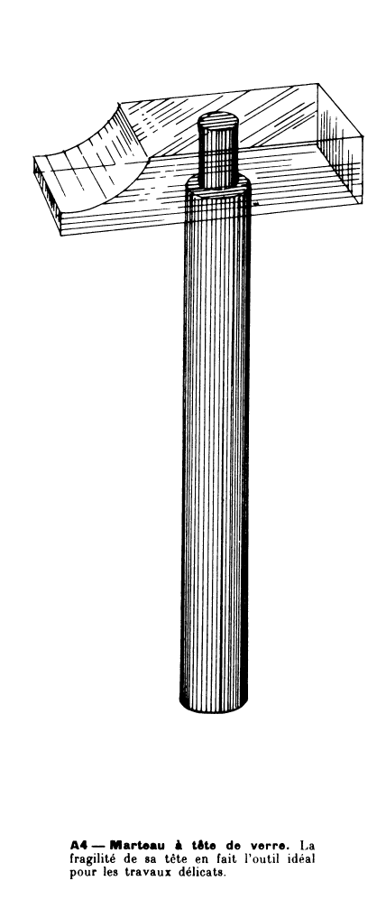
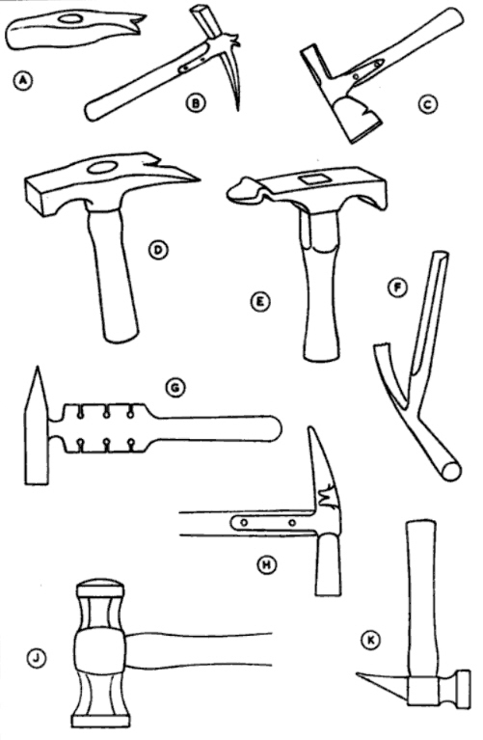
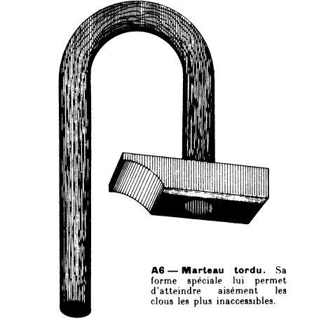
ML is “technique driven”

Slide 14
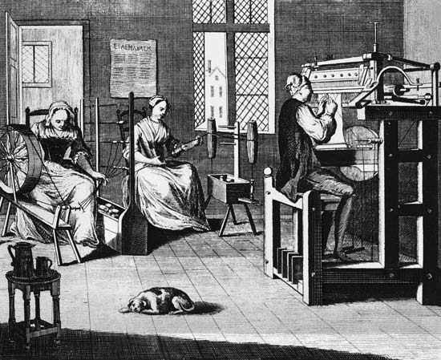
More like a
Cottage Industry
Small groups
Limited systematisation
Little reuse – do it all oneself
No standards

Slide 15

How does this guide ML research?
Q: What is a machine learning problem?
  As opposed to a particular algorithm (can’t compare them)
  How are they parameterized?
Q: How can one catalogue and relate all the problems to each other?
  How can one reduce a given problem to other problems?
Q: How can one do this in a manner that makes it easy to abstract real-world problems into neat ML problems that can then be solved? (psychology needed!)
Switch to to make some progress!

