Slide 1
CROWDSOURCING &
MACHINE LEARNING
Adam Tauman Kalai – MSR
ML WITH CROWD TWIST
Regression and feature multi-selection: with Sivan Sabato
Kernels: with Omer Tamuz, Ce Liu, Serge Belongie, Ohad Shamir
Eliciting features: with Kamalika Chaudhuri and James Zhou
Problem and data generation: with George Pierrakos

Slide 2
CROWDSOURCING &
MACHINE LEARNING
Adam Tauman Kalai – MSR
ML WITH CROWD TWIST
Regression and feature multi-selection: with Sivan Sabato
Kernels: with Omer Tamuz, Ce Liu, Serge Belongie, Ohad Shamir
Eliciting features: with Kamalika Chaudhuri and James Zhou
Problem and data generation: with George Pierrakos

Slide 3


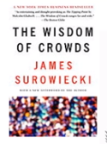

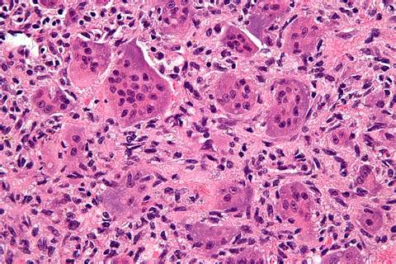
= 1,197 lbs
Avg of 800 guesses
1,198 lbs
Applications of crowdsourced estimation:
What % of U.S. teenagers will click on this ad?
Is this tumor cancerous?
Notes:
Galton 1907

Slide 4
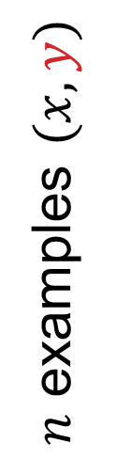
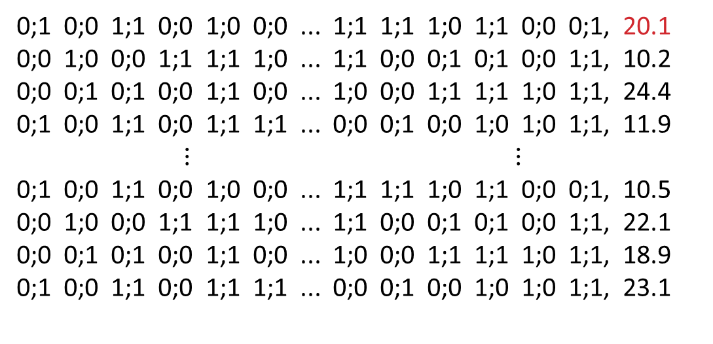


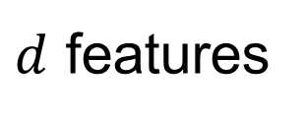
Double-judged examples
$d$ features
$$y$$
0;1 0;0 1;1 0;0 1;0 0;0 ... 1;1 1;1 1;0 1;1 0;0 0;1, 20.1
0;0 1;0 0;0 1;1 1;1 1;0 ... 1;1 0;0 0;1 0;1 0;0 1;1, 10.2
0;0 0;1 0;1 0;0 1;1 0;0 ... 1;0 0;0 1;1 1;1 1;0 1;1, 24.4
0;1 0;0 1;1 0;0 1;1 1;1 ... 0;0 0;1 0;0 1;0 1;0 1;1, 11.9
$$⋮ ⋮$$
0;1 0;0 1;1 0;0 1;0 0;0 ... 1;1 1;1 1;0 1;1 0;0 0;1, 10.5
0;0 1;0 0;0 1;1 1;1 1;0 ... 1;1 0;0 0;1 0;1 0;0 1;1, 22.1
0;0 0;1 0;1 0;0 1;1 0;0 ... 1;0 0;0 1;1 1;1 1;0 1;1, 18.9
0;1 0;0 1;1 0;0 1;1 1;1 ... 0;0 0;1 0;0 1;0 1;0 1;1, 23.1
$n$ examples $(x,y)$
2 iid judgments per$x_{i}$

Slide 5


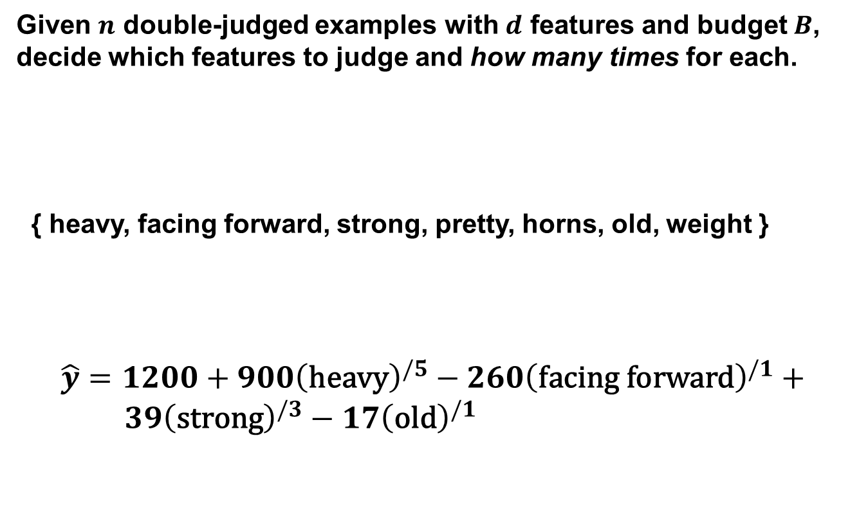


Feature multi-selection
Given $n$ double-judged examples with $d$ features and budget $B$, decide which features to judge and how many times for each.
{ heavy, facing forward, strong, pretty, horns, old, weight }
$$\hat{y}=1200+900{\left(\text{heavy}\right)}^{/5}−260{\left(\text{facing} \text{forward}\right)}^{/1}+ \\ 39{\left(\text{strong}\right)}^{/3}−17{\left(\text{old}\right)}^{/1}$$
$\{0,1\}$ features
real-valued (4 x longer)
Average $5$ independent judgments
(budget$B=10$)

Slide 6
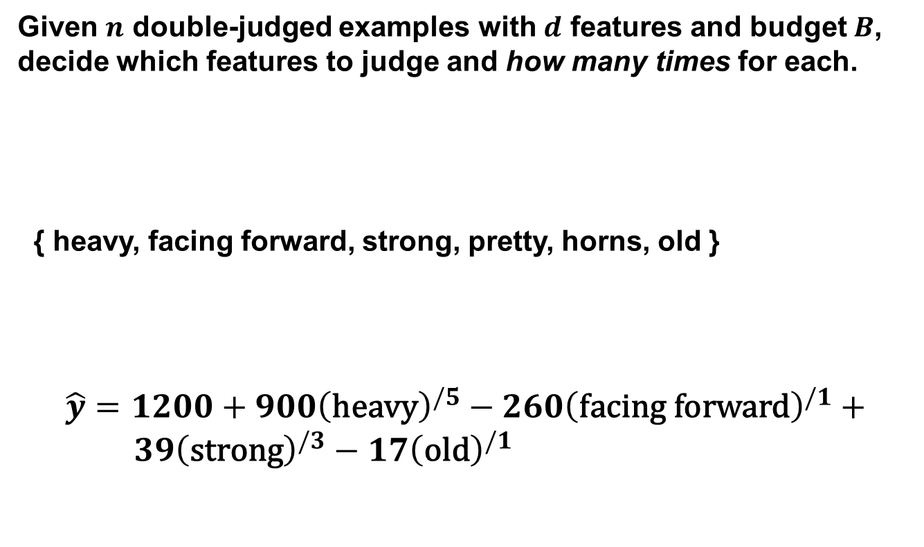

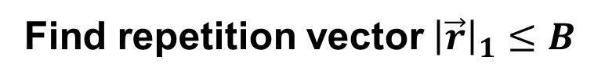
Feature multi-selection
Given $n$ double-judged examples with $d$ features and budget $B$, decide which features to judge and how many times for each.
{ heavy, facing forward, strong, pretty, horns, old }
$$\hat{y}=1200+900{\left(\text{heavy}\right)}^{/5}−260{\left(\text{facing} \text{forward}\right)}^{/1}+ \\ 39{\left(\text{strong}\right)}^{/3}−17{\left(\text{old}\right)}^{/1}$$
Average $5$ independent judgments
$\vec{r}=(5,1,3,0,0,1)$
(budget$B=10$)
Find repetition vector${\left|\vec{r}\right|}_{1}≤B$

Slide 7
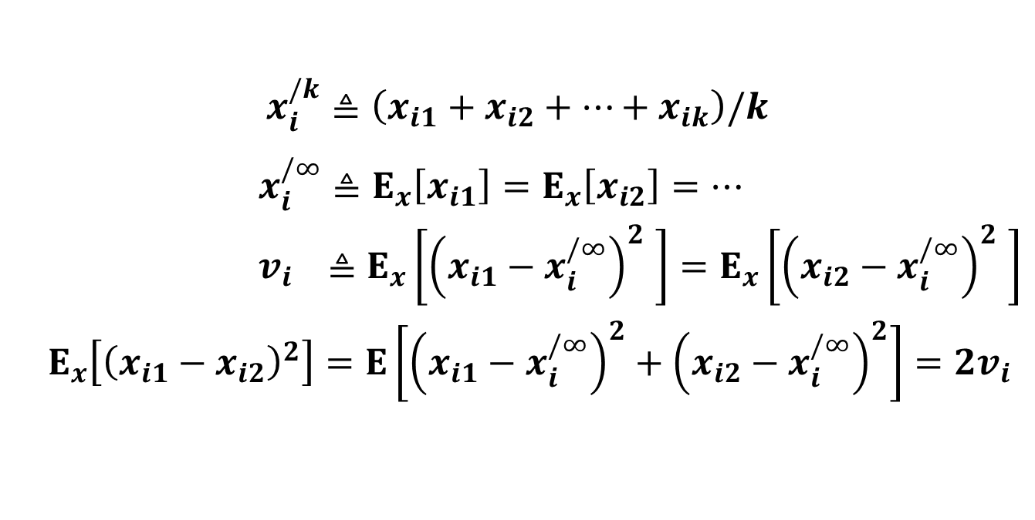
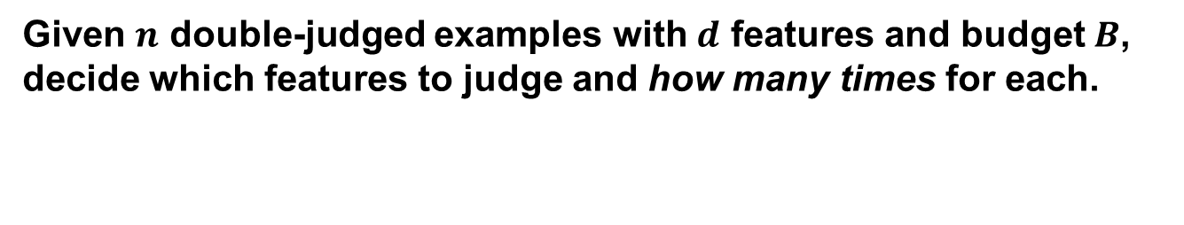
Feature multi-selection
Given $n$ double-judged examples with $d$ features and budget $B$, decide which features to judge and how many times for each.
iid judgments
$x_{i}^{/k}$ $≜\left(x_{i1}+x_{i2}+…+x_{ik}\right)/k$
$x_{i}^{/∞}≜E_{x}\left[x_{i1}\right]=E_{x}\left[x_{i2}\right]=…$
$${ v}_{i} ≜E_{x}\left[{\left(x_{i1}−x_{i}^{/∞}\right)}_{}^{2}\right]=E_{x}\left[{\left(x_{i2}−x_{i}^{/∞}\right)}_{}^{2}\right]$$
$${ E}_{x}\left[{\left(x_{i1}−x_{i2}\right)}^{2}\right]=E\left[{\left(x_{i1}−x_{i}^{/∞}\right)}^{2}+{\left(x_{i2}−x_{i}^{/∞}\right)}^{2}\right]=2v_{i}$$

Slide 8

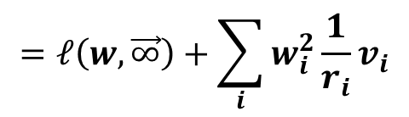
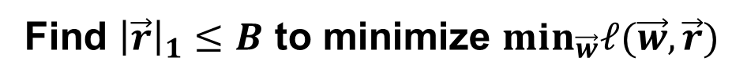
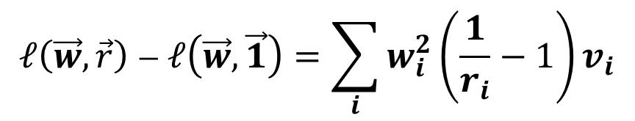
Feature multi-selection
Given $n$ double-judged examples with $d$ features and budget $B$, decide which features to judge and how many times for each.
$$ℓ\left(\vec{w},\vec{r}\right)≜ E_{x,y}\left[{\left(y−\sum_{i}{w_{i}x_{i}^{{/r}_{i}}}\right)}^{2}\right]$$
$$=E_{x,y}\left[{\left(y−\sum_{i}{w_{i}x_{i}^{/∞}}+\sum_{i}{w_{i}x_{i}^{/∞}}−\sum_{i}{w_{i}x_{i}^{/r_{i}}}\right)}^{2}\right]$$
$$=ℓ\left(w, \vec{∞}\right)+\sum_{i}{w_{i}^{2}\frac{1}{r_{i}}v_{i}}$$
$$ℓ\left(\vec{w}, \vec{r}\right)−ℓ\left(\vec{w}, \vec{1}\right)=\sum_{i}{w_{i}^{2}\left(\frac{1}{r_{i}}−1\right)v_{i}}$$
Find ${\left|\vec{r}\right|}_{1}≤B$ to minimize $min_{\vec{w}}ℓ(\vec{w},\vec{r})$

Slide 9

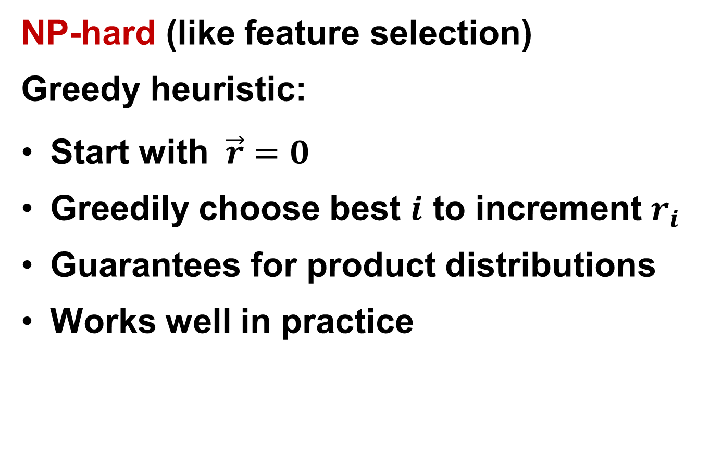
picking $\left(\vec{w},\vec{r}\right)$
NP-hard (like feature selection)
Greedy heuristic:
Start with $\vec{r}=0$
Greedily choose best $i$ to increment $r_{i}$
Guarantees for product distributions
Works well in practice

Slide 10
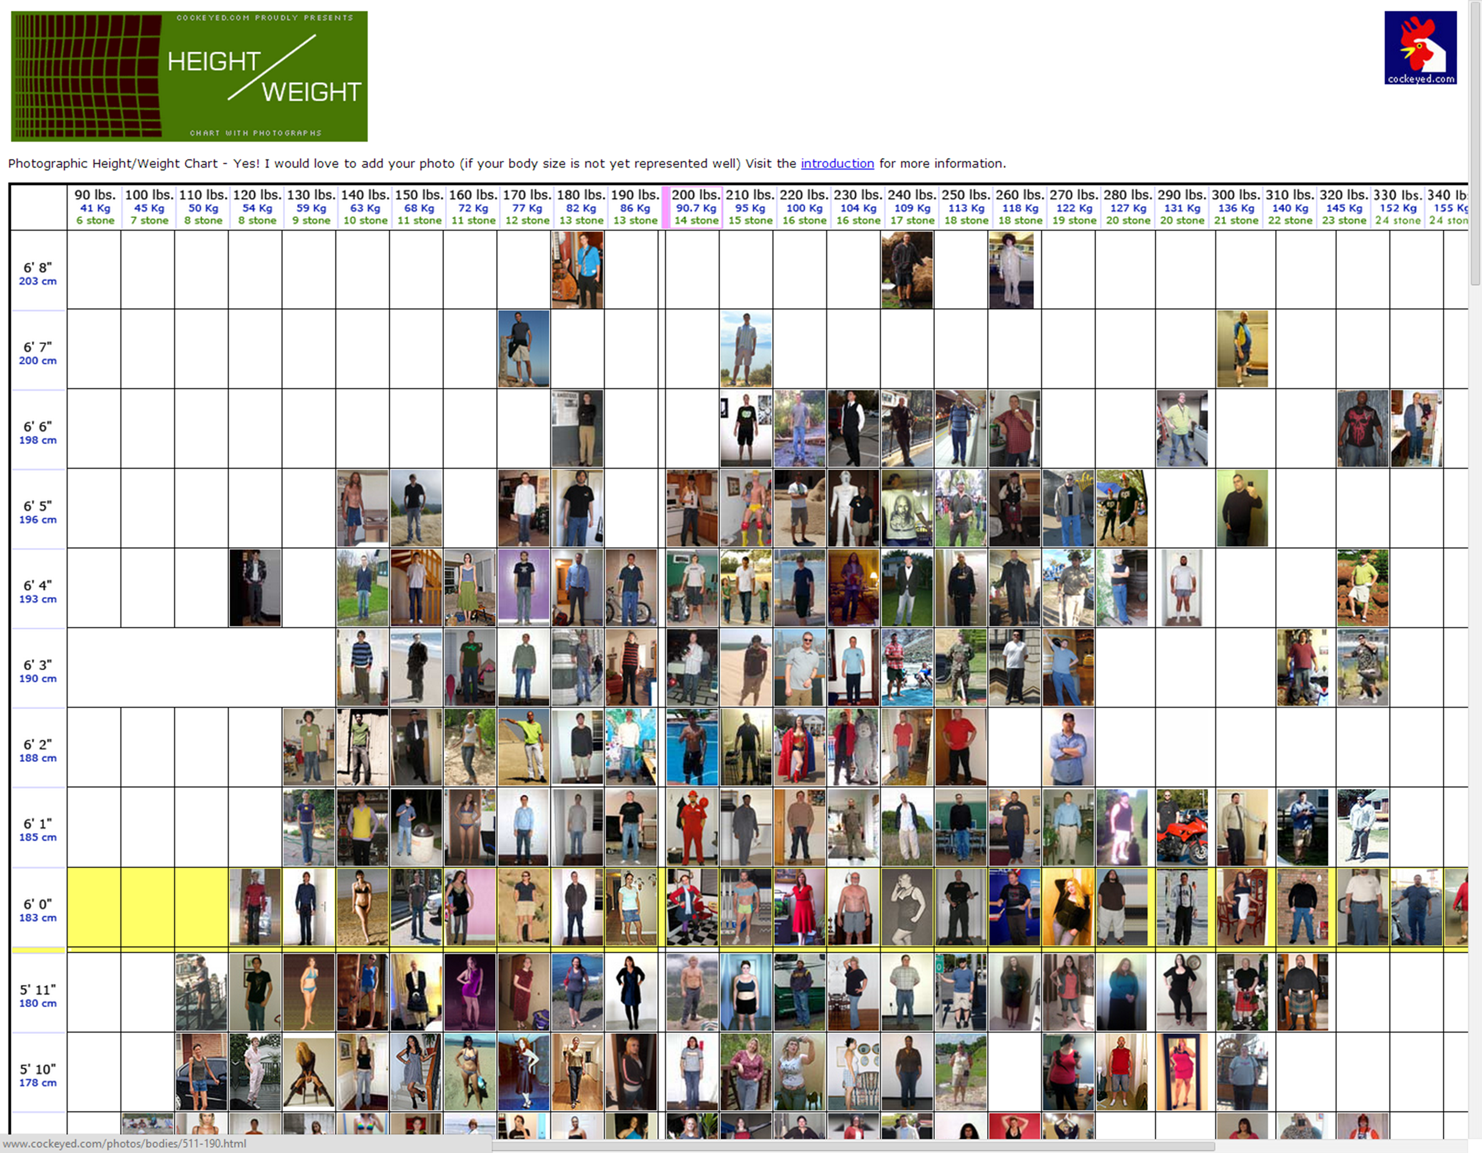
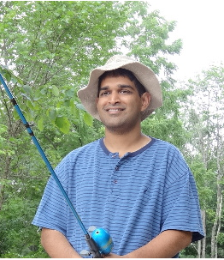

height/weight Experiments

Slide 11
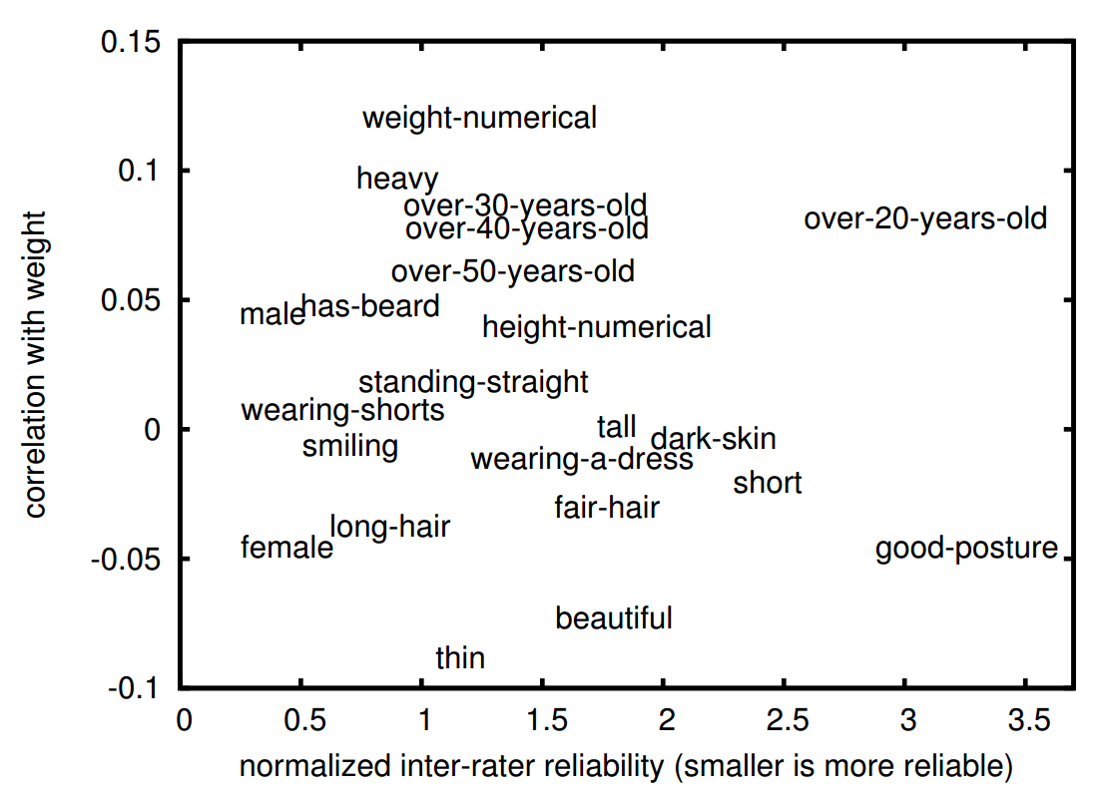
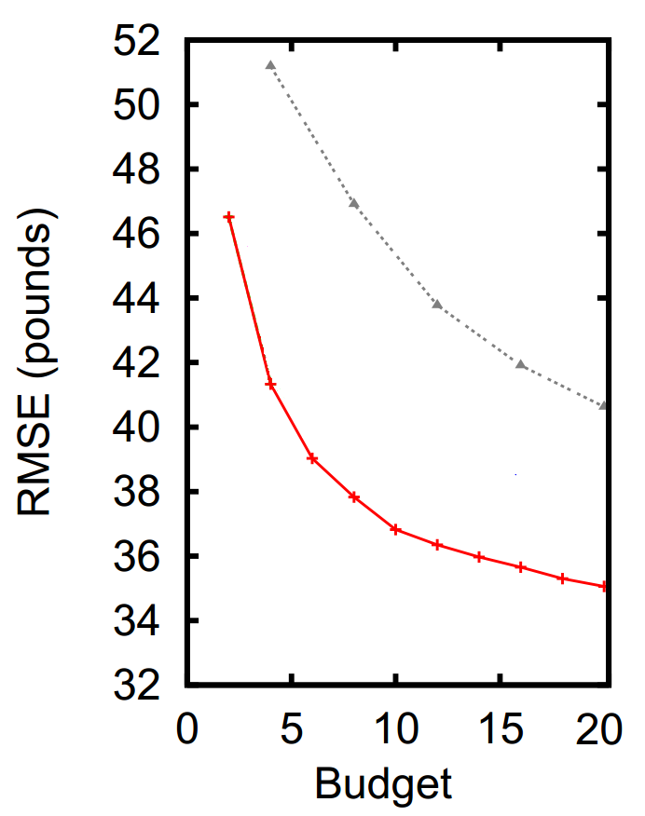
height/weight Experiments
avg weight
guesses
our alg
Subjective features improve accuracy

Slide 12
CROWDSOURCING &
MACHINE LEARNING
Adam Tauman Kalai – MSR
ML WITH CROWD TWIST
Regression and feature selection: with Sivan Sabato
Kernels: with Omer Tamuz, Ce Liu, Serge Belongie, Ohad Shamir
Eliciting features: with Kamalika Chaudhuri and James Zhou
Problem and data generation: with George Pierrakos

Slide 13
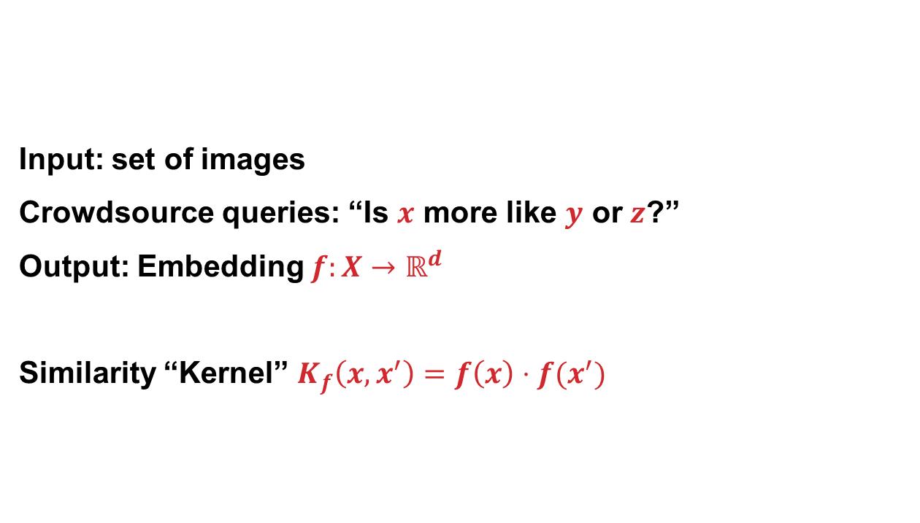
Crowd Kernel Problem
Input: set of images
Crowdsource queries: “Is $x$ more like $y$ or $z$?”
Output: Embedding $f:X→ℝ^{d}$
Similarity “Kernel” $K_{f}\left(x,x^{′}\right)=f\left(x\right)⋅f(x^{′})$

Slide 14
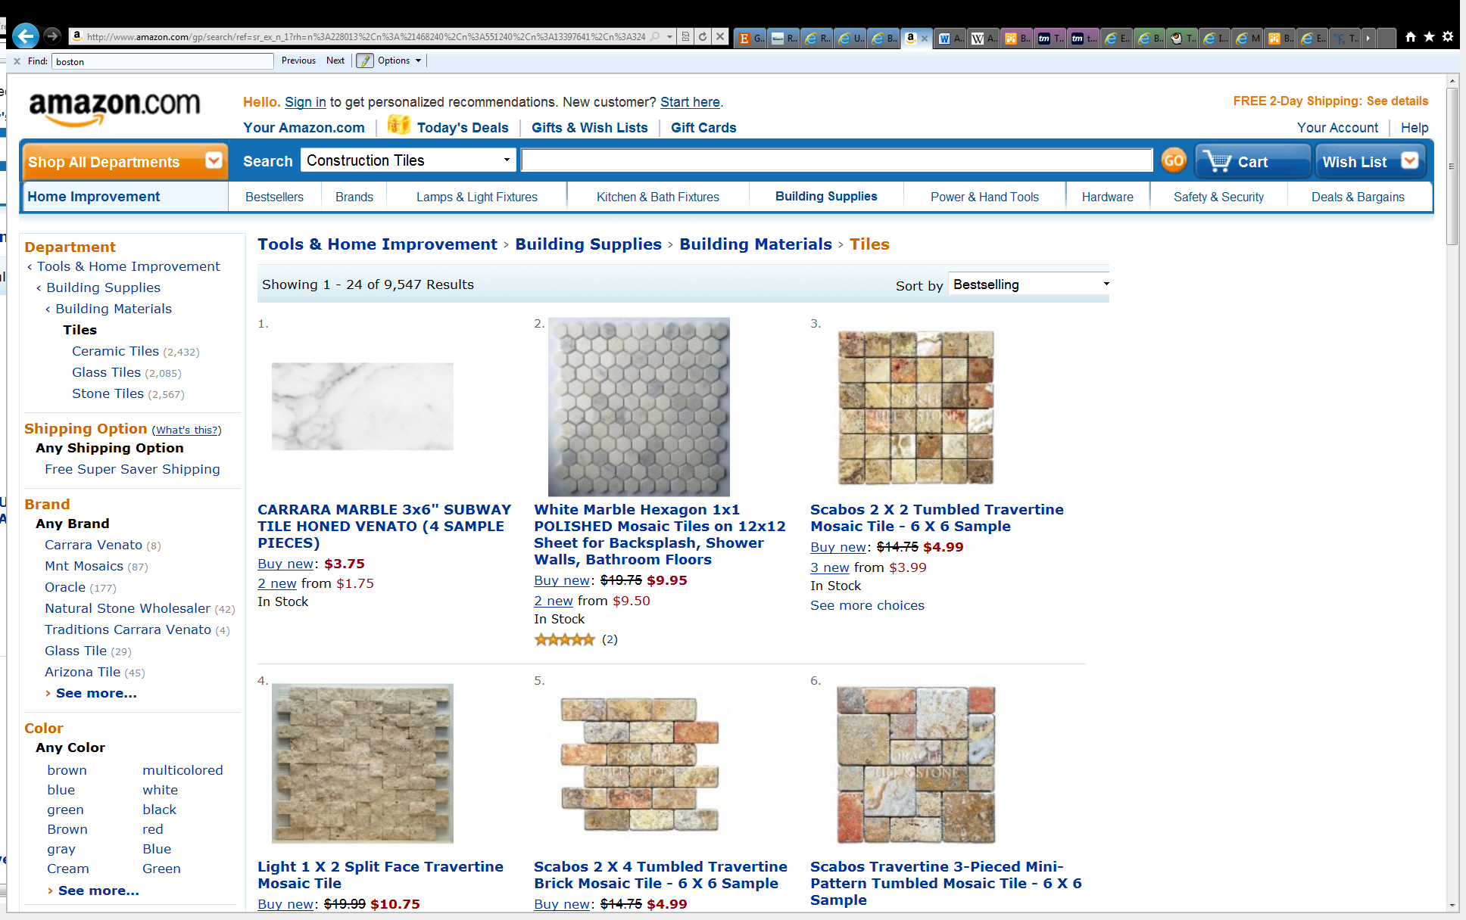
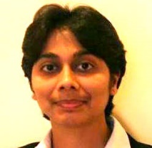

1. INPUT
+

Slide 15
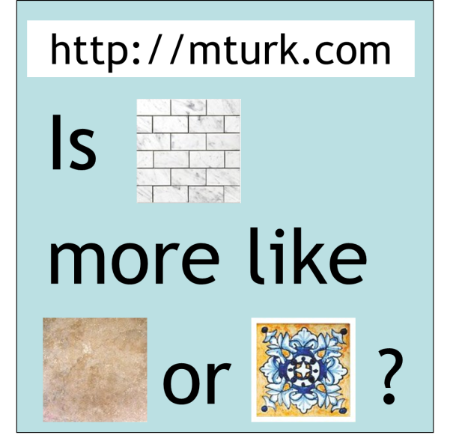
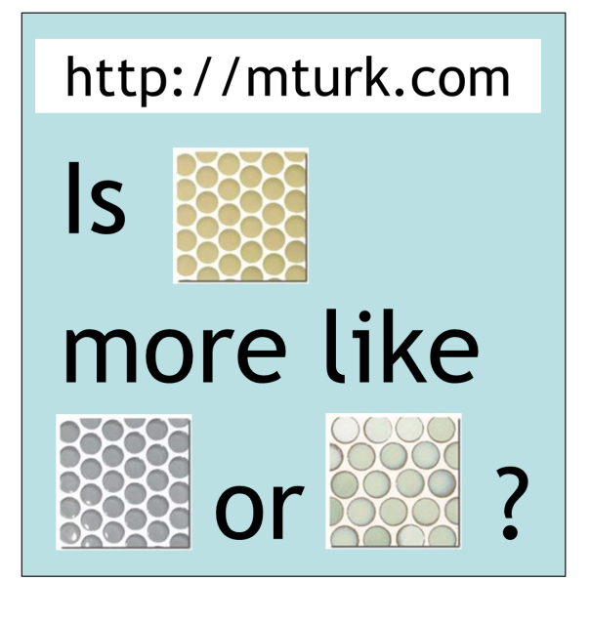
2. Crowd Queries
Adaptively chosen
Randomly chosen
Notes:
http://65.215.1.20/faces/simp_sim4.py?instructions=112462&tid=shortCut112465&assignmentId=ASSIGNMENT_ID_NOT_AVAILABLE&hitId=218W618N46UXOGYOUO3EYNDS5YBOQA

Slide 16
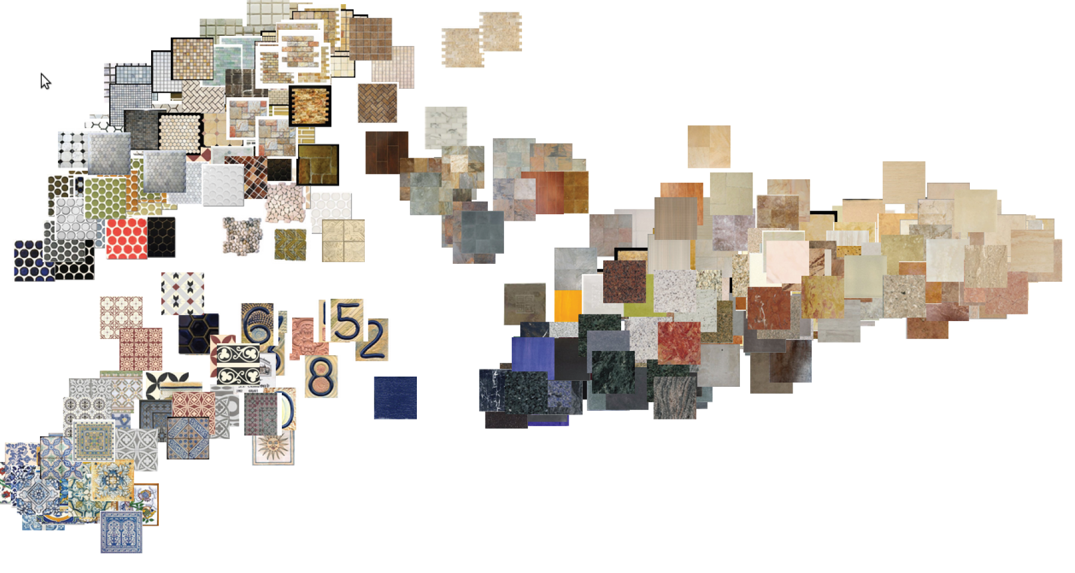




3. Output
embedding in $ℝ^{d}$

Slide 17
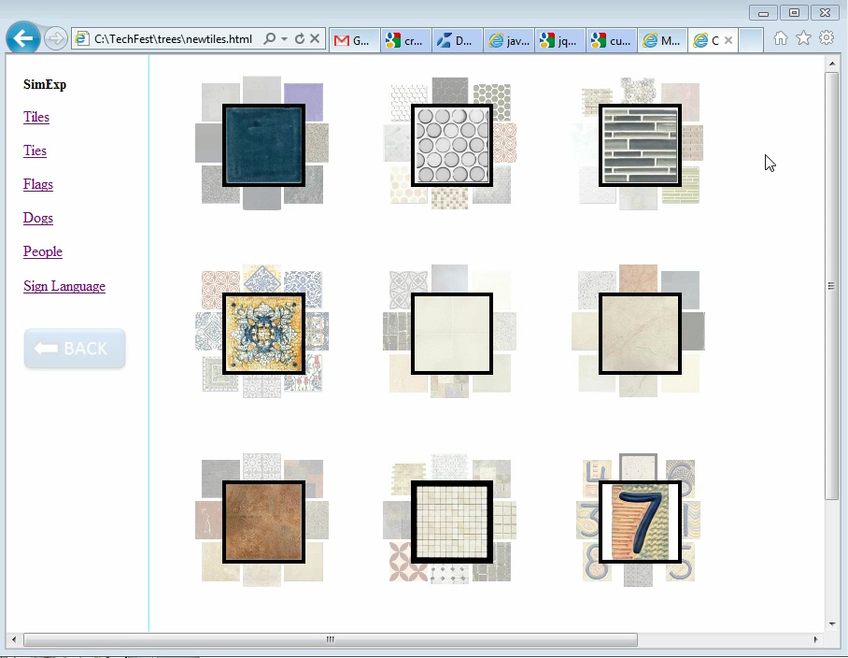
4. Applications

Slide 18
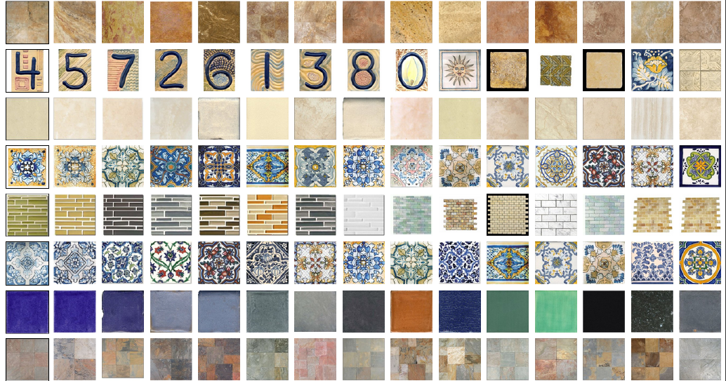

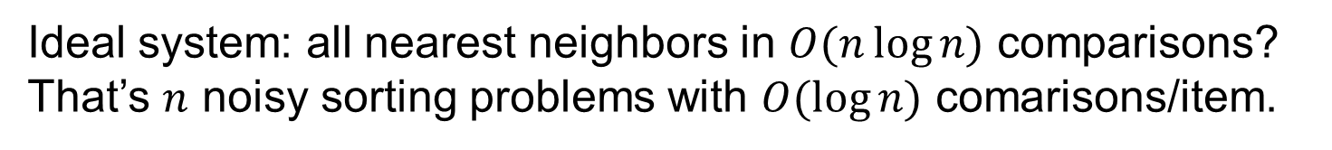
Nearest Neighbors
Ideal system: all nearest neighbors in $O(n\log{n)}$ comparisons?
That’s $n$ noisy sorting problems with $O(\log{n)}$ comarisons/item.

Slide 19
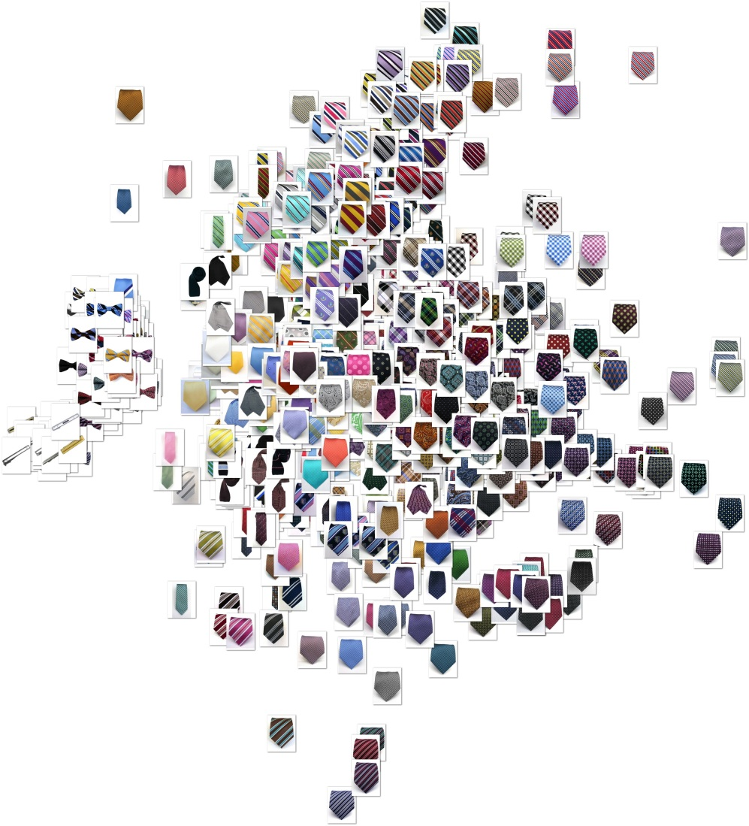
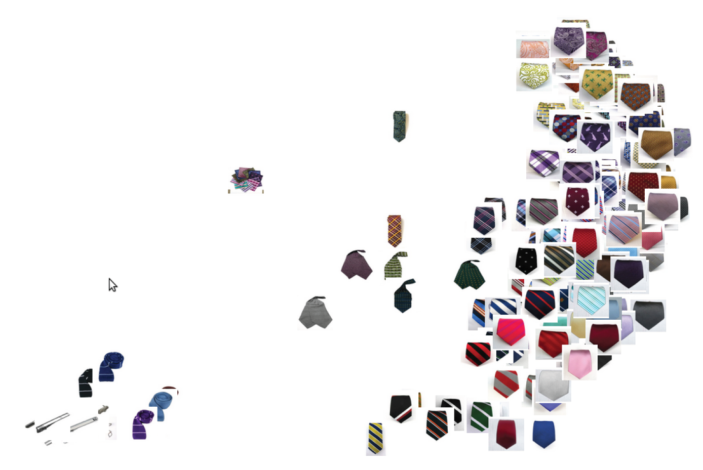
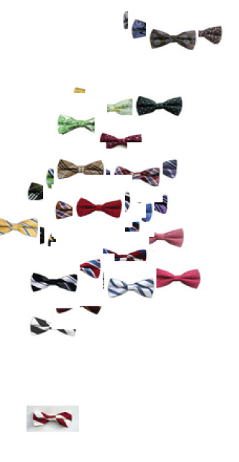

Slide 20
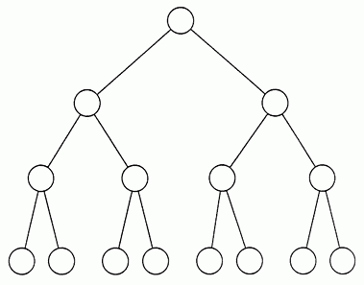

Adaptive queries
Toy example: complete binary trees with $n$leaves, depth $O(log n)$
Avg. cost/item is $Θ\left(n\right) \text{from} \text{random} \text{queries}$.
Avg. cost/item is $Θ\left(log n\right)$ from adaptive queries.
Tie store
Scarves
Tie clips
Bow ties
Neck ties

Slide 21
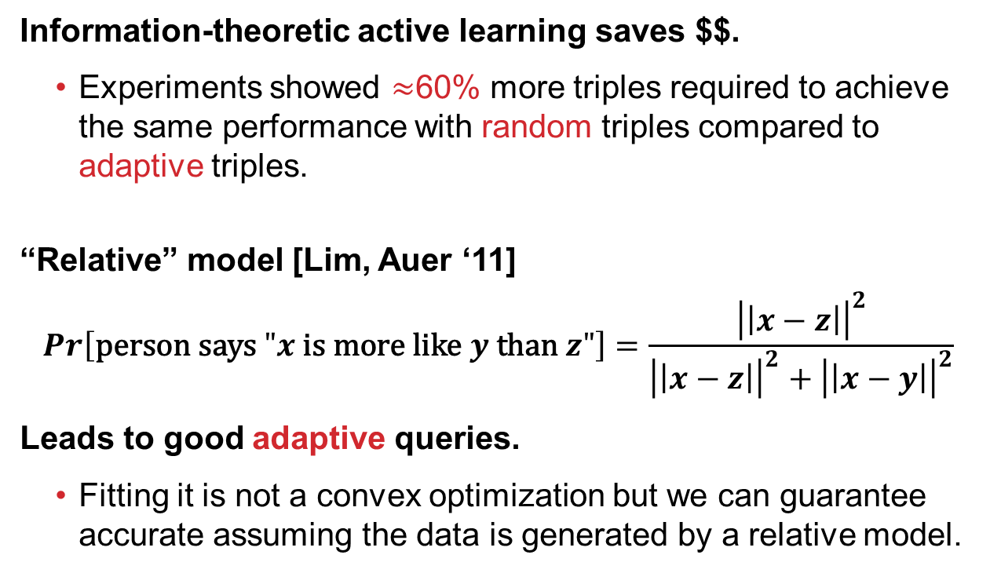
Adaptive Learning
Information-theoretic active learning saves $$.
  Experiments showed $≈$60% more triples required to achieve the same performance with random triples compared to adaptive triples.
“Relative” model [Lim, Auer ‘11]
$$Pr\left[\text{person} \text{says} "x \text{is} \text{more} \text{like} y \text{than} z"\right]=\frac{{\left|\left|x−z\right|\right|}^{2}}{{\left|\left|x−z\right|\right|}^{2}+{\left|\left|x−y\right|\right|}^{2}}$$
Leads to good adaptive queries.
  Fitting it is not a convex optimization but we can guarantee accurate assuming the data is generated by a relative model.

Slide 22
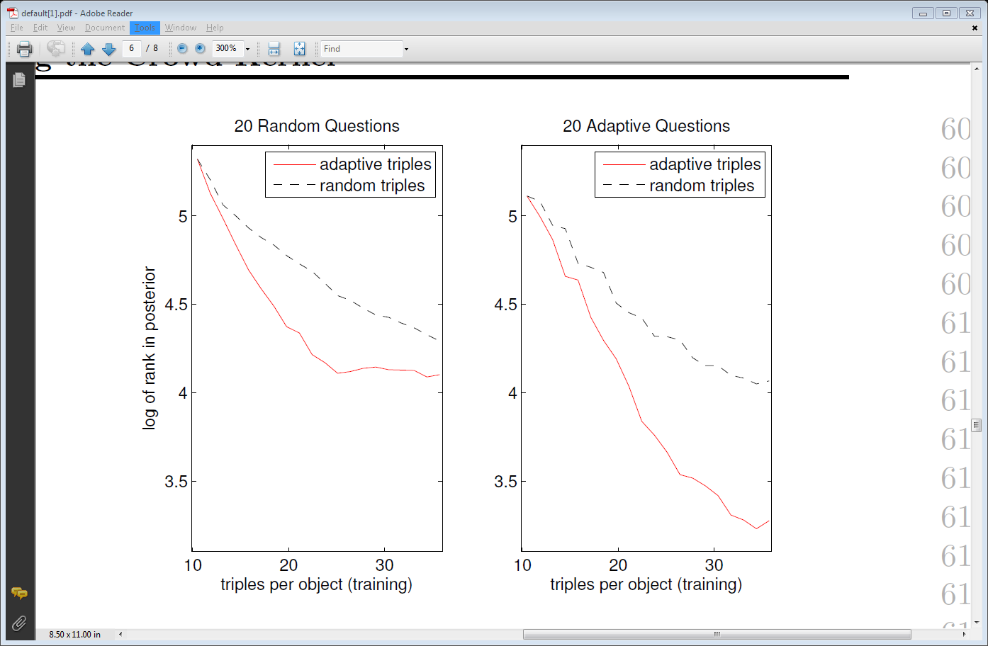
Performance Evaluation
20 Questions metric
Random object is chosen secretly
System asks 20 questions and then ranks objects in terms of likelihood
Dataset: 75 ties+75 tiles+75 flags

Slide 23
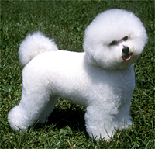
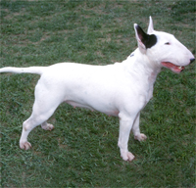
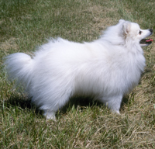
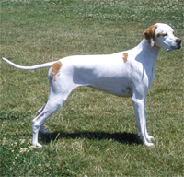
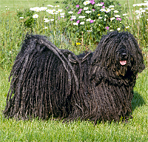
Good question?
Say system has “figured out” it’s a small white dog and
wants to know how furry it is.

Slide 24



























Embeddings and kernels
Embedding of the $n$objects into $ℝ^{d}$ for some $d≤n.$ Kernel ${K∈ℝ^{n×n}, K}_{ij}=x_{i}⋅x_{j}$.
$$x_{1}$$
$$x_{2}$$
$$x_{3}$$
$$x_{4}$$
$$x_{1}$$
$$x_{1}⋅x_{1}$$
$$x_{1}⋅x_{2}$$
$$x_{1}⋅x_{3}$$
$$x_{1}⋅x_{4}$$
$$x_{2}$$
$$x_{2}⋅x_{1}$$
$$x_{2}⋅x_{2}$$
$$x_{2}⋅x_{3}$$
$$x_{2}⋅x_{4}$$
$$x_{3}$$
$$x_{3}⋅x_{1}$$
$$x_{3}⋅x_{2}$$
$$x_{3}⋅x_{3}$$
$$x_{3}⋅x_{4}$$
$$x_{4}$$
$$x_{4}⋅x_{1}$$
$$x_{4}⋅x_{2}$$
$$x_{4}⋅x_{3}$$
$$x_{4}⋅x_{4}$$
$$K≽0$$
Assume $x_{i}^{2}=1$.

Slide 25




Embeddings and kernels
Embedding of the $n$objects into $ℝ^{d}$ for some $d≤n.$ Kernel ${K∈ℝ^{n×n}, K}_{ij}=x_{i}⋅x_{j}$.
$$x_{1}$$
$$x_{2}$$
$$x_{3}$$
$$x_{4}$$
$$x_{1}$$
$$1$$
$$x_{1}⋅x_{2}$$
$$x_{1}⋅x_{3}$$
$$x_{1}⋅x_{4}$$
$$x_{2}$$
$$x_{2}⋅x_{1}$$
$$1$$
$$x_{2}⋅x_{3}$$
$$x_{2}⋅x_{4}$$
$$x_{3}$$
$$x_{3}⋅x_{1}$$
$$x_{3}⋅x_{2}$$
$$1$$
$$x_{3}⋅x_{4}$$
$$x_{4}$$
$$x_{4}⋅x_{1}$$
$$x_{4}⋅x_{2}$$
$$x_{4}⋅x_{3}$$
$$1$$
$$K≽0$$
Assume $x_{i}^{2}=1$.

Slide 26



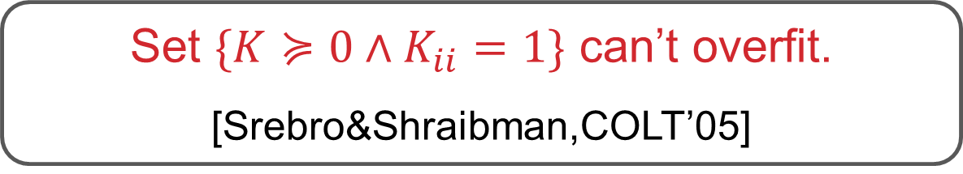

Embeddings and kernels
Embedding of the $n$objects into $ℝ^{d}$ for some $d≤n.$ Kernel ${K∈ℝ^{n×n}, K}_{ij}=x_{i}⋅x_{j}$.
$$x_{1}$$
$$x_{2}$$
$$x_{3}$$
$$x_{4}$$
$$x_{1}$$
$$1$$
$$x_{1}⋅x_{2}$$
$$0.9$$
$$x_{1}⋅x_{3}$$
$$x_{1}⋅x_{4}$$
$$0.9$$
$$1$$
$$x_{2}⋅x_{3}$$
$$x_{2}⋅x_{4}$$
$$x_{2}$$
$$≥\text{.62}$$
$$x_{3}$$
$$1$$
$$x_{3}⋅x_{4}$$
$$x_{4}$$
$$1$$
$$K≽0$$
Set $\{K≽0∧K_{ii}=1\}$ can’t overfit. [Srebro&Shraibman,COLT’05]

Slide 27
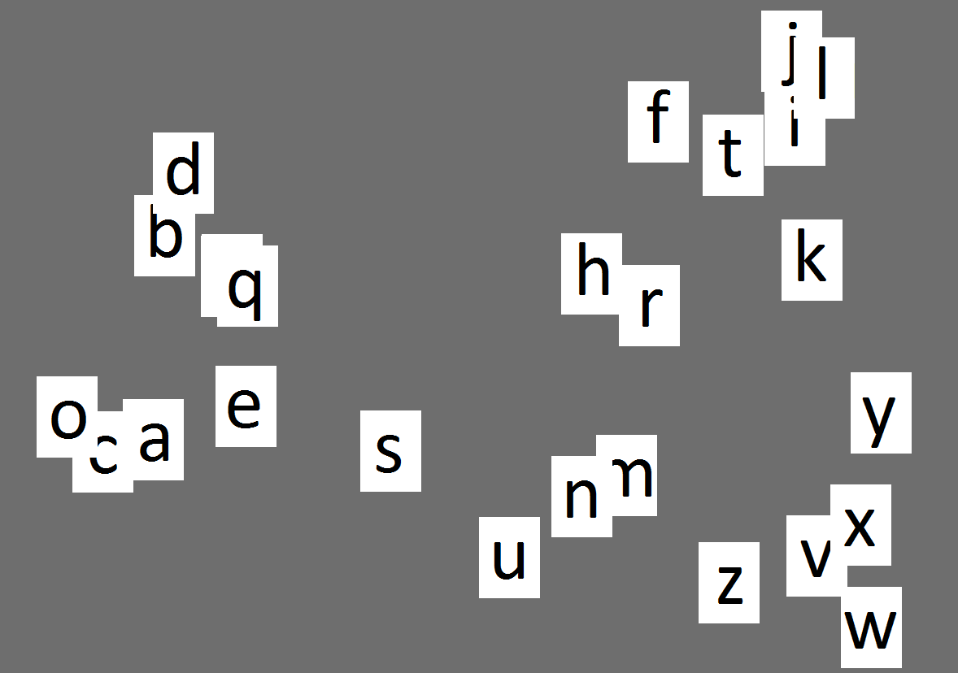
SUBJECTIVE Questions…
e
s
u

Slide 28
…still capture semantic features
a
b c
d e
f
g
h
i
j
k
l
m
n
o
p
q
r
S
t
u
v
w
x
y
z
Vowel/consonant
Tall/short (“h” vs “n”)
Alphabetical order (a-z)
Different crowdmembers
use different criteria –
capitalize.
e
s
u

Slide 29
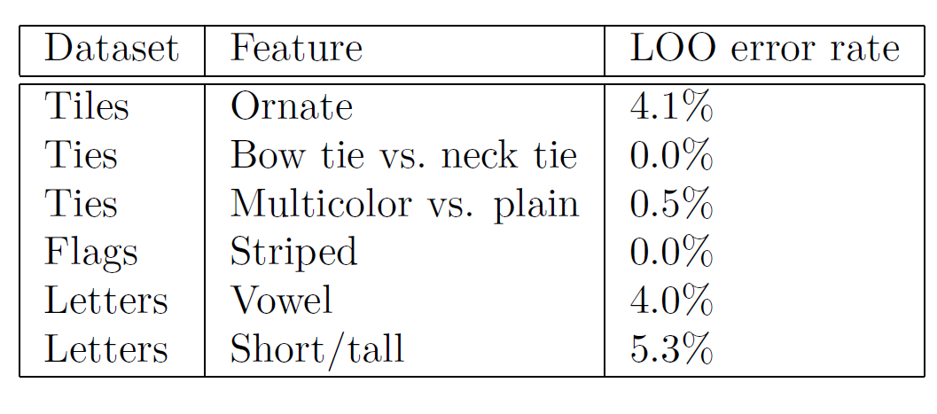
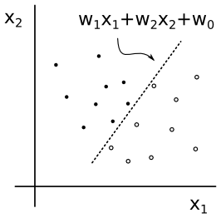

Using “Kernel” in HALFSPACES
$$w⋅x≥θ$$

Slide 30
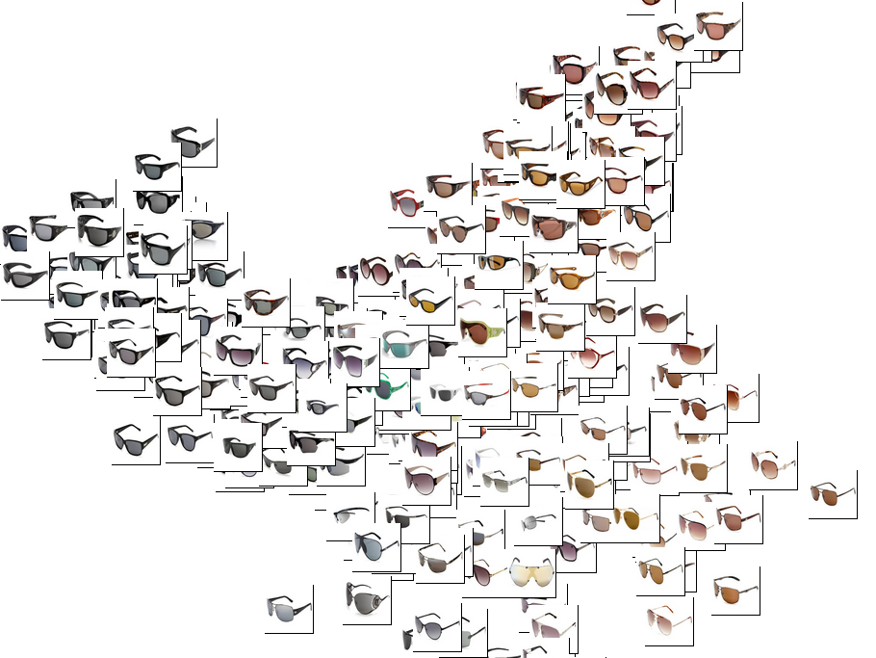

Slide 31
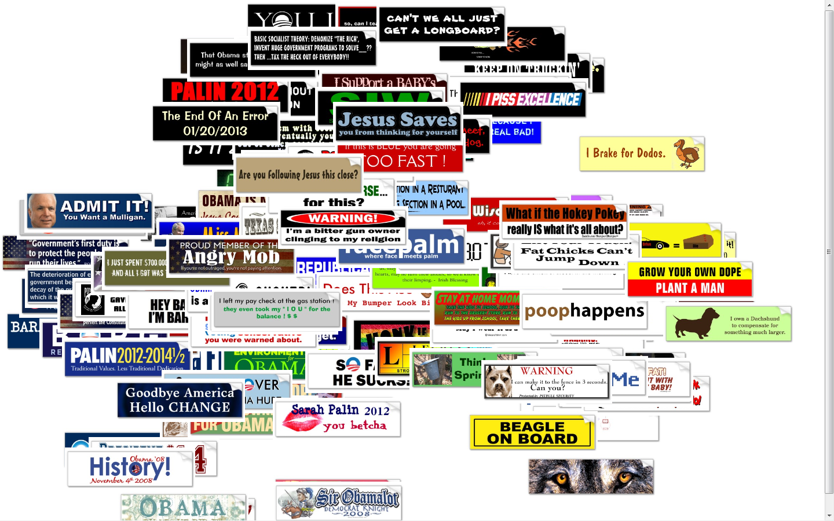
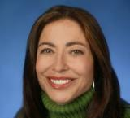

Slide 32
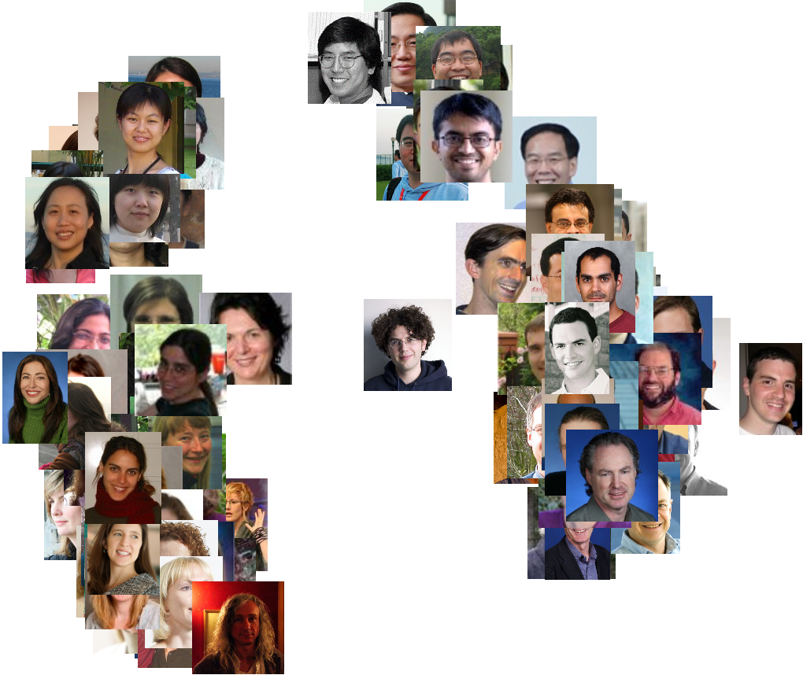
Asian
Female
Male
Caucasian

Slide 33
CROWDSOURCING &
MACHINE LEARNING
Adam Tauman Kalai – MSR
ML WITH CROWD TWIST
Regression and feature selection: with Sivan Sabato
Kernels: with Omer Tamuz, Ce Liu, Serge Belongie, Ohad Shamir
Eliciting features: with Kamalika Chaudhuri and James Zhou
Problem and data generation: with George Pierrakos

Slide 34
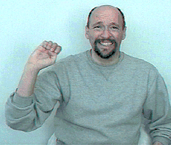

Feature ELICITATION
vs.
Labels:
Notes:
http://65.215.1.20/faces/simp_sim4.py?instructions=112462&tid=shortCut112465&assignmentId=ASSIGNMENT_ID_NOT_AVAILABLE&hitId=218W618N46UXOGYOUO3EYNDS5YBOQA

Slide 35



Feature ELICITATION
[Donahue Grauman11, Patterson Chen Hays 11]
vs.
Notes:
http://65.215.1.20/faces/simp_sim4.py?instructions=112462&tid=shortCut112465&assignmentId=ASSIGNMENT_ID_NOT_AVAILABLE&hitId=218W618N46UXOGYOUO3EYNDS5YBOQA

Slide 36

Feature ELICITATION
Given $X=\left\{x_{1}, x_{2}, …,x_{n}\right\}$
Unknown $\text{ℱ}=\{{ f}_{1},f_{2},…,f_{d} \}:X→\{0,1\}$
Query: $A, B⊂X$
Answer: any feature $f∈\text{ℱ}$ such that,
$$f\left(x\right)=1 for x∈A and f\left(x\right)=0 for x∈B$$
Goal: adaptively choose queries $A_{i}, B_{i}⊂X$to find all features as quickly as possible.
Notes:
http://65.215.1.20/faces/simp_sim4.py?instructions=112462&tid=shortCut112465&assignmentId=ASSIGNMENT_ID_NOT_AVAILABLE&hitId=218W618N46UXOGYOUO3EYNDS5YBOQA

Slide 37
CROWDSOURCING &
MACHINE LEARNING
Adam Tauman Kalai – MSR
ML WITH CROWD TWIST
Regression and feature selection: with Sivan Sabato
Kernels: with Omer Tamuz, Ce Liu, Serge Belongie, Ohad Shamir
Eliciting features: with Kamalika Chaudhuri and James Zhou
Problem and data generation: with George Pierrakos

Slide 38






Machine learning steps
Choose representation for data
Label data set according to that representation
Run regression/clustering/etc. algorithms on labeled data

Slide 39










Machine learning steps
Choose representation for data
Feature-based
Similarity-based
1 | 0.5 | 0.1 | 0.3
0.5 | 1 | 0.2 | 0.3
0.1 | 0.2 | 1 | 0.4
0.3 | 0.3 | 0.4 | 1
Striped
Funny
0 1 1 0
0 0 0 1
$⋮$
$$…$$
$$⋮$$

Slide 40
Machine learning steps
Choose representation for data
Label data set according to that representation
Run classification/clustering/etc. algorithms on labeled data
AUTOMATIC

Slide 41
Machine learning steps
Choose representation for data
Label data set according to that representation
Run classification/clustering/etc. algorithms on labeled data
CROWDOMATIC

Slide 42
Machine learning steps
Choose representation for data
Label data set according to that representation
Run classification/clustering/etc. algorithms on labeled data

Slide 43
Machine learning steps
0. Choose problem
½. Get data
Choose representation for data
Label data set according to that representation
Run classification/clustering/etc. algorithms on labeled data

Slide 44
Crowdsourcing ML PRoblem
Help us come brainstorm interesting machine learning problems based on a data set that we will create:
Help invent a fun game:
Guess from a picture of
???
gender
handwriting

Slide 45
Crowdsourcing ML problem
Help us come brainstorm interesting machine learning problems based on a data set that we will create:
Help invent a fun game:
Guess from a picture of
???
eye color
face with eyes closed

Slide 46

Crowdsourcing Data

Slide 47

Crowdsourcing Data

Slide 48

Conclusions
Crowdsourcing inspires new ML problems
Opportunities for:
  Theory (modeling, problem solving)
  Practice
Hybrid systems
  More accurate
  Improve machine accuracy
  Improve human accuracy

Slide 49
Thank you (CROWD)

