Slide 1
The Latent Power of Absurd Ideas (aka Robust Query Processing)
Jayant Haritsa Database Systems Lab
Indian Institute of Science

Slide 2
CWG 2010 Expense Estimates
Government valuation: 5000 crores
Media speculation: 70000 crores
Geometric Mean: √5000 * 70000 = 18708 crores
CAG audit: 18532 crores !

Slide 3
Database Systems

Slide 4
Database Management Systems (DBMS)
Large and complex software systems
millions of lines of code
Efficient and convenient mechanisms for capturing, storing, querying, maintenance of enterprise data
Cornerstone of computer industry
Uses > 80 percent of computers worldwide
Employs > 70 percent of computer professionals
Largest monetary sector of computer business

Slide 5
Current Database Systems
Commercial
IBM DB2, Microsoft SQL Server, HP SQL/MX Oracle Exadata, SAP Hana/Sybase IQ
Public-domain
PostgreSQL / MySQL / Berkeley DB

Slide 6
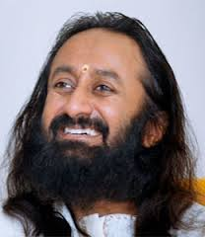
DBMS FEATURES.1
PEACE OF MIND
changes to the database are guaranteed to be immune to subsequent system failures
Sri Sri Ravishankar of the Information World

Slide 7
DBMS FEATURES. 2
DECLARATIVE ACCESS
state what you want, not how to get it
unlike standard (imperative) programming, where you specify every step of the way
Professor to PhD student: Go write a great thesis, don’t ask me how!

Slide 8
Relational Database Systems [RDBMS]
Based on first-order logic
Edgar Codd of IBM Research, Turing Award (1981)
“We believe in Codd, not God”
Data is stored in a set of relations (i.e. tables) with attributes, relationships, constraints
STUDENT
COURSE
Roll No | Name | Address
Course No | Title | Credits
81061 | Jayant | Bangalore
E0 261 | DBMS | 4
REGISTER
Roll No | Course No | Grade
81061 | E0 261 | A+

Slide 9
QUERY INTERFACE
Structured Query Language (SQL)
Invented by IBM, 1970s
Example: List names of students and their courses
select STUDENT.Name, COURSE.Title from STUDENT, COURSE, REGISTER where STUDENT.RollNo = REGISTER.RollNo and REGISTER.CourseNo = COURSE.CourseNo
STUDENT
COURSE
Roll No | Name | Address
Course No | Title | Credits
REGISTER
Roll No | Course No | Grade

Slide 10
Query Execution Plans
SQL is a declarative language
Specifies ends, not means select STUDENT.Name, COURSE.Title
from STUDENT, COURSE, REGISTER where STUDENT.RollNo = REGISTER.RollNo and REGISTER.CourseNo = COURSE.CourseNo
Unspecified: join order [((S ! R) ! C) or ((R ! C) ! S) ?]
join technique [Nested-Loops / Sort-Merge / Hash?]
DBMS query optimizer identifies the optimal evaluation strategy: “query execution plan”

Slide 11
Sample Execution Plan
Card: 10000
RETURN
Cost: 286868
Card: Output Cardinality (rows)
Cost: Execution Cost (time)
Card: 10000
HASH JOIN
Cost: 286868
Card: 10000
MERGE JOIN
Cost: 278751
Card: 10000
SORT
Cost: 225103
Card: 100
INDEX SCAN
Cost: 6745
Card: 1000
TABLE SCAN
Cost: 6834
Card: 10000
TABLE SCAN
Cost: 209760
STUDENT
COURSE
REGISTER
Notes:
This is OptA real plan with cost values.

Slide 12
Query Optimization Framework
Query Optimizer (Dynamic Programming)
Optimal [Min Cost] Plan P(Q)
Declarative Query (Q)
Operator Execution Cost
Estimation Model
Function of Hardware and DB Engine
Operator Output Cardinality
Estimation Model
Function of Data Distributions and Correlations

Slide 13
Run-time Sub-optimality
The supposedly optimal plan-choice may actually turn out to be highly sub-optimal (e.g. a 1000 times worse!) when the query is executed with this plan. This adverse effect is due to errors in:
(a) cost model → limited impact
(b) cardinality model → huge impact
Coarse statistics, outdated statistics, attribute value independence (AVI) assumption, multiplicative error propagation, query construction, …
e.g. (student.age < 25) AND (student.salary > 1 crore)

Slide 14
Proof by Authority [Guy Lohman, IBM]
Snippet from April 2014 Sigmod blog post on “Is Query Optimization a “Solved” Problem?”
The root of all evil, the Achilles Heel of query optimization, is the estimation of the size of intermediate results, known as cardinalities. The cardinality model can easily introduce errors of many orders of magnitude! With such errors, the wonder isn’t “Why did the optimizer pick a bad plan?” Rather, the wonder is “Why would the optimizer ever pick a decent plan?”

Slide 15
Recent Election Predictions
Tamil Nadu Assembly Elections 2011 (234):
Pre-polls and post-polls claimed very close race
ORG poll: 120 seats for DMK, 110 for AIADMK
Landslide Results: 203 for AIADMK, 31 for DMK
Delhi Assembly Elections 2015 (70):
Pre-polls and post-polls claimed tossup race
Cvoter poll: 36 for BJP, 31 for AAP
Landslide Results: 67 for AAP, 3 for BJP

Slide 16
Prior Research (lots!)
VVS LAXMAN
Sophisticated estimation techniques
SIGMOD 1999, VLDB 2001, VLDB 2009, SIGMOD 2010, VLDB 2011, …
e.g. wavelet histograms, self-tuning histograms, learning histograms
Selection of Robust Plans
SIGMOD 1994, PODS 2002, SIGMOD 2005, VLDB 2008, SIGMOD 2010, …
e.g. LEC (least expected cost)
Runtime re-optimization techniques
SIGMOD 1998, SIGMOD 2000, SIGMOD 2004, SIGMOD 2005, …
e.g. POP (progressive optimization), RIO (Re-optimizer)
RAHUL DRAVID
M S DHONI
Several novel ideas and formulations, but lack performance guarantees

Slide 17
Our Results
Our lab has solved this classical (~35 years) problem by developing a new query processing technique, called “plan bouquets”, which completely abandons making estimations of operator cardinalities
Plan Bouquet Approach: run-time cardinality discovery using compile-time selected bouquet of plans
provides worst case performance guarantees wrt omniscient oracle that magically knows the correct cardinalities e.g. for a single error-prone cardinality, relative guarantee of 4
empirical performance well within guaranteed bounds on industrial-strength environments

Slide 18
Plan Bouquets: A Fragrant Approach to Robust Query Processing
Plan 1
Plan 2
Plan 5
Plan 3
Plan 4
(Phd Thesis work of Anshuman Dutt)

Slide 19
Sample Relational Database: Manufacturing
Supplier
Region
PartSupp
Nation
Part
Customer
Lineitem
Orders

Slide 20
Cardinality Estimation
select *
from lineitem, orders, part
where p_partkey = l_partkey and
o_orderkey = l_orderkey and
p_retailprice < 1000
RDBMS
Statistical Metadata
Query Optimizer
Estimated Join
Cardinality
Card: 1.2 x 10⁶
Hash Join
Estimated Join
Cardinality
Card: 1.5 x 10⁵
TableScan
Card: 1.2 x 10⁶
Hash Join
Card: 1.5 x 10⁵
orders
Estimated Selection Cardinality
Card: 4 x 10³
FilterScan
Card: 6 x 10⁶
TableScan
Base Relation Cardinality
Card: 2 x 10⁴
part
Card: 6 x 10⁶
lineitem

Slide 21
Cardinality Estimation Error (Example Query)
select *
from lineitem, orders, part
where p_partkey = l_partkey and
l_orderkey = o_orderkey and
p_retailprice < 1000
Compile time estimate
1.2 * 10⁶
Optimizer assumes orders are equally likely for all prices
4 x 10³
6 x 10⁶
lineitem
2 x 10⁴
part
Run time situations
There are no orders for cheap parts
All the orders correspond to cheap parts
0
6 x 10⁶
Huge overestimate
4 x 10³
6 x 10⁶
lineitem
4 x 10³
6 x 10⁶
lineitem
Huge
underestimate
2 x 10⁴
part
2 x 10⁴ part

Slide 22
Problem Framework

Slide 23
Cardinality (Selectivity) Dimensions
select *
from lineitem, orders, part
where p_partkey = l_partkey and
l_orderkey = o_orderkey and
p_price < 1000
Selectivity = Normalized Cardinality [0 to 100%]
sel = (Output Rows / Max Output Rows) * 100
p_price < 1000
sel = (4 x 10³ / 2 x 10⁴ ) * 100
= 20 %
100%
Card: 4 x 10³
FilterScan
sel (part ! lineitem)
2 x 10⁴
0%
sel (σ (part))
100%
sel (lineitem ! orders)
100%

Slide 24
Performance Metrics
100%
sel (part ! lineitem)
q_{e} – estimated selectivity location in SS
q_{a} – actual run-time location in SS
P_{oe} – optimal plan for q_{e}
P_{oa} – optimal plan for q_{a}
q_{a}(75%, 62%, 85%)
q_{e}(5%, 2%, 8%)
0%
sel (σ (part))
100%
$$SubOpt\left(q_{e}, q_{a}\right)= \frac{cost(P_{oe}, q_{a})}{cost(P_{oa}, q_{a})} [1, ∞)$$
100%
sel (lineitem ! orders)
$$MaxSubOpt \left(MSO\right)=MAX\left[SubOpt\left(q_{e}, q_{a}\right)\right] ∀q_{e}, q_{a}∈SS$$

Slide 25
Main Assumption
Plan Cost Monotonicity
Cost(P, q₂) =100
q₂
cost(P, q_{i}) < 100

Slide 26
Contemporary Optimizer Behavior on One-dimensional SS

Slide 27
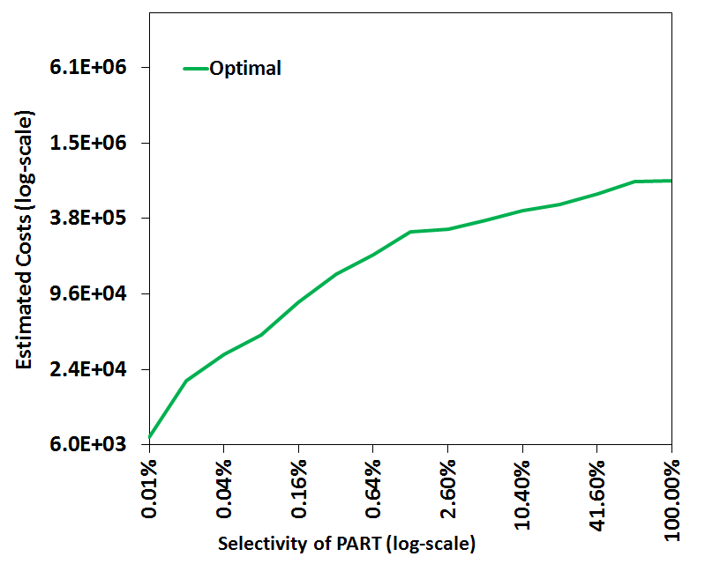
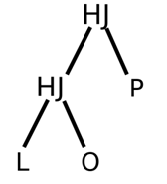
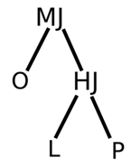
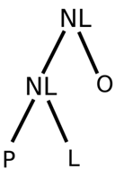
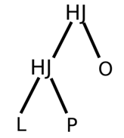
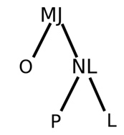
Parametric Optimal Set of Plans (POSP)
( Parametric version of Example Query)
select *
from lineitem, orders, part
where p_partkey = l_partkey and
l_orderkey = o_orderkey and
SEL (PART) = $1
log-scale
P5
P4
P3
P2
Using Selectivity Injection
P1
NL: Nested Loop Join
MJ: Merge Join
HJ: Hash Join
L: Lineitem
O: Orders
P: Part
log-scale
Notes:
JH: Keep single predicate
Bring plan also one by one : done

Slide 28
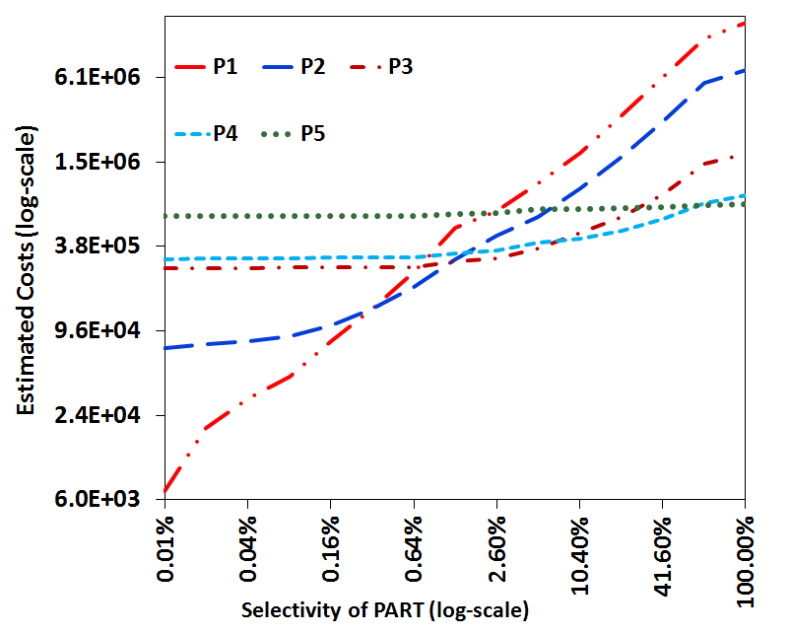
POSP Performance Profile (across SS)
P5
P4
P3
P2
P1

Slide 29
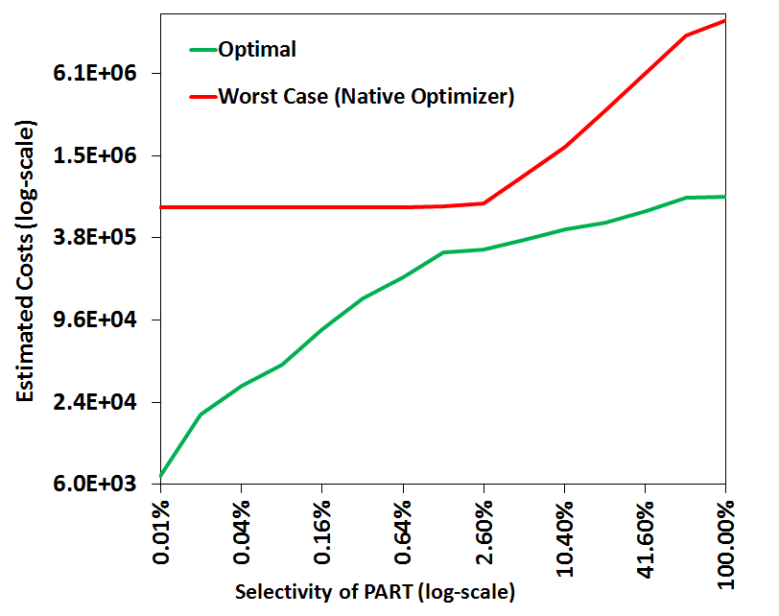
Sub-optimality Profile (across SS)
P1
SubOpt
(q_{e}= 1%, q_{a}= 99%)
= 20
P5
P5
SubOpt
(q_{e}= 80%, q_{a}= 0.01%)
= 100
P4
P3
P2
MaxSubOpt = 100
P1

Slide 30
Plan Bouquet Behavior on One-dimensional SS

Slide 31
Bouquet Identification
Step 1: Draw cost steps with cost-ratio r=2 (geometric progression).
Step 2: Find plans at intersection of optimal profile with cost steps
IC7
IC6
IC5
IC4
IC3
IC2
IC1
P5
P3
P2
P1
P1
P1
P1
Bouquet = {P1, P2, P3, P5}

Slide 32
Bouquet Execution
Let q_{a} = 5%
(1) Execute P1
with budget IC1(1.2E4)
Throw away results of P1
(2) Execute P1
with budget IC2(2.4E4)
Throw away results of P1
(3) Execute P1
with budget IC3(4.8E4)
Throw away results of P1
(4) Execute P1
with budget IC2(9.6E4)
Throw away results of P1
(5) Execute P2
with budget IC5(1.9E5)
Throw away results of P2
(6) Execute P3
with budget IC6(3.8E5)
P3 completes with cost 3.4E5
IC7
IC6
IC5
IC4
IC3
IC2
IC1
P5
P3
P2
P1
q_{a} = 5%

Slide 33
Stupid Ideas ?
Yes! Extremely stupid!
We are expending lots and lots of wasted effort at both 1) planning time (producing POSP cost profile) and
2) execution time (repeatedly throwing away work) !
Certainly a recipe for disaster …
But, actually works surprisingly well → rest of talk

Slide 34
Bouquet Execution
Let q_{a} = 5%
(1) Execute P1
with budget IC1(1.2E4)
(2) Throw away results of P1
Execute P1
with budget IC2(2.4E4)
(3) Throw away results of P1
Execute P1
with budget IC3(4.8E4)
(4) Throw away results of P1
Execute P1
with budget IC2(9.6E4)
(5) Throw away results of P1
Execute P2
with budget IC5(1.9E5)
(6) Throw away results of P2
Execute P3
with budget IC6(3.8E5)
P3 completes with cost 3.4E5
Bouquet Cost = 3.4 E5 (P3) +
1.92 E5 (P2) +
0.96 E5 (P1) +
0.48 E5 (P1) +
0.24 E5 (P1) +
0.12 E5 (P1)
= 7.1 E5
SubOpt (*, 5%) = 7.1/3.4 = 2.1
With obvious optimization
SubOpt(*, 5%) = 6.3/3.4 = 1.8
IC7
IC6
IC5
IC4
IC3
IC2
IC1
P5
P3
P2
P1
q_{a} = 5%

Slide 35
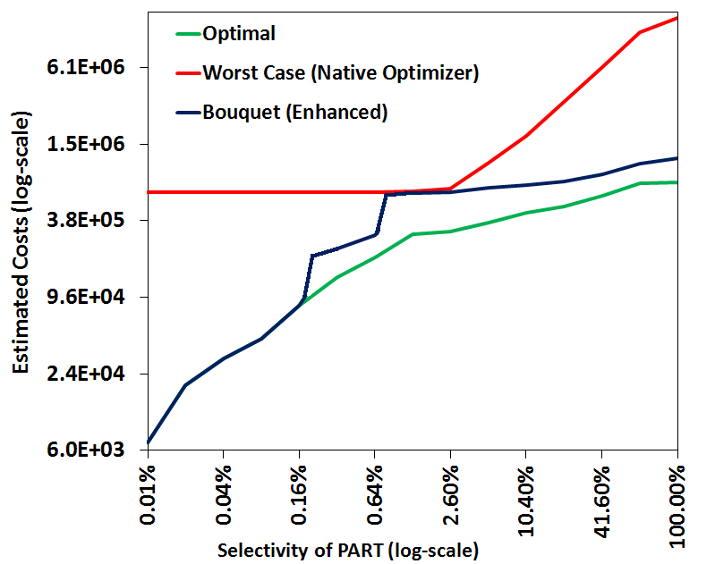
Bouquet Performance (EQ)
Native Optimizer
MaxSubOpt = 100
Bouquet
MaxSubOpt = 3.1

Slide 36
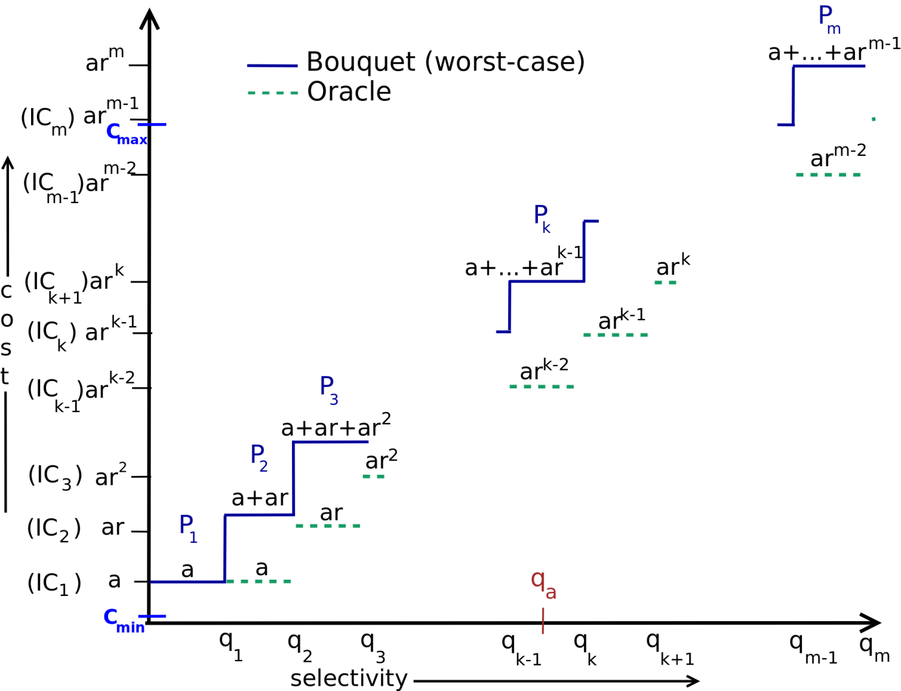
Worst Case Cost Analysis
Bouquet (upper bound)
Optimal (lower bound)
P_{k} would complete within its budget when q_{a} ϵ (q_{k-1}, q_{k}]

Slide 37
1D Performance Bound
$$C_{bouquet}\left(q_{k−1}, q_{k}\right]=cost\left(IC_{1}\right)+cost\left(IC_{2}\right)+ …+cost\left(IC_{k−1}\right)+cost(IC_{k})$$
$$= a + ar + …+ ar^{k−2 } + ar^{k−1}$$
$$= \frac{ a(r^{k} −1)}{(r−1)}$$
$$C_{optimal}\left(q_{k−1}, q_{k}\right] ≥ar^{k−2}$$
(Implication of PCM)
Reaches minima at r = 2
➔ MSO = 4
Best performance achievable by any deterministic online algorithm!
Notes:
JH: Formatting is poor : done

Slide 38
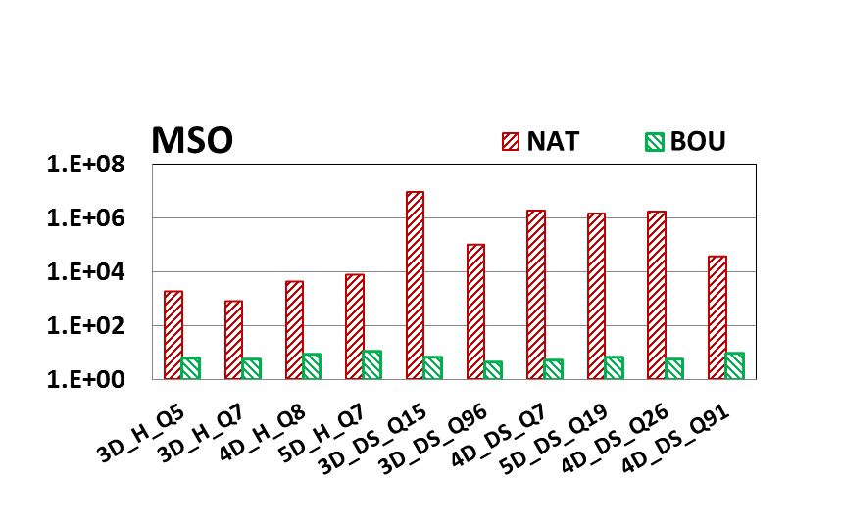
Performance on PostgreSQL
Native Optimizer
Plan
Bouquet
Log-scale
MSO
bounds
Notes:
Showing Enhanced bouquet

Slide 39
Summary
Plan bouquet approach achieves
bounded performance sub-optimality
using a (cost-limited) plan execution sequence guided by isocost contours defined over the optimal performance curve
robust to changes in data distribution
only q_{a} changes – bouquet remains same
easy to deploy
bouquet layer on top of the database engine
repeatability in execution strategy (important for industry)
q_{e} is always zero, depends only on q_{a}
independent of metadata contents
Notes:
Say that for us – q_e is always 0 and hence we have repeatability

Slide 40
For more details, visit project website:
dsl.serc.iisc.ernet.in/projects/QUEST
Concepts paper: ACM SIGMOD 2014
Demo paper: VLDB 2014 (Best Demo Award)
Concepts + Implementation: ACM TODS (June 2016)

Slide 41
Take Away
Plan 1
Near
Plan 2
Optimal
Query
Execution
Performance
Plan 5
Plan 3
SQL
Query
Plan 4
Do you know the correct selectivities ?

Slide 42
Connection to Online Bidding Problem
There is an object D with hidden value V in range (1, 100)
Your task is to bid for D until you acquire it under the following rules:
If the bid B < V, then you forfeit B, and bid again
If the bid B ≥ V, then you pay B and acquire D
Your goal is to minimize the worst-case ratio of your total payment to the object value, i.e. min ((B₁ + B₂ + … + B_{k}) / V)
Bid doubling algorithm is best possible choice
Notes:
JH: Formatting is poor : done

Slide 43
Bouquet Approach in 2D SS

Slide 44
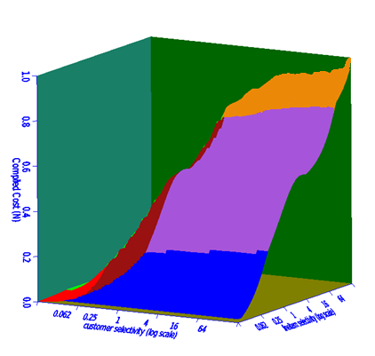
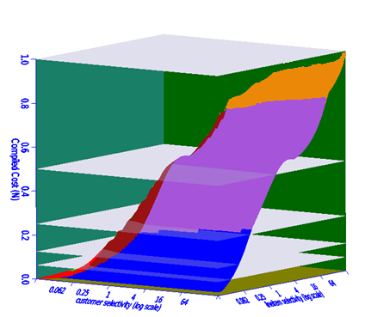
2D Bouquet Identification
Cost
(normalized)
Isocost Contours
Plans
Isocost Planes
Cost
Plans
Multiple Plans per contour
sel-X
sel-Y
Notes:
Fix PCM violation in these pics using paint : done

Slide 45
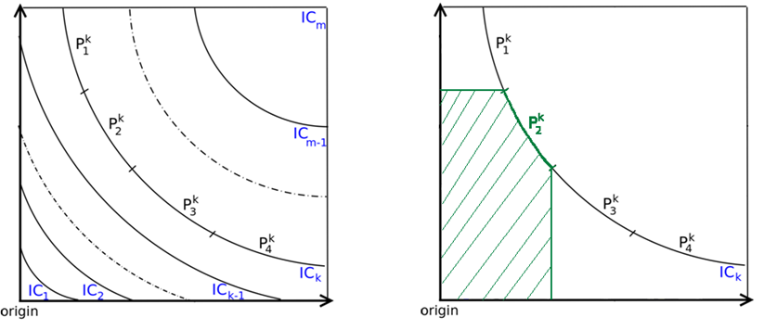
Characteristics of 2D Contours
s
e
l
-
Y
s
e
l
-
Y
sel - X
sel - X
2D contours
Hyperbolic curves
Multiple plans per contour
Third quadrant coverage (due to PCM)
P₂^{k} can complete any query with actual selectivities(q_{a}) in the shaded region within cost(IC_{k})
Notes:
Mention Cmax and Cmin
Make the bottom thing a callout : done

Slide 46
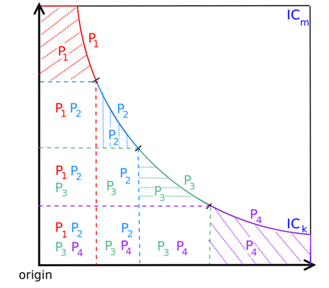
Crossing 2D Contours
Covered by only one plan in contour
Covered by all plans in contour
s
e
l
-
Y
sel - X
⇒ Entire set of contour plans must be executed to fully cover all locations under IC_{k}
Notes:
Highlight the region being covered : done

Slide 47
2D Performance Analysis
When q_{a} ϵ (IC_{k-1}, IC_{k}]
Number of plans on i^{th} contour
$$C_{bouquet}\left(q_{a}\right)= \sum_{i=1}^{k}{[n_{i} ×cost\left(IC_{i}\right)]}$$
ρ = max(n_{i})
$$C_{bouquet}\left(q_{a}\right) ≤ ρ ×\sum_{i=1}^{k}{cost\left(IC_{i}\right)}$$
$${SubOpt}_{bouquet}\left(q_{a}\right)=4ρ$$
(Using 1D Analysis)
Bound for N-dimensions:
$${SubOpt}_{bouquet}\left(q_{a}\right)=4 × ρ_{ _{ICsurface} }$$
Notes:
JH: Need to make colors consistent across slides! Keep font to be Arial throughout. : see
JH: Give nD analysis at bottom

Slide 48
MSO guarantees (compile time)
Query (dim) | MSO Bound
Q5 (3D) | 14.4
Q7 (3D) | 14.4
Q8 (4D) | 33.6
Q7 (5D) | 43.2
Q15 (3D) | 14.4
Q96 (3D) | 14.4
Q7 (4D) | 19.2
Q19 (5D) | 38.4
Q26 (4D) | 24.0
Q91 (4D) | 43.2
TPC-H
TPC-DS
Notes:
Costgreedy with FPC was used

Slide 49
Empirical Evaluation

Slide 50
Experimental Testbed
Database Systems: PostgreSQL and COM (commercial engine)
Databases: TPC-H and TPC-DS (standard benchmarks)
Physical Schema: Indexes on all attributes present in query predicates
Workload: 10 complex queries from TPC-H and TPC-DS
with SS having upto 5 error dimensions
Metrics: Computed MSO using Abstract Plan Costing over SS

Slide 51
Additional Results
Contour Identification Algorithms
Don’t require full cost diagram, only contours
NEXUS algorithm (constant factor of optimal for contours)
Randomized Algorithms
Intra-contour plan sequence permutation
Contour placement (shift the GP left by a random factor)
MESO ≈ 2 $ρ$ + 1
Invasive changes in DB engine [Srinivas Karthik]
Contours crossed with at most 2 executions per contour
MSO = D² + 3 D (where D is dimensionality of ESS)
Notes:
Say that for us – q_e is always 0 and hence we have repeatability

Slide 52
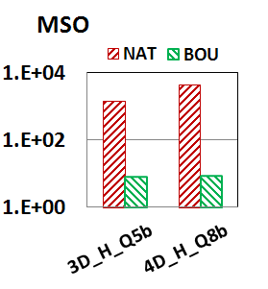
Performance with Commercial System

